Slide 1
How We Can Help

Slide 2
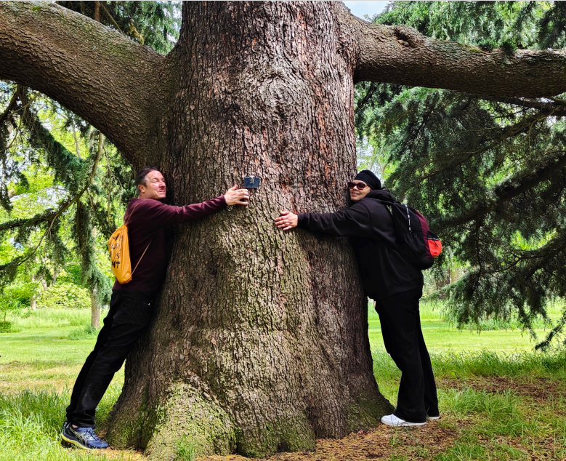
Mind in Croydon
Mind in Croydon is a local mental health charity that has been supporting people in Croydon since 1967. As part of the national Mind network, we work to promote good mental health, prevent mental distress, and empower people living with mental health problems to lead fulfilling, independent lives. The charity offers a wide range of services including advice, advocacy, social support, counselling, and community projects that reduce isolation and improve wellbeing.

Slide 3





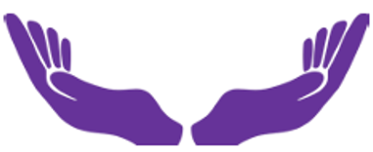





Advocacy Service
Carers
Support
Social Networking
Mind in Croydon
Services
Carers Counselling
Mental Health Personal Independence Co-ordinator Service
Lived Experience Advisory Panel (LEAP)

Slide 4
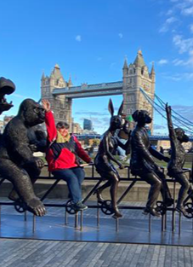
Active Minds
Active Minds promotes physical and mental wellbeing by supporting people with experience of a mental health problem to make healthy lifestyle changes to benefit both physical and mental health. We break down the barriers faced when taking part in sport and activities in the local community.
Active Minds run a variety of friendly accessible sports and healthy lifestyle groups across Croydon from gardening to yoga and cycling. These are a mix of in-person and online.
All of our groups are FREE to attend, you don’t have to pre-book once you’re registered and there’s no pressure to attend every week. There’s also no pressure to take part in the activity if you come along.
For more information or to book into a group contact us via phone or email.
Referral Route
To attend the activities, you can refer yourself or have a referral from any professional providing support for your health and well-being.
Contact Number Contact Email
020 8253 8205 activeminds@mindincroydon.org.uk

Slide 5

Advocacy – Independent Mental
Health Advocacy
IMHA Advocates are specially trained to work within the framework of the Mental Health Act.
The Mind in Croydon Advocacy Service provides an IMHA service to qualifying patients residing in and funded
by Croydon. This includes Croydon admission wards at Bethlem Royal Hospital.
Anyone who is being treated in hospital or in the community under a section of the Mental Health Act (and
some other people) have a right to an IMHA Advocate.
An IMHA Advocate can continue to work with clients even if they are no longer on a section and are an informal
patient.
Referral Route
Anyone can make a referral such as: You, family, friends, health staff, voluntary organisations.
As the Advocates work as instructed by the individual, consent from that individual is required when making
a referral on their behalf.
Contact Number Contact Email
020 8763 6730 advocacy@mindincroydon.org.uk

Slide 6
Carers Support
This service for those who are living in Croydon, 24 years or above and look after someone with a mental
health problem or experiencing a problem themselves.
The Carers’ Support Service can provide them with:
Information on services available
Support to access help you need
An advocacy service
Emotional support
Access to events and workshops
An opportunity to meet other carers
Opportunities to get involved in the planning and development of services for carers.
They also hold monthly meetings for mental health carers only to chat and support each other.
Referral Route
Anyone can make a referral. Please note that the meeting is for the mental health carer only.
Contact Number Contact Email
020 8688 1210 carers.support@mindincroydon.org.uk

Slide 7

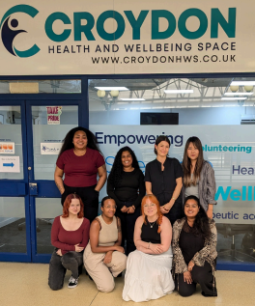
Croydon Health &
Wellbeing Space
In partnership with the NHS, Croydon BME Forum and Mind in Croydon, we’re here to provide mental health support to the Croydon community, in-person and online. We provide a Space for people to receive Advice, Guidance, and Signposting alongside Clinical Support from our Clinical Psychology team under one roof.
We take a non-judgmental, person-centered approach to improving your mental wellbeing and any other areas of your life that might affect your mental health.
Referral Route
Please walk-in (10am to 1pm Mon –Sat) or contact us on one of the routes below to book an appointment .
Contact Number Contact Email
020 3154 9539 info@croydonhws.co.uk

Slide 8
MHPIC’s - Mental Health Personal Independence Co-ordinator Service
The MHPIC Service offers one to one support for people with a serious mental health illness. The aim of the service is to focus on what matters most to clients and to see how best we can support both them and their family. We endeavour to support them to stay well – both mentally and physically – and help them to live their best independent life.
A Mental Health Personal Independence Co-ordinator can offer one to one support and help clients to:
co-ordinate daily tasks and manage their Personal Recovery Plan
identify and set goals and work towards achieving them
overcome any barriers that may arise in achieving their identified goals
create and build social and community networks
Referral Route
If you would like to access the MHPIC service, speak to your GP who can refer you. Self-referrals are not accepted.
Contact Email
mhpics@mindincroydon.org.uk or ch-tr.mhpics@nhs.net

Slide 9

Peer Support In-Reach
What is peer support?
Peer support is when people use their own lived experiences to help each other.
A Peer Support Worker is someone who has had their own lived mental health experiences and have been
able to form a sense of recovery and are now able to support others and bring on shared understanding, respect
and mutual empowerment. Peer Workers are role models for recovery who inspire hope that recovery is possible.
The Peer will support clients while they are on the ward to develop a wellbeing plan, coping mechanisms, engage in meaningful activities, support them to access community-based resources to further aid their recovery when they transition back into the community.
The Peer Support Worker will then support the client in the process of being discharged from the unit into the community, they will support them for several more weeks to access community activities, practical support with managing bills, shopping, work or study, emotional support, make links with their community team, GP.
Referral Route
Gemma is based on the unit, so clients are welcome to approach her directly to find out more and engage with her for support.

Slide 10
Recovery Space
The Recovery Space offers a safe, non-clinical, supportive environment for people experiencing a social mental health crisis from 11am – 4pm from the Croydon Health and Wellbeing Space and from 5pm – 11pm at a central location in East Croydon, 7 days a week. We offer short term, recovery focused support for up to 10 persons / evening as an alternative to using other crisis services.
Crisis Support Workers can work alongside you to help you:
Manage your crisis
Identify your crisis triggers
Identify your strengths & coping methods
Develop effective ways of coping
Explore self-help tools and apps
Improve your self-confidence, esteem & independence
Develop your own personalized wellbeing tool kit
Referral Route
This service is accessible by professional referral only.
Contact Number Contact Email
020 8688 1210 mindmatch@mindincroydon.org.uk

Slide 11

The Hub/Social Networking
Studies show that feeling isolated and unable to make connections with others has a negative impact
on mental health.
If clients are experiencing a mental health problem, this can affect their social life in many ways. Our Social
Networking service, The Hub, accepts that people may need help and support to be part of their community and
connect with others.
The Hub also provides a safe place for people who maybe lonely or isolated to meet and socialise with people and a place for them to receive practical help and advice. Activities include signing, crafts, exercise and practical volunteering opportunities.
Referral Route
This service is accessed by professional referral only such as GP’s, Community Mental Health Teams etc.
Contact Number Contact Email
020 8688 1210 hub@mindincroydon.org.uk

Slide 12
Counselling Services
Carers Groups
The counselling team provide free Carers Groups to carers that are 24 and over and live, work or study in the
Borough of Croydon or if the person they care for lives, works of studies in the borough.
They cover useful topics such as:
Referral Route
Please provide your name, address, phone number and email address and we will email/post the registration form for you to complete and return to us.
Contact Number Contact Email
020 8763 2064 counselling@mindincroydon.org.uk
Managing Challenging Behaviour
Life After Caring
Taking a Break - Respite Care
Depression
Mindfulness
Understanding the Stress of Caring
Managing Thoughts and Keeping Positive
Anxiety
Understanding Mental Health Problem

Slide 13

Cousnelling Services
One-to-One
Counselling can provide an opportunity to talk to someone who is trained to listen. It can help you make sense of the
feelings experienced and enable you to see the difficulty in a more manageable way.
We provide an accredited professional service in a confidential and safe setting. We are committed to delivering services designed to meet the needs of local people and in particular
excluded groups.
Referral Route
Please provide your name, address, phone number and email address and we will email/post the
registration form for you to complete and return to us.
Contact Number Contact Email
020 8763 2064 counselling@mindincroydon.org.uk

Slide 14

Welfare Benefits
It is a specialist service focusing on cases which need to be taken to Tribunals on appeal and others which raise difficult legal issues or which require detailed understanding of the administrative procedures of the Department of Work and Pensions and other public bodies.
To access support around Welfare Benefits please contact the Croydon Health and Wellbeing Space. The Croydon Health and Wellbeing Space is the collaborative product of the Croydon BME Forum, South West London CCG and Mind in Croydon.

Slide 15
Volunteering with MiC
Through volunteering with Mind in Croydon people can give back to the local
community, gain experience, make friends, learn new skills, and so much more.
We have a range of volunteering roles at Mind in Croydon.
If anyone is interested in volunteering for us we ask them to please visit our website - www.mindincroydon.org.uk and go to Get Involved - Volunteer for all the opportunities currently available.
Alternatively please contact the services directly to see if they need any help.
The contact details for each service can be found on the Contact Us page on our website.

Slide 16
More information on our services can be found at: www.mindincroydon.org.uk

