Slide 1

Mental Health Support for Adults in Croydon
(One Croydon Training Programme)
Presented by: Cllr Dr Manju Shahul-Hameed
Organisation:
24/09/2025

Slide 2
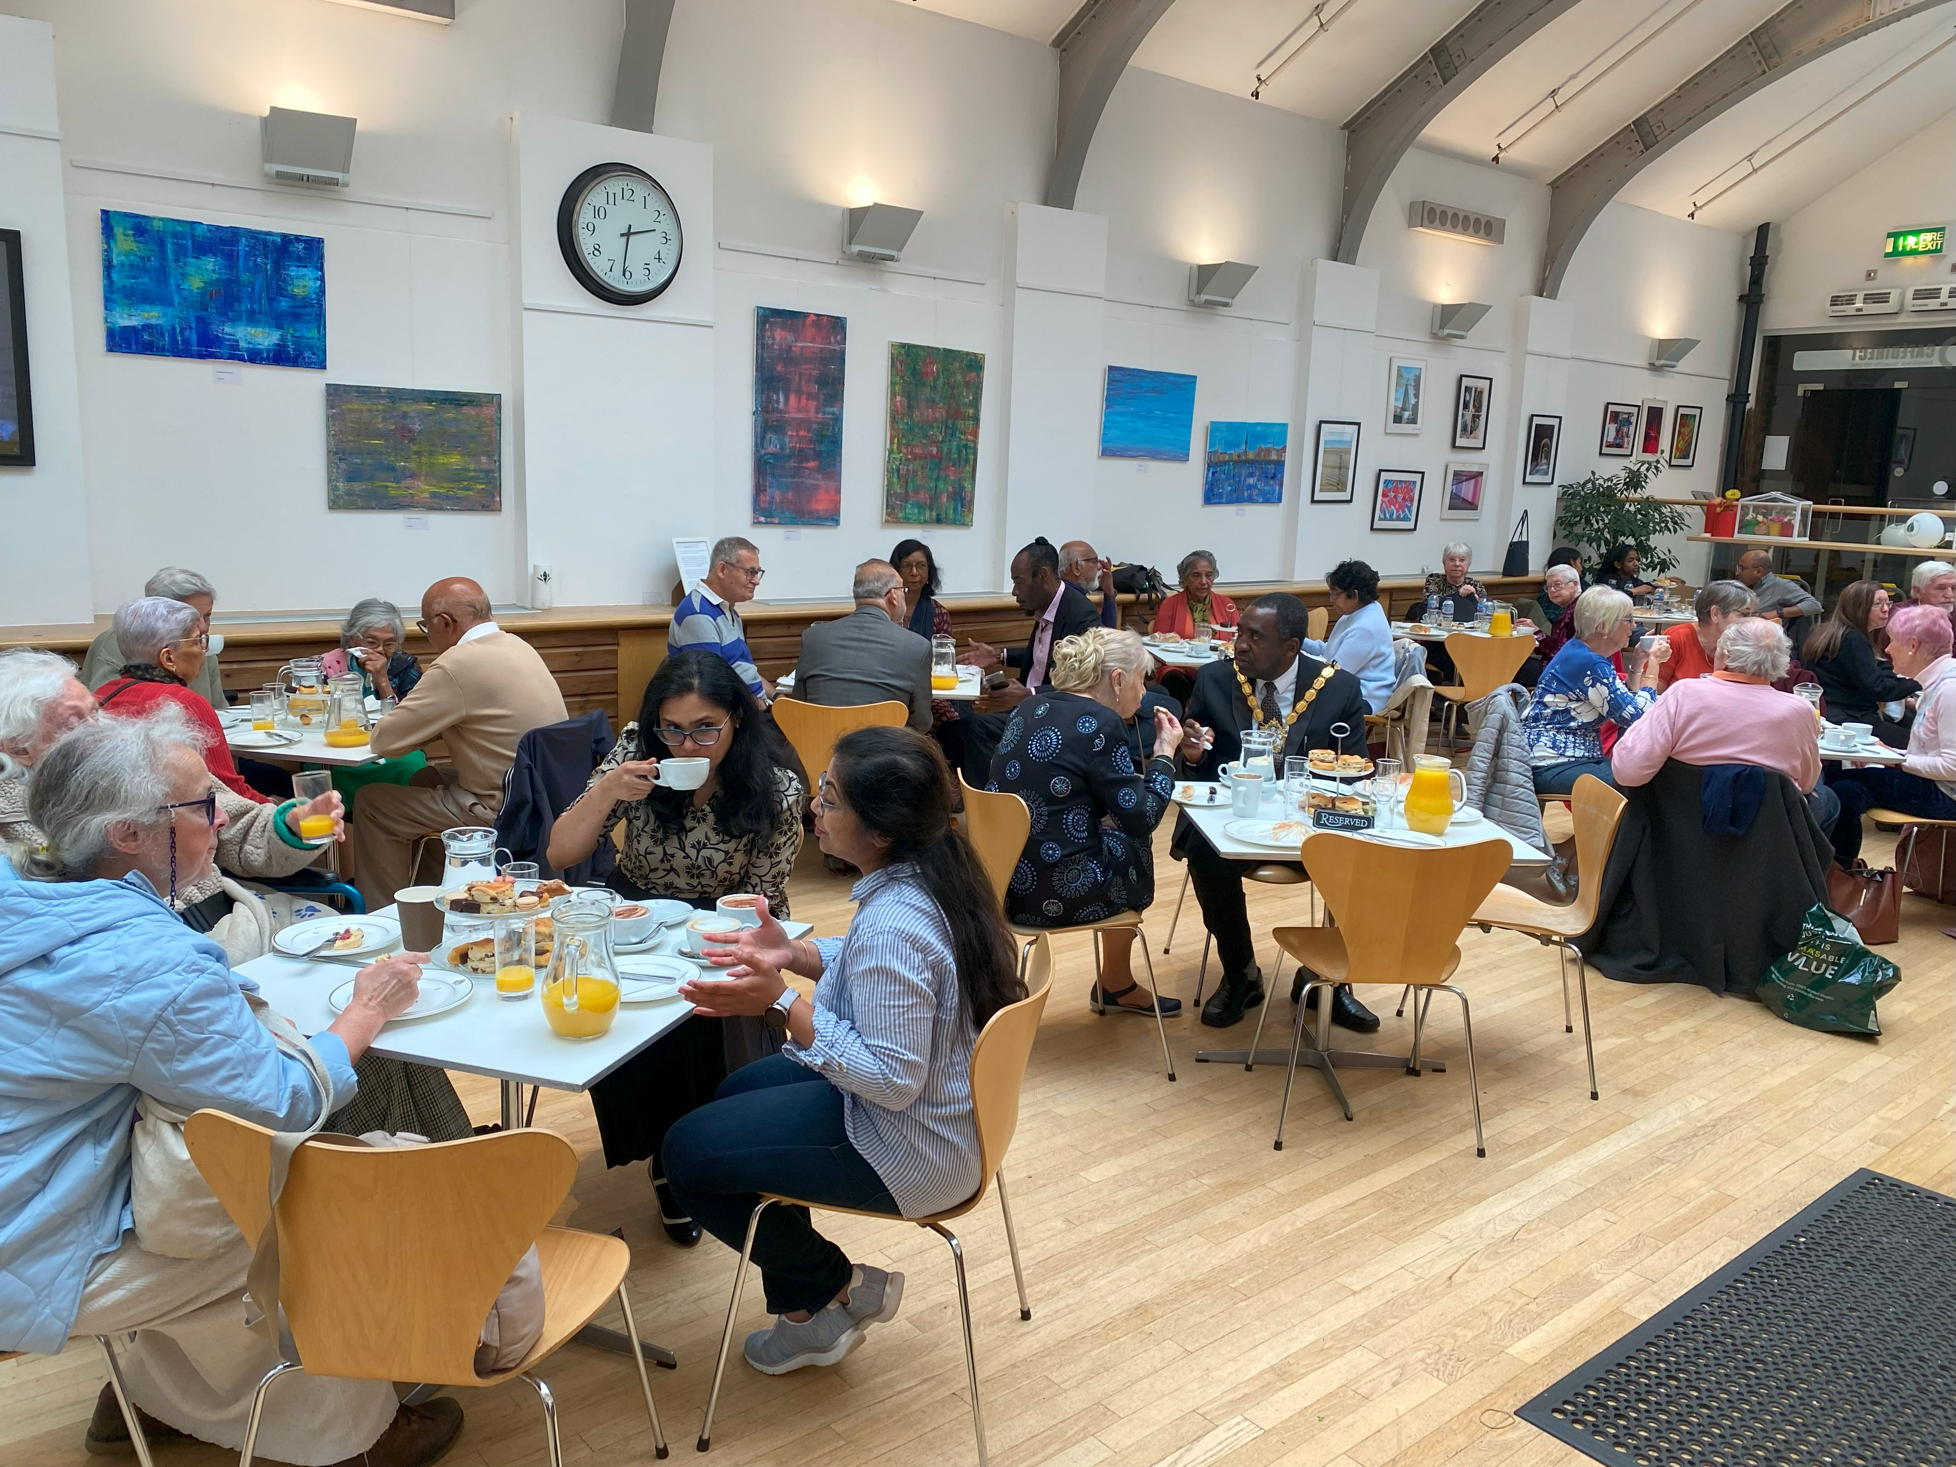
About the Charity
Who We Are
Founded 8 years ago in Croydon
Mission: Challenging stigma and
promoting inclusive mental health support
Focus: Marginalised and underrepresented
communities.
Website: www.msfoundations.co.uk

Slide 3
Introducing the Dementia Café Programme
Our Intergenerational Dementia Cafés - Started in 2022
Now operating in 4 areas of Croydon
Designed to support people living with dementia and their carers
Emphasis on community, connection, and intergenerational learning

Slide 4
Dementia Cafes
Dementia Café 1 – Age UK Croydon & Local College
Dementia Café 2 – Croydon Council
Dementia Café 3 – Croydon University Hospital
Dementia Café 4 – Coulsdon Temple

Slide 5
Living Well with Psychosis
Counselling
Four Dementia Cafes
Coffee with Counsellor

Slide 6
Coffee with Counsellor / Silver Sunday /Intergenerational Care
Coffee with Counsellor
Venue : West Croydon Methodist Church, 93 London Rd, Croydon CR0 2RF
2nd Wednesday of every month
Silver Sunday
Venue: Clocktower Café, 9 Katharine St, Croydon CR9 1ET
5th October 2025
Intergenerational Care
Venue: John Ruskin College, Selsdon Park Rd, South Croydon CR2 8JJ
14th October 2025

Slide 7
Thank You
Website: www.msfoundations.co.uk
Contact info: manju@msfoundations.co.uk, events@msfoundations.co.uk
Facebook, LinkedIn & You Tube: Manju Shahul-Hameed Foundation for Mental Health
Instagram: msfoundations.co.uk
X : MSHFoundations

