Slide 1


Croydon Family Hubs
January 2026

Slide 2

“
Family Hubs use a whole-family approach, providing a single access point to integrated family support services across health (physical and mental health) and social care, as well as VCS and education settings. A Family Hub makes these things come together.
”
https://www.gov.uk/government/collections/family-hubs-and-start-for-life-programme

Slide 3
Family Hubs & Best Start in Life programme
Family Hubs
Start for Life → Best Start in Life
Model of delivery including both buildings and development of the online offer, and Family Hub Navigators to signpost families to services
Multiple organisations in a ‘one stop shop’ for to 19 (up to 25 with SEND)
Transformation of the system – everyone who works with families in Croydon – to work together, be trained and deliver for families
Three-year programme started in 2023. Additional funding to extend the programme 2025 to 2026
        Expansion of the programme from 75 LAs 2023-2026 to national rollout from April 2026
First 1001 days is a critical period in a child’s life – focus on conception to 2 years old in the Start for Life Programme
↓
The new DfE focus for Best Start in Life (BSiL) is 75% of children achieving a Good Level of Development nationally by 2028. Through Parenting and Home Learning Environment programmes
Healthy Babies is the Department for Health & Social care programme for 0-2 which is Infant Feeding and Perinatal Mental Health and Parent Infant Relationships

Slide 4
Family Hubs
24 Services in one place
Activities for children aged 0-5
Health Visiting
Midwifery/ Maternity
SEND support and Services
Birth Registration
Housing
Nutrition and Weight management
Stop smoking support
Debt and Welfare advice
Infant Feeding Support
Oral health improvement
Substance (alcohol/drug) misuse support
Domestic abuse support
Intensive targeted family support services
Parent-infant relationships and perinatal mental health support
Support for separating and separated parents
Early language and the Home Learning Environment
Local authority 0-19 public health services
Parenting Support
Youth Justice services
Early Childhood Education and Care
Mental health services
Reducing Parental Conflict
Youth Services-universal and targeted

Slide 5
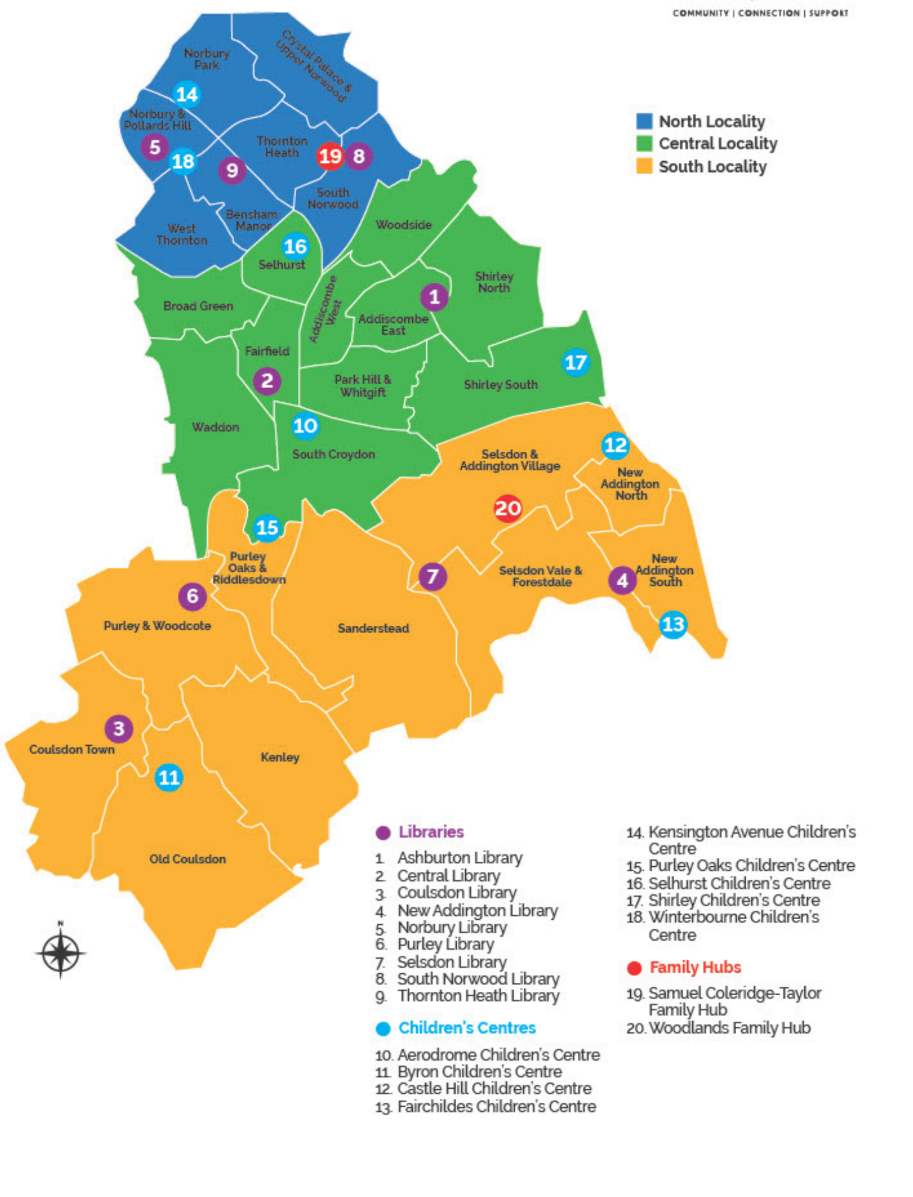
Where are Family Hubs?
We have two hubs open now:
Woodlands Family Hub – South locality
Samuel Coleridge Taylor Family Hub – North locality
Public consultation over the summer for expansion of the model into Children’s Centres. Final decision will be made at Cabinet based on resident’s responses to the consultation.

Slide 6
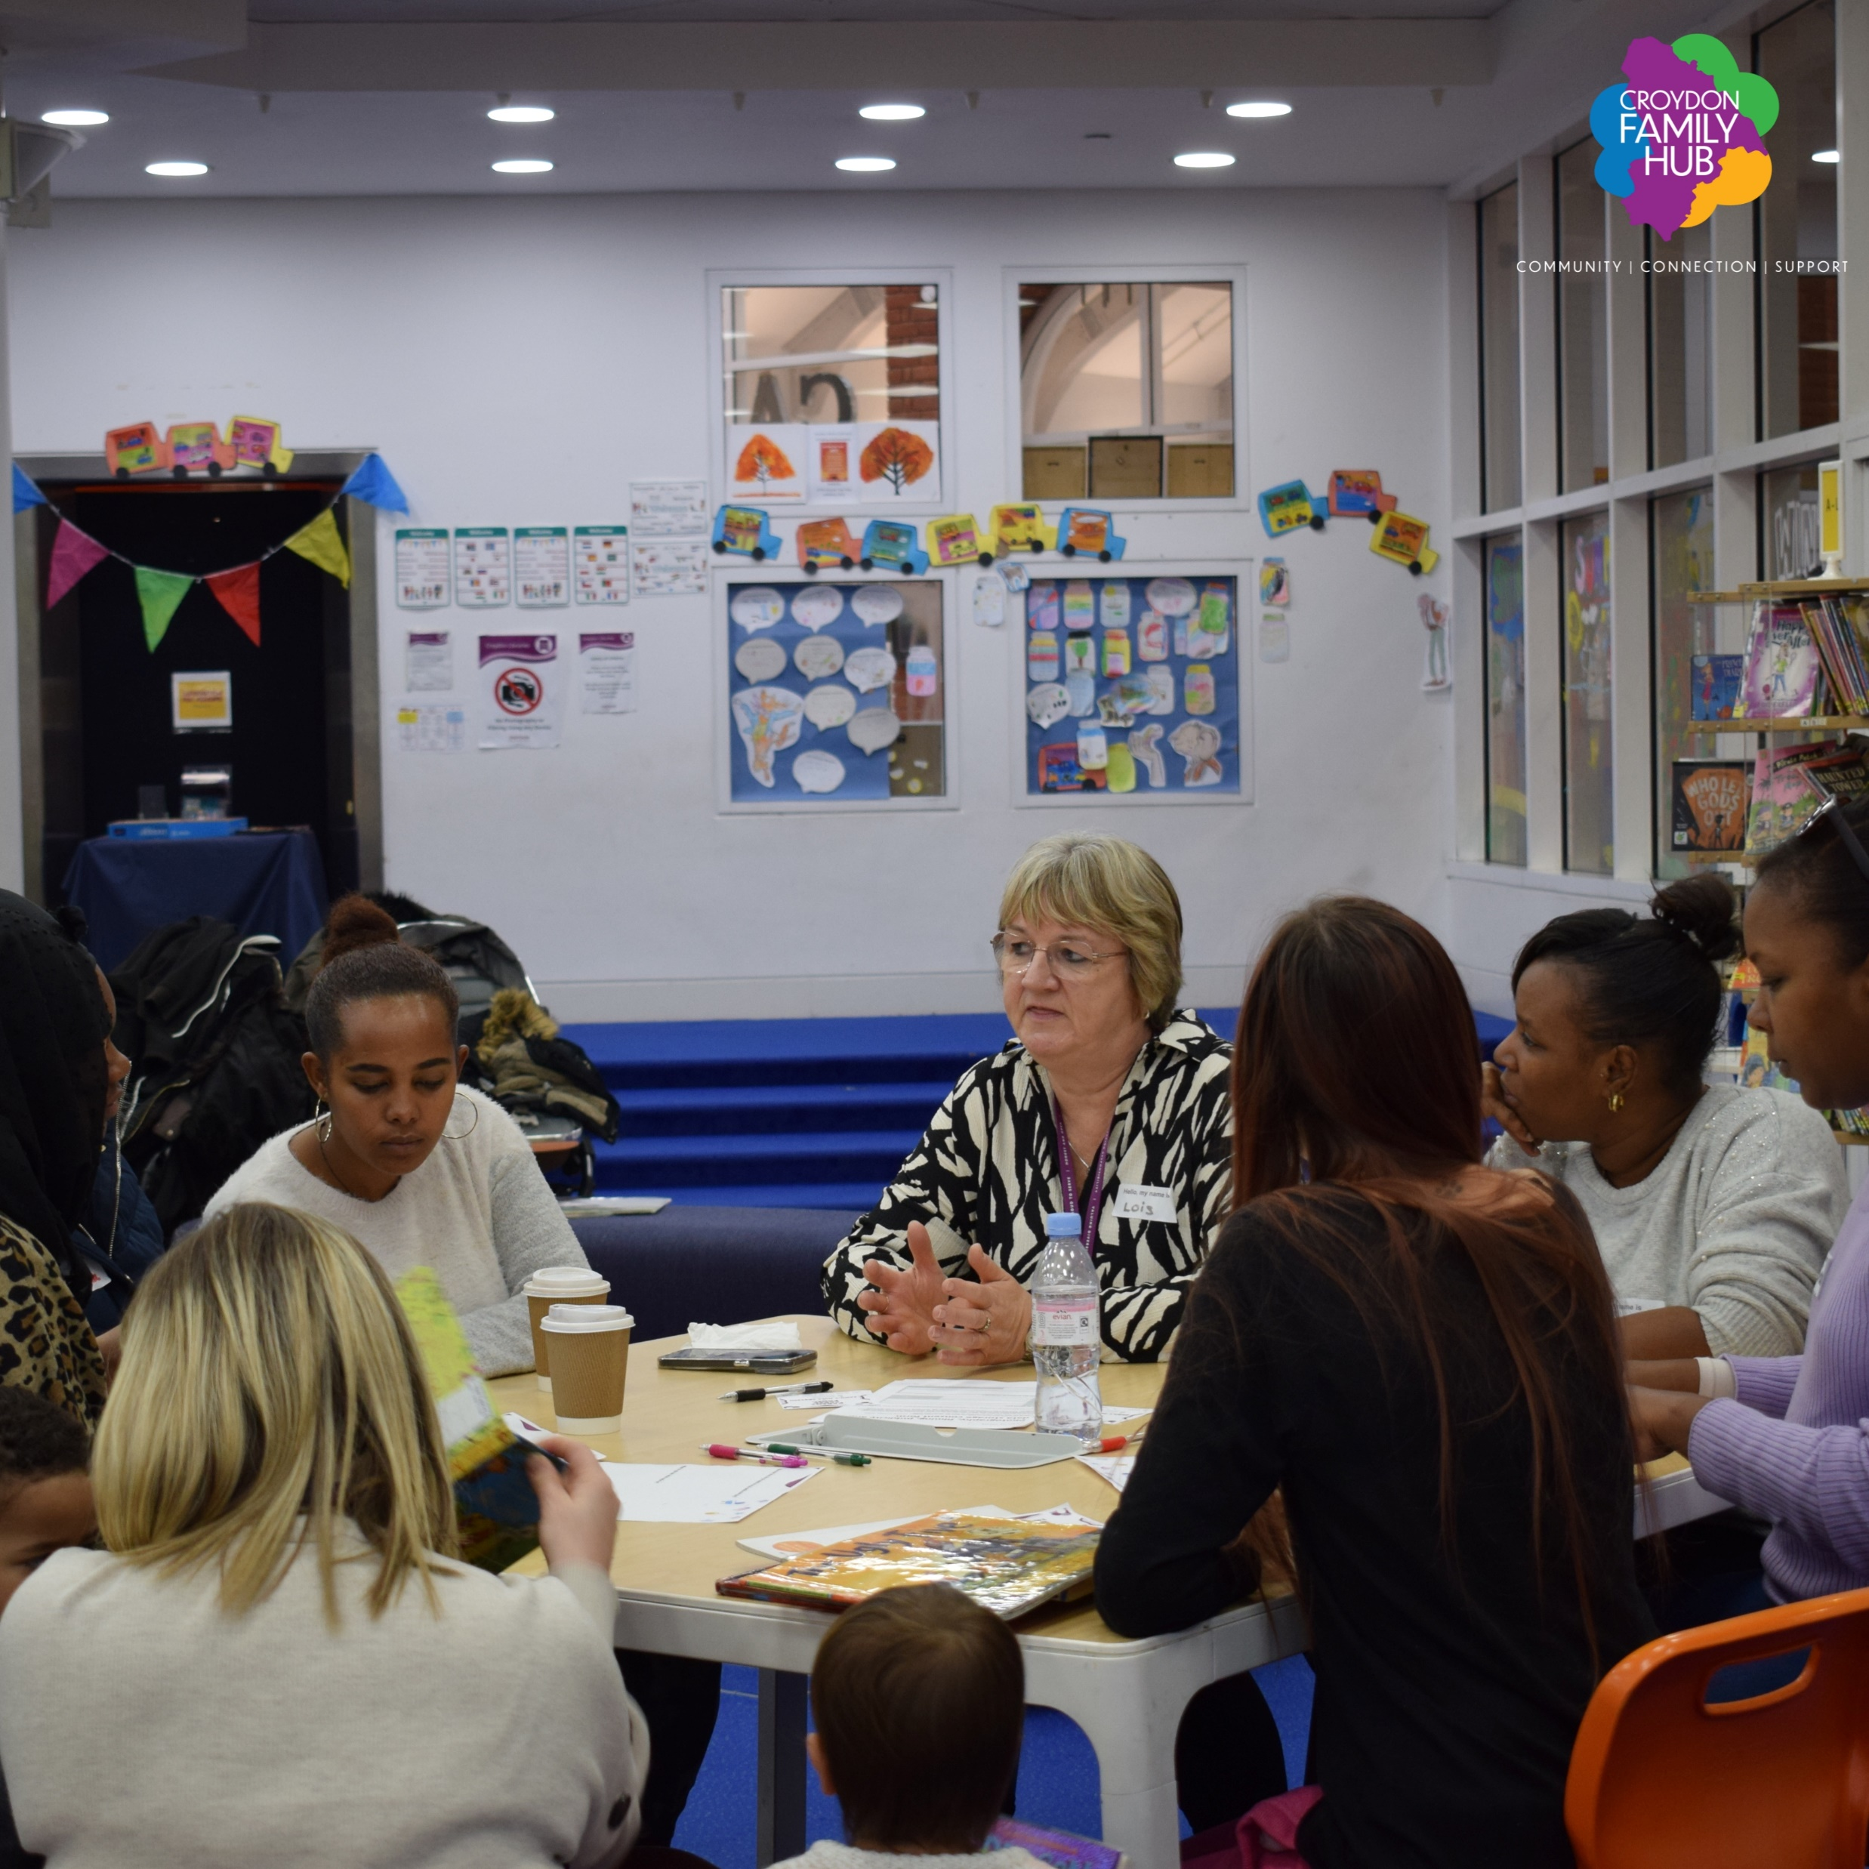
Parent Carer Panels - recruiting now !!
Parent Carer Panels are a DfE requirement for Family Hubs
They help to inform and shape services for children, especially around the Start for Life period (conception to 2 years)
Meetings are held every 8 weeks – a creche, incentives and refreshments provided. Guest speakers, discussions, support
Training is offered to the parents ie First aid, Public speaking
We currently have two Parent Carer Panels -
Central Croydon Parent Carer Panel
started in May 2023
Woodlands Parent Carer Panel
started July 2025

Slide 7
Family Hub Navigators
One to one Navigator appointments for families at Woodlands & Samuel Coleridge Taylor Family Hubs
Promote the Start for Life offer broadly across the borough for example to GP practices, nurseries and the community
Engage with partners and families at various venues i.e. Babyzone, children’s centre’s, toddler groups, nurseries, youth clubs/activities and schools etc. to promote Family Hubs.
Deliver Family activities at the Family Hub in the school holidays
Attend local community groups – networking with voluntary sector organisations
Building relationships and maintaining communications with users of the Family Hubs via newsletters, emails and telephone.
Please contact familyhubs@croydon.gov.uk

Slide 8
Training and Partnership events for Professionals
Family Hub training platform
Family Hubs offer practitioner training via the Croydon Safeguarding and Children’s Partnership's PHEW training platform:
Culturally Sensitive Training
Think Family and Perinatal Mental Health
Practical Skills for Supporting Parent and Infant Bonding
Family Hubs Leadership and workforce programmes
Whole family approach working with DA
Father Inclusive Practice with Fatherhood institute
Natural thinkers
Sign4life ADHD, ASD and dyslexia
Makaton
To access Family Hub Training
Event List : All Croydon Family Hubs
Partnership events:
Lunch and Learn Sessions every 6 weeks
Locality Delivery Groups for managers and service Leads every 2/3 months
Wider partnership events, 3 held and 2 more planned including Infant feeding and PIMH strategy launch and Fathers/male carers conference
To request to be added to the mailing lists to attend the partnership events email familyhubs@croydon.gov.uk
Also available:
Practitioners Guide to Family Hubs
Croydon Togetherness CPD -Croydon PRF | Togetherness - Togetherness

Slide 9
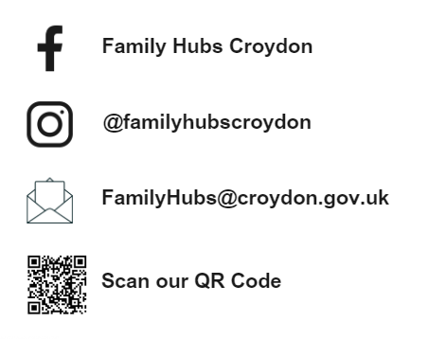
How to get in touch…
Families:
Families can walk into the Family Hub to access the offer
Family Hub timetables are available on our social media links
Early years activity timetables are available through the Family Hubs webpage and Croydon Best Start Facebook page
For professionals:
Email the team at the email address questions or feedback
Families can be signposted to the hub for universal support
Linktree- Familyhubscroydon | Instagram, Facebook | Linktree

