Slide 1
Centre of Change Counselling and Mentoring Service

Slide 2
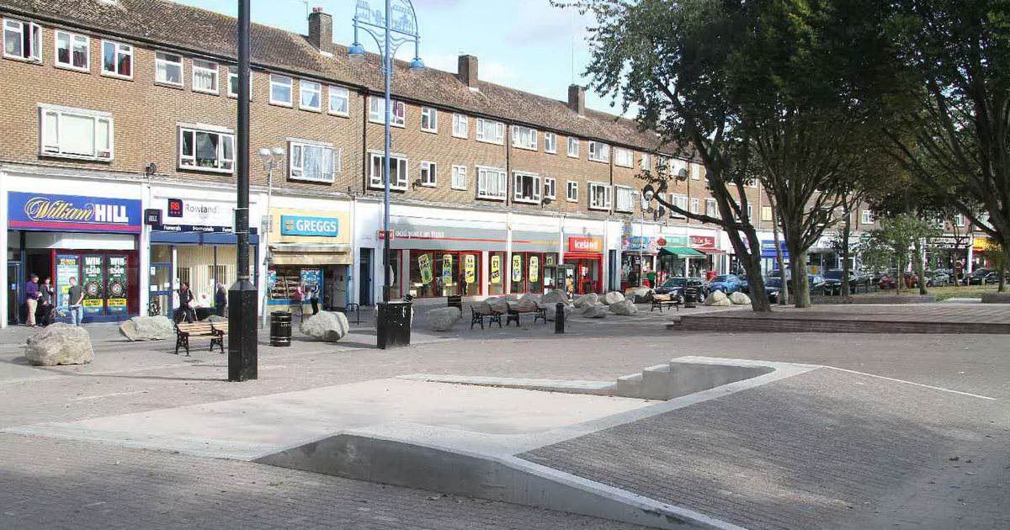
Centre of Change: some background
Established in 2008 by Sarah Kiffin (New Addington resident for over 50 years)
Gained Charity status in 2019
Placement Provider for trainee counsellors, working with:
Metanoia University
Roehampton University
Lambeth College
Sutton College

Slide 3
Who we are and What we do:
We are a community-based counselling and mentoring organisation. We provide affordable counselling and psychotherapy to people in the Croydon community, supporting children and young people between the ages of 10 and 18, adults and families with mental health challenges. We work in schools and in the community
A large proportion of our clients are from socio-economically challenged backgrounds, with many unemployed, on zero hour contracts or having no recourse to public funds.
Through one-to-one sessions, service users are empowered to learn and apply life changing concepts and techniques that allow them to lead more fulfilling, positive lives.
Our community mentors facilitate young people to understand themselves and their emotions better, make and maintain healthy relationships, and set goals for their futures. Sessions are varied and bespoke, tailored specifically to each young person, allowing them to see a raft of opportunities and supporting them in making independent, informed choices. We are also a placement provider for trainee counsellors and psychotherapists, so we are committed to training the next generation of mental health practitioners.

Slide 4
Why are we so different?
We are the ONLY Black, female led organisation in the entire Croydon borough.
We work medium to long term with our clients (minimum 12 week programmes) including open-ended
Our service is fully inclusive: age range / culture and ethnicity / religion / gender identity / (dis)ability

Slide 5
EMHIP Hub – based at Centre of Change
Monday 11 – 3 DROP-IN
Thursday 12.30 – 4pm (structured workshops)
Financial
Self-love / Self-care
Healthy Relationships

Slide 6
Our recent successes
300 unique clients per year
Successful placements for over 20 trainees over the past year
67% of our service users from BAME backgrounds
Became the EMHIP hub for New Addington (one of 6 in the borough)

Slide 7
What do we offer support for:
Bereavement
Depression
Anxiety
Trauma
Complex trauma
Childhood Abuse
Bi-polar
Psychosis
Eating disorder
Domestic Abuse

Slide 8
Questions

