Slide 1
Croydon’s Health Inclusion Directory of Services – November 2022
An inclusive and innovative approach to care.
Presented by: Lewis Irani
Primary Care Programme Development Manager
South West London Integrated Care System

Slide 2
LBC – Rough Sleepers Team
Outline of Service Function
The Team is responsible for co-ordination and delivery of a range of interventions with the aim of reducing rough sleeping in Croydon. The Rough Sleeping Co-ordinator takes the overall lead for rough sleeping across the Council.
Operational Hours
09:00-17:00 Mon-Fri
Service Benefits
LA lead for rough sleeping
The team manages the MHCLG (Ministry of Housing, Communities & Local Government) rough sleeping grant, commissions, mobilises and manages services.
The Team work within several partnerships, between the statutory, commissioned, voluntary and faith sector, within Croydon and pan-London.
Oversight and coordination of rough sleeping pathway – includes statutory, commissioned and voluntary/faith sector services
The Rough Sleeping Coordinator chairs the Task and Targeting Meeting, a multi-agency tasking forum, focussing on rough sleepers who are living on the streets or who have multiple periods of rough sleeping
Delivery of Severe Weather Emergency Accommodation and coordination of pandemic response for rough sleepers

Slide 3
LBC - Croydon Association for Young Single Homeless (CAYSH)
Outline of Service Function
Service for Young single homeless people aged 16-21, including those with low to medium support needs around independent living skills. Must have a Croydon connection (e.g. born, lived or been at school in the borough, family or relatives living there).
Operational Hours
09:00-17:00 Mon- Fri
Drop in Zone
Croydon Turnaround Centre
51/55 South End
London
Greater London
CR0 1BF
Service Benefits
Preventing clients from reaching point of homeless from application/ escalation.
Work with parents/ prison navigation team
Working with Hospital Discharge team re; return to accommodation/ emergency accommodation.
Work with supporting housing providers (tenancy sustainment/ complaints)
Staff visit projects a minimum of 2-3 times a week.
Care plan, support plan, and key working sessions at least monthly.
Staff act as advocates, provide informal counselling and help residents access specialist services.
Residents expected to participate in planned programme of activities and may move from shared housing to the more independent bedsits and flats.
Work with SLaM, Hospital Discharge Team, Police, Probation Team & Rough Sleepers Service

Slide 4
Croydon Association for Young Single Homeless (CAYSH)
Who we cannot help
Young people with dependents.
Those with a conviction for serious violence, sexual offences or arson.
Those with "an active criminal lifestyle".
Those with drug or alcohol dependencies.
Making a Referral
Applicants should check website to ensure Drop In Zone is open before calling in to arrange an appointment.
Length of stay
Minimum stay: 3-6 Months
Maximum stay: 2 Years

Slide 5
LBC
Croydon “Drop in Zones” @ the Turnaround Centre
Outline of Service Function:
A walk-in centre for advice and support in a safe and secure environment. With experienced professionals on hand to deal with immediate concerns, also able to identify where young people or their families require additional help or intervention and signpost them to those services.
Operational Hours
09:00-17:00 Mon, Tues, Thurs & Fri
13:00-17:00 Weds
Croydon Turnaround Centre
51/55 South End
London
Greater London
CR0 1BF
Service Benefits
Offer an integrated assessment service with referral into social services and hostel placement services if appropriate
Helping young people and their families who are in housing crisis
Helping young people who feel that they can no longer stay living at home
Helping families’ work through any conflicts or difficulties they are facing
Demographics & Geography
The Drop in Zone is for 14-21 year olds living in Croydon.
Care Leavers

Slide 6
LBC
Croydon “Drop in Zones” @ the Turnaround Centre
Making a Referral
Applicants should check website to ensure Drop In Zone is open before calling in to arrange an appointment. Application form. Initial housing advice interview. Further interview if criteria met. May require background information.
Length of stay
Minimum stay: 3-6 Months
Maximum stay: 2 Years
The Croydon Turnaround Centre is operated by Croydon Council in partnership with a range of expert agencies to provide support services for the benefit of the young people of Croydon.
Challenges:
Receiving a lot of parental exclusions who were not known to SS & lots of gang violence.
Lots of prevention work with client & families.
Advisors are doing a lot of mediation

Slide 7
LBC – Homeless Referrals
If you are referring a young person 16-21 please email
DIZADVISORS@croydon.gov.uk or phone 020 8760 5530 ext 64311
If you are making a new homelessness application on behalf of a client please resend your email to:
HSG-HousingNeeds&AssessmentsReferrals@croydon.gov.uk
Mental health professionals referring clients for supported housing:
Ben.Kearns@croydon.gov.uk
BWH social workers referring clients for supported housing:
Holly.Phillips@croydon.gov.uk & SHS@croydon.gov.uk
Probation / CRC officers/ prison resettlement teams referring clients for supported housing: Leonie.Thomas@croydon.gov.uk
Professionals referring 16-21 year olds for supported housing
Sharon.Butt@croydon.gov.uk & DIZadvisors@croydon.gov.uk
If you are reporting a rough sleeper please resend to commissioned outreach service Croydon Reach CRduty@thamesreach.org.uk

Slide 8
CHS - Integrated Discharge Team
Outline of service function:
An Integrated Discharge Team focussing on complex discharges and a length of stay of over 14 days; of which there is a Housing & Homeless Link Liaison role.
Operational hours:
Mon – Fri 09:00-17:00
Service benefits:
Signposts to other services
Visit people in ED (Emergency Department)
Patients are brough back from temporary accommodation to see Homeless Link Liaison Officer.

Slide 9
Rainbow Health Service
Outline of service function:
A Primary Care and Outreach Community Based Service for Homeless people and Asylum Seekers in Croydon. The team offers a specialised holistic service tailored to meet the specific health needs of this group. The aim of this service is to tackle the gaping hole of health inequalities of this cohort in Croydon.
Operational Hours:
Mon – Fri: 09:00 – 17:00
Closed at weekends.
Reception 020 8274 6070
Service Benefits ​
Provide specialised holistic service tailored to meet the specific needs of Asylum Seekers, Homeless individuals, children and families.​
Provide seamless and supported process of individual’s registering for Primary Care Services.​
Enable positive experiences for people experiencing homelessness when accessing Primary Care Services.​
To ensure all patients have access to locally commissioned interpretation services - language line.​
Collaboratively working across local agencies, that support the population, to provide the right services, at the right time, in the right place.​
Signpost patients to additional support services and facilitate them in doing so e.g. Prescription exemption applications.​
Work with Initial Accommodation services staff to facilitate consultations, notify them of booked health appointments that will require transport and provide a contact for urgent health needs.​
Provide information/advice on the NHS system, care pathways and self-care.​
Brigstock Primary Care Centre​
141 Brigstock Road​
Thornton Heath​
London​
Greater London​
CR7 7JN

Slide 10
Evolve Supported Housing
Outline of Service Function
A charity that provides shelter and support to homeless young people, young parents and adults in the London Boroughs of Croydon, Bromley, Lambeth, Merton and the Royal Borough of Kensington and Chelsea. The aim is to help children, young people and adults who are homeless or at risk of homelessness to become independent and resilient. Adopt a strengths based, aspiration and goals approach to break the cycle of homelessness..
Service Benefits
A programme of support tailored to meet people’s individual needs, including housing, employment and skills training, mentoring and counselling.
Woking with young parents and children at risk of exclusion to build the skills and resilience that can help prevent homelessness.
Building affordable homes to help people move on to an independent life.
Campaigning to end Homelessness
Contact
Head Office
16-20 Kingston Road
South Wimbledon
SW19 1JZ
enquiries@evolvehousing.org.uk
020 7101 9960

Slide 11
Homeless Young People​ | Location​ | Capacity (single people) ​
Beacon House​ | Kensington​ | 16​
Burton-White House​ | Earls Court​ | 24​
Fitze Millennium Centre​ | Upper Norwood ​ | 80​
Hillyard Street​ | Lambeth​ | 7​
Ingram Court​ | Croydon​ | 44​
King George’s House​ | Lambeth​ | 87​
Merton ​ | Multiple Sites​ | 70​
Merton Care Leavers Service​ | Merton​ | 15​
Homeless Adults ​ | ​ | ​
Alexandra House​ | Croydon​ | 80​
Palmer House​ | Croydon​ | 60​
Somewhere Safe to Stay Hub​ | Croydon​ | 28 Day Emergency Accommodation​
People with mental ill-health​ | ​ | ​
Mental Health Step Down Service​ (Eva, Emily & Crocus House)​ | Croydon​ | 27​
Homeless Families ​ | ​ | ​
Homeless Teenage Parents’ Service​ | Stockwell​ | 7 teenage parents/families ​
Keystone House​ | Croydon​ | Temporary Emergency Accommodation​
Merton Young Parents’ Service ​ | Merton​ | Women aged 16-21 who are pregnant or have a child under the age of 2​
Evolve Supported Housing Sites

Slide 12
Evolve – Health & Wellbeing
Outline of Service Function:
Supporting people with experience of homelessness to improve their mental health and wellbeing.
Contact:
Alexandra House
32 Dingwall Road
Croydon
CR9 3LQ
Jenna.soame@evolvehousing.org.uk
Service Benefits:
One to one counselling service
A high quality service in a confidential & safe setting.
Free of charge for all residents.
Receive referrals from selected external partners including Crisis, St Giles & Thames Reach
Psychological wellbeing therapists
First steps project
Flexible to the needs of our client base and understanding that some people need extra support to attend, and multiple tries before they can undertake a full course of sessions
Rapid in communicating with clients and referrers as there is a single point of contact for the service
Long-lasting and has significant impact on our homeless residents, as each person is offered a follow-up after the conclusion of their sessions, and the possibility of re-referral in future

Slide 13
Evolve – Work & Learning
Outline of Service Function:
Empowering residents to develop key areas and skills they need and want to work on, before moving on to independent living in the community.
Service Benefits
Work + Learning programme is funded by the Big Lottery Fund.
Providing the resources for residents to explore and develop their interests and skills and become experts in managing their own lives.
The programme aims to increase confidence and motivation, improve health and wellbeing, enhance independent living skills, improve employability skills, and enable customers to access education, training and employment.
Activities, workshops, and courses are available to all residents living in Evolve services across the London Boroughs of Bromley, Croydon, and Lambeth, and the Royal Borough of Kensington and Chelsea.
There is a range of formal and informal opportunities, some of which are accredited.
Contact
Jon.deakin@evolvehousing.org.uk
07788315867

Slide 14
CRISIS Skylight - Croydon
Outline of Service Function
Crisis is the national charity for Homeless people. We help people directly out of homelessness and campaign for the changes needed to solve it altogether. Skylight Croydon provides 1:1 support, courses and information, advice & guidance to people who have become homeless. We work in a person-centred way; how we help someone depends on their individual needs and situation.
Operating Hours
Building open Mondays to Thursdays 10:00 – 16:00
Phone duty open Monday to Friday 10:00 – 16:00
Mainly taking self-referrals: call 07825133089, email croydon@crisis.org.uk or visit the Skylight

Slide 15
CRISIS Skylight - Croydon
Service Benefits
Initial Contact and Engagement team completes initial assessments and provides IAG and signposting to people who approach us for assistance.
Lead workers provide one to one support. We prioritise those who do not have other services supporting them.
The learning offer is currently limited and can be accessed only by a referral from a CRISIS lead worker
Recently employed 2 clinical psychologists (1 FTE) who are supporting Skylight staff to become more psychologically informed to be able to offer our members support in a way that takes into account their emotional and psychological needs. We continue to implement a PIE (Psychologically Informed Environments) approach.
Shower and laundry facilities for those who are rough sleeping
A non-commissioned service, which gives us the freedom to work very flexibly with our members
Keen to work well with other services in the borough to avoid duplication and to together offer support to as many people as possible
Currently working with START, Turning Point, Talking Therapies, Rainbow Health Centre, LBC, Evolve, Salvation Army, Thames Reach

Slide 16
The START Team – SLaM
Outline of Service Function
Homeless Outreach (START) is a small multi-disciplinary assessment team for street homeless people in Lambeth, Southwark and Croydon. Our role is to engage and assess homeless people with severe mental health problems and to refer them on to local mainstream services.
Operational Hours
09:00-17:00 Mon- Fri
10am to 4pm, a duty service operates, which you can call:
Reception 020 3228 1800
Duty 10am to 4pm 020 3228 5911
startteam@slam.nhs.uk
Service Benefits
Provide short-term care coordination.
Take referrals from day centres & self referral.
Engage over a longer period of time to adopt a longitudinal approach
Offer health and social interventions e.g. housing support
Involved in PHE dual diagnosis service (2 diagnosis workers & part time psych)
Receive referrals from Turning Point
Advice or information on homeless resources
Discuss a potential referral
Check whether a homeless client in contact with your service is known to START

Slide 17
The START Team
Demographics & Geography?
The Wellington Hostel
CRISIS day centre
Turning Point Drug service
Rainbow Health Centre
Rough sleeping
Sleeping in abandoned buildings, parks or on public transport
Over 18 years of age
Have a severe and enduring mental illness. This includes schizophrenia, affective disorders and personality disorders
Are unwilling or unable to engage with mainstream services
All four criteria must be met. We do not see people just because they are homeless
Making a Referral
Referrals can be made by phone or fax using the referral form found on our website. We are not a crisis service and we work separately to the Homeless Pathway Team.
If a local mental health service has a homeless client with whom they are unable to maintain contact, we can provide advice and, in some cases, work jointly with that service to re-engage the client.
If accommodation has recently been lost while under the care of a SLAM team, we will not take the case.
Fran Busby is the Team Leader for START Team.

Slide 18
Change, Grow, Live
Outline of Service Function
A wrap around support service that helps to build a treatment plan based on people’s circumstances. People must commit to sessional work and a set of core principles to utilise this service
Operational Hours
09:00-17:00 Mon-Fri
190 Church Rd
Croydon
CR0 1SE
0300 123 9288
Service Benefits
Supporting people who use drugs to make positive changes in their life
Substance misuse education, group work and courses.
Therapeutic Recovery based programmes, providing coping strategies and networks
Mindfulness training
Support through detoxification, both physical and psychological
Digital treatment tools and support technologies

Slide 19
Croydon Voluntary Action + LBC Homelessness Forum
Service Offer
A forum for likeminded voluntary sector organisations working with rough sleepers and the homeless in Croydon. Information provided about local development and services and initiate collaborations.
Operational Hours
Monthly, online forums.
Booking via CVA’s website
82 London Rd, Croydon CR0 2TB
020 8253 7060
Service Benefits
Ensuring the Forum’s work is led by people with lived experience of seeking sanctuary in Croydon.
Themed forums based on need and request.
Population to be surveyed on what it is that they would like to cover

Slide 20
Croydon Voluntary Action Croydon Refugees and New Communities Forum
Outline of Service Function:
A forum for voluntary sector organisations working with asylum seekers and refugees in Croydon. The Forum is an umbrella organisation acting as a voice for migrant based charities and voices in Croydon.
Service Benefits:
Increased engagement and participation with migrant communities in Croydon, ensuring the Forum’s work reflects the needs of the communities it serves.
Hoping to achieve Organisation of Sanctuary status, and raised awareness of this status and the implications for Croydon, and fellow member organisations.
Engaging with health link workers and the Homeless & Asylum Health Steering Group
Encourage training of healthcare workers with organisations such as Doctors of the World.
Encourage GP surgeries to becomes ‘Safe Surgeries’ and sign up to the City of Sanctuary pledge.
Hoping to achieve a feeling of welcome among migrant communities available to them in Croydon & the UK
Contact:
refugeeforum@cvalive.org.uk

Slide 21
MIND in Croydon
Outline of Service Function:
A charity that leads developing ways of working with people with mental health problems and their families in Croydon. It aims to increase understanding of the difficulties faced by those with mental health problems and to express the views of its members on mental health issues and services.
Service Benefits:​
Projects help to relieve social isolation, enable people to acquire skills for independent life and promote positive mental health.
Empowering people to lead a full life as part of their local community
Active Minds
The Hub/ Social Networking
Benefits, housing (we don't specifically operate housing advice, but we can provide low level signposting on this) and employment support :: our employment support service was decommissioned by our Council commissioners in September this year. So unfortunately, this needs to be deleted from this list ::
Counselling Services
Advocacy
Mental Health Personal Independence Coordinator Service
Address​
26 Pampisford Road ​
Purley ​
Surrey ​
CR8 2NE​
020 8668 2210​
admin@mindincroydon.org.uk​
​

Slide 22
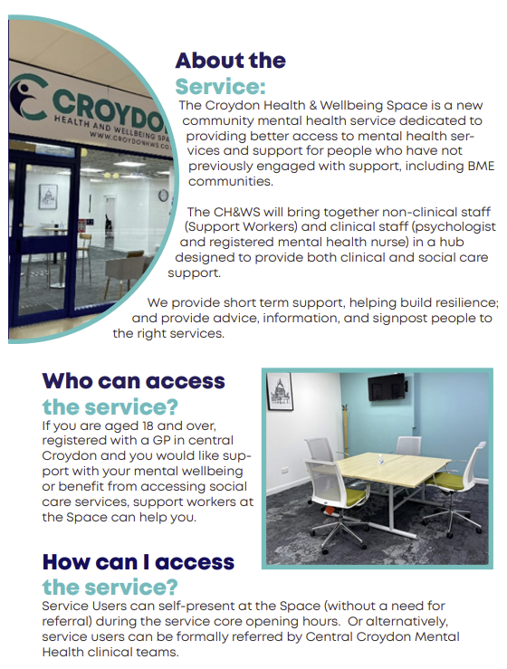
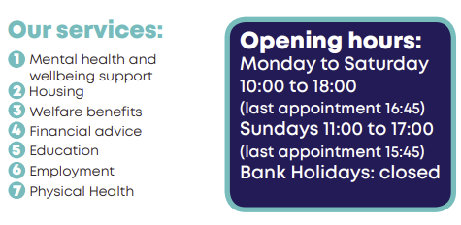
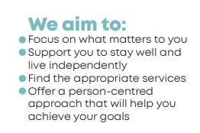

Slide 23
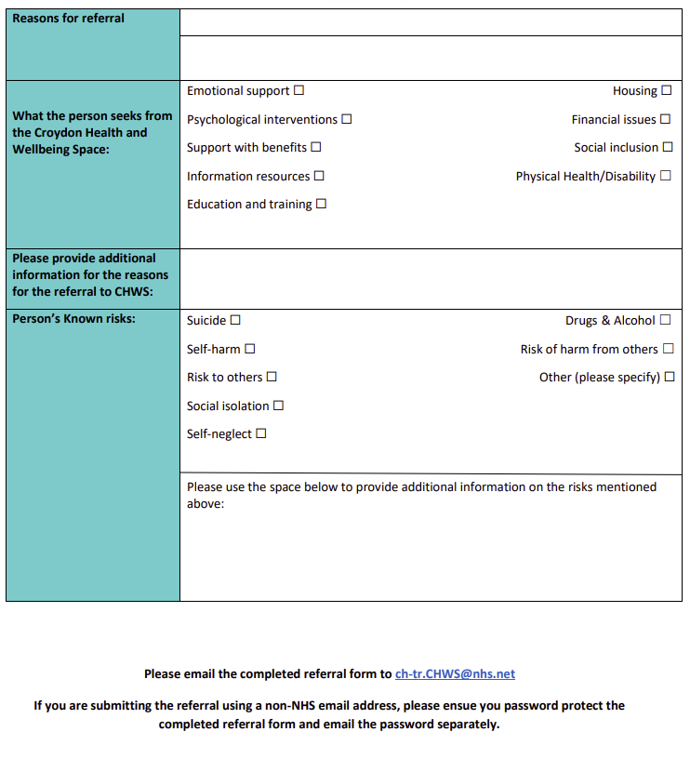
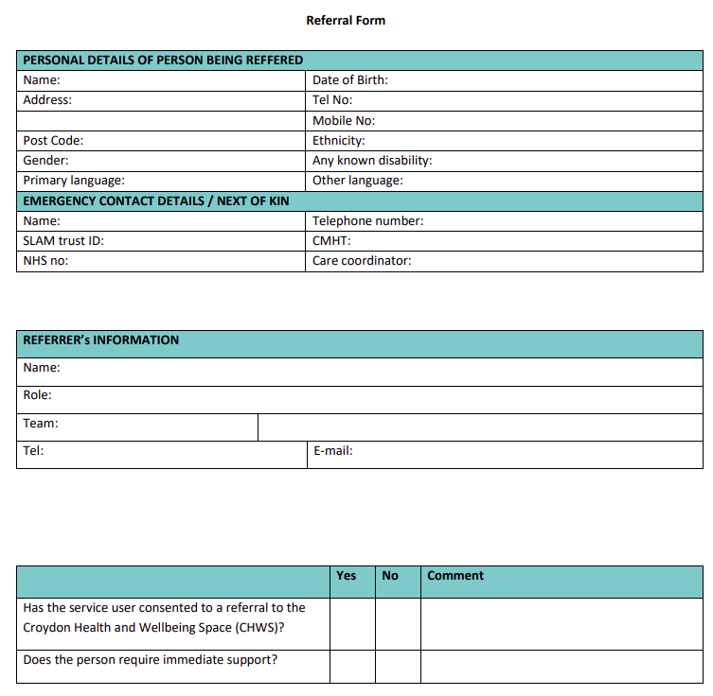

Slide 24
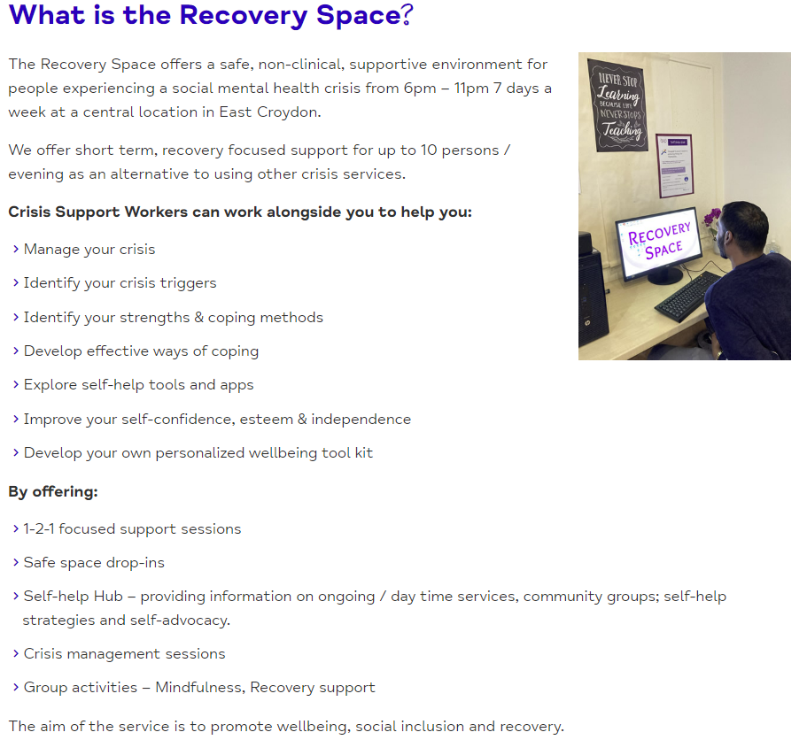
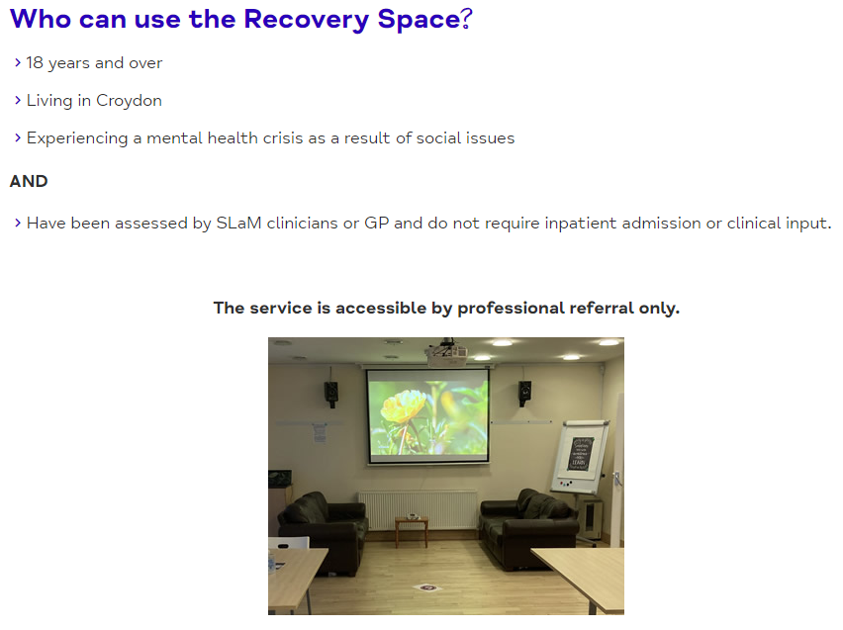
Mind in Croydon – Recovery Space

Slide 25
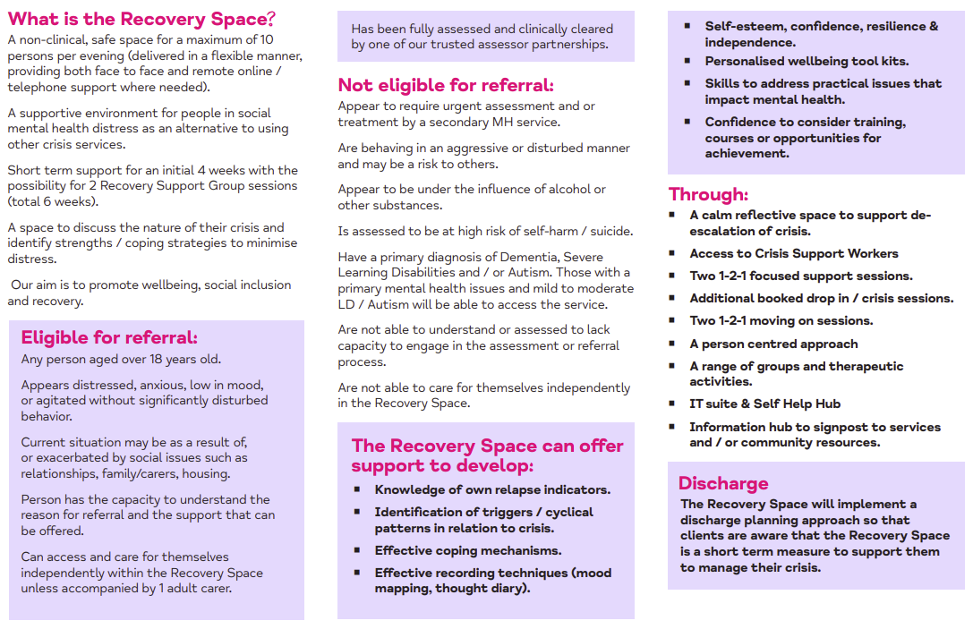

Slide 26
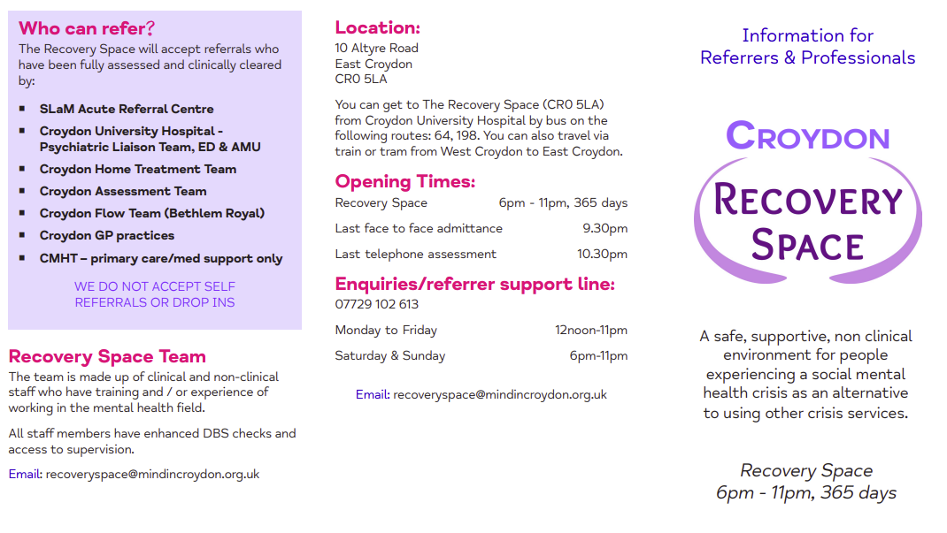

Slide 27
Croydon Reach (Thamesreach)
Outline of Service Function:
Croydon Reach helps people sleeping rough across the borough to escape homelessness and then move on into permanent accommodation.
The staff help people sleeping rough into No Second Night Out assessment hubs, hostels, private rented sector properties, and bed and breakfast accommodation.
When people are placed into temporary accommodation, staff then help resettle them into a permanent home and provide support to make sure they maintain it.
A Department for Communities and Local Government Prevention Rough Sleeper Service (DCLG-PRS) staff member also provides support to those rough sleepers with lower support needs, by helping them into accommodation in the private rented sector, and to find volunteering opportunities and work.
Operational Hours:​
Central office and general enquiries​
Tel: 020 7702 4260​
Email: enquiries@thamesreach.org.uk​
Registered address:​
Employment Academy​
29 Peckham Road​
Camberwell​
London SE5 8UA

Slide 28
Croydon Service – Look Ahead
Outline of Service Function:
A specialist semi-independent living service of 6 bedrooms, offering a medium level of support to Unaccompanied Asylum Seeking Children (UASC) who are either in or leaving care. Appropriate for unaccompanied Asylum Seeking Children (UASC); usually aged 16-17; young people with no recourse to public funds aged 18-21 although individuals aged up to 25 will also be considered.
Operational Hours
24/7
https://www.lookahead.org.uk/properties/croydon-service/
Service Benefits:​
Safe and strong community environment, encouraging cultural exchange​
Staff work closely in partnership with local organisations, including solicitors around immigration issues ​
Dedicated Specialist Support Worker who is trained to support asylum seekers. ​
Young people have access to 24/7 phone support, including translation services, CCTV in communal areas and a security presence overnight to ensure safety for all.​
We work closely with commissioners, agencies and families to develop and deliver bespoke support and accommodation offers tailored to individual needs.

Slide 29
Croydon Healthwatch
Outline of Service Function
Healthwatch Croydon works to get the best out of local health and social care services responding to the voice of the service user. From improving services today to helping shape better ones for tomorrow, we listen to your views and experiences and then influence decision-making.
Operational Hours
24 Hours
24 George St
Croydon
CR0 1PB
0300 012 0235
Service Benefits ​
Local people shape health and social care delivery​
Local people influence the services they receive personally​
Local people hold services to account

Slide 30
Croydon Nightwatch
Outline of Service Function:
Nightwatch volunteers are out every night in the centre of Croydon giving food and other help to homeless and other vulnerable people. We can be found every night at 9.30pm in the Queen’s Gardens, by Fell Road.
Core activity is providing direct support for homeless people and others in need. Helping people at every level of homelessness, from the street homeless to those in hostels and bed and breakfast accommodation and vulnerable former homeless people who need continuing support if they are not to become homeless again.
Operational Hours:
There are no paid staff, and no office premises.
croydonnightwatch@btinternet.com.
Service Benefits:​
To act as first line contact for homeless people, to signpost them to other agencies​
To provide urgent and necessary items of food, clothes, toiletries, pots, pans, household goods to people in need​
The stabilisation of former homeless people in new accommodation​
To assist in helping unemployed homeless people (both financially and emotionally) to take up vocational training and education​
To befriend homeless people to encourage empowerment and increase in confidence​
To educate the community at large in Croydon about the realities of homelessness

Slide 31
StreetLink
Outline of Service Function
StreetLink exists to help end rough sleeping by enabling members of the public to connect people sleeping rough with the local services that can support them.
Operational Hours:
0300 500 0914
Download from the Apple App store or the Google Play store for Android.
Service Benefits:
If you are concerned about someone over the age of 18 that you have seen sleeping rough in England or Wales, you can use this website to send an alert to StreetLink.
The details you provide are sent to the local authority or outreach service for the area in which you have seen the person, to help them find the individual and connect them to support.
It is important to note that if you think the person you are concerned about is under 18 please do not contact StreetLink but instead call the police.
Please report any cases of Rough Sleeping via the Streetlink website
www.streetlink.org.uk

