Slide 1
The Project
For Perpetrators of Domestic Abuse
Drive is a Partnership formed of Respect, SafeLives and Social Finance

Slide 2
About DRIVE
Drive believes domestic abuse is not acceptable or inevitable. Drive works with high-harm, high-risk and serial perpetrators of domestic abuse to prevent their abusive behaviour and protect victims.
High-risk, high-harm perpetrators are those who have been assessed as posing a risk of serious harm or murder to people they are in intimate or family relationships with.
Drive employs a whole-system approach using an intensive case management system alongside a coordinated multi-agency response.
Drive challenges perpetrators to change and works with partner agencies – like the police and social services – to disrupt abuse.
Drive advocates for changes to national systems so that perpetrators posing all levels of risk can no longer get away with abusive behaviour and can access the help they need to stop.

Slide 3
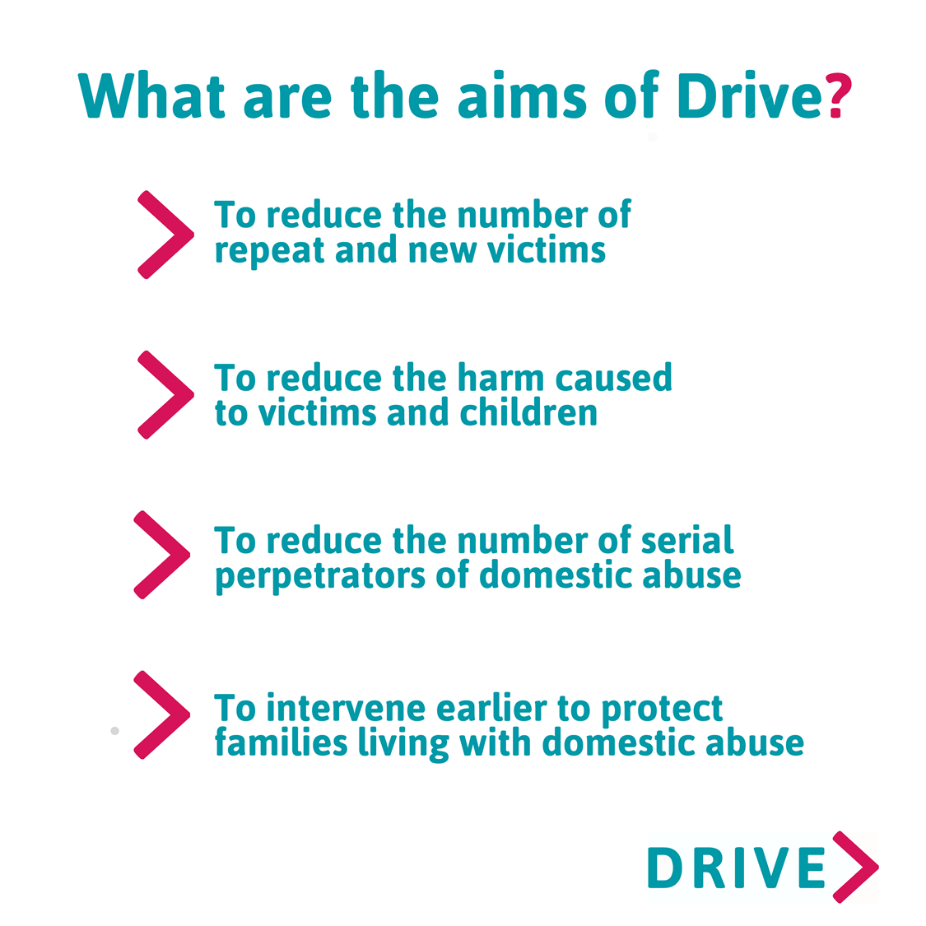

Slide 4
Essential DRIVE Criteria
- Victim-Survivor informed consent is needed
- IDVA oversight has to be in place for duration of case
- Viable and active lever to engage AP with Drive, who will facilitate introduction and promote engagement with Drive Case Manager
- Robust information sharing and multi-agency between agencies throughout Drive, as per marac information sharing agreement
- Drive require information including Marac/Dapp referrals and minutes, police intelligence and V/S DASH information in order to complete an effective and safe ‘Initial Contact Strategy’

Slide 5
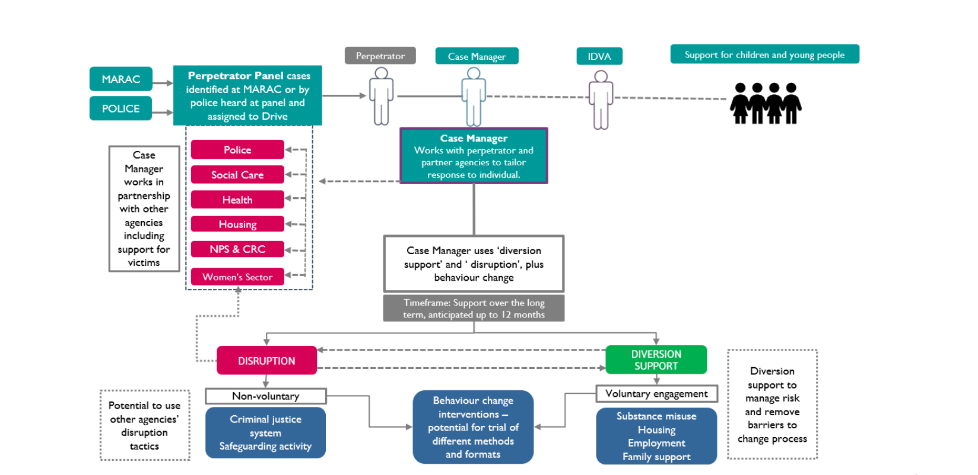

Slide 6
DRIVE model
Drive Case Management
Diversion Support
Access to diversionary support to address needs
e.g. housing, finances, substances, MH, work & training, arranging appointments to safeguard and encourage VS’s engagement
Behaviour Change Intervention
Tailored/structured 1-2-1 sessions aimed to increase insight and awareness, challenge and support change and healthy relationships. Trauma informed work, CBT, affects of DA on children, emotional management
Disrupt
Multiagency approach to safeguarding e.g. via police/CJS, housing etc to implement activity to prevent and disrupt abuse. Actioned via Dapp/marac. Gang affiliated – info sharing with gangs team, social media sweep, Marac and MASH referrals, including to other boroughs/areas that pertain to AP and family members

Slide 7
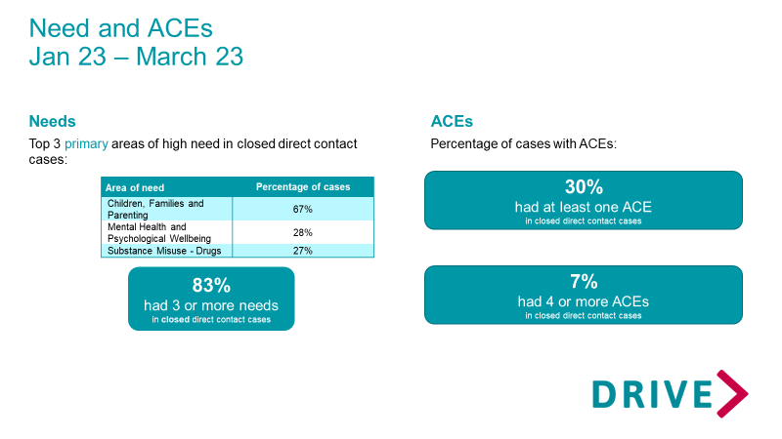
Client Needs – South BCU Q4

Slide 8
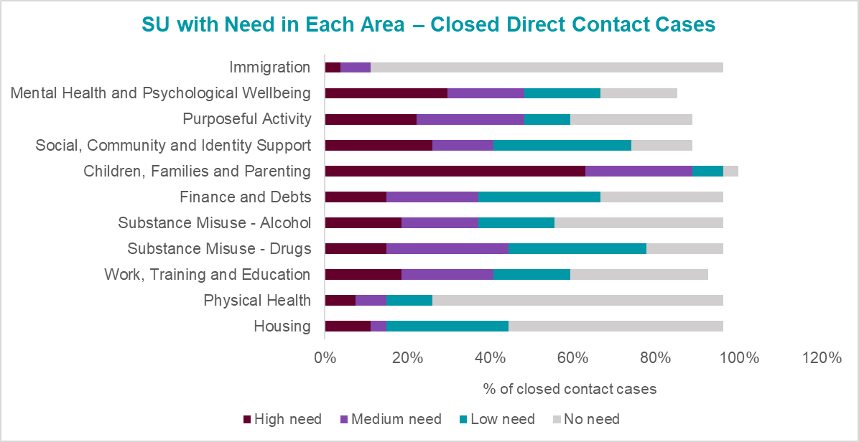
South BCU Q4 - Needs Profile (Closed Direct Contact Cases)

Slide 9
Service user feedback
“I have learnt a lot about myself and it was great to meet someone who cared”
“I would not have got this far without Drive intervention”
“I have come to recognize what I thought I had lost and remember what my potential is”
“Made me realise it’s not outwards but within (again..) therefore I am grateful and have learnt a lot”
Drive- “dedication and respect”

Slide 10
X BCU DRIVE Team contact details
Service Manager:
Kelly McDonagh - kelly.mcdonagh@risemutual.org
Team Leader:
Sarah Middleton – sarah.middleton@risemutual.org

