Slide 1
South London Partnership Connect to Work January 2025

Slide 2
What is Connect to Work?
Connect to Work is a national supported employment programme being rolled out over the next 9 months by Department for Work and Pensions supported by Department for Health and Social Care.
It is voluntary programme aimed at tackling economic inactivity to increase the workforce pool, raise the UK employment rate and boost national productivity.
It is based on the following principles:
Everyone has the potential to be in real, paid work with the right support
Participants will start looking for work as soon as possible then will continue to be supported in the workplace
Participants will be supported into real, paid work not volunteering or other outcomes
Includes clinical integration where required and appropriate
Notes:
Connect to Work is the new supported employment programme, supporting the ‘Get Britain Working’ strategy to enable good growth and inclusive economies.
Its primary focus is on those who are inactive but will also support some people who are at high risk of becoming inactive if they fall out of work or are unemployed.
Long-term sickness continues to be the most common reason for non-engagement in the Labour Market among the working age population.
People with multiple and complex barriers to work often have health conditions or a disability as well.
Everyone has the potential to be in real, paid work with the right support
The delivery model is firmly routed in place and retain, participants will start looking for work as soon as possible then will continue to be supported in the workplace or they will be supported whilst in employment to prevent them from leaving the workforce.

Slide 3
Who is it for? Eligibility and Suitability
Eligible and Suitable | Not Eligible
Hidden Unemployed’ – economically inactive, disabled people, people with health conditions, or those with more complex barriers to work who are outside the labour market, from a specified disadvantaged group (85% of starts) Employed - Help those in work but at risk of falling out of the labour market (15% of starts) | Any local or national supported employment programme such as Individual Placement and Support for Alcohol and Drug Dependence and Individual Placement and Support for Severe Mental Illness should not be accessed by individuals simultaneously with the supported employment programme. If these services are available, there should be consideration as to which is more appropriate for the individual
Notes:
More specifically the
Disabled/long term health conditions
An offender (someone who is serving a community service) or ex-offender (someone who has completed a custodial or community sentence).
• A carer/ An ex-carer.
• A homeless person.
• A former member of His Majesty’s (HM) Armed Forces (AF), a member of HM AF reserves, or a partner of current or former Armed Forces personnel.
• A person for whom a drug or alcohol dependency, including a history of dependency, presents a significant barrier to employment.
• Care experienced young person or a care leaver
• A refugee, a resettled Afghan.
• A person on the Ukrainian scheme.
• A victim/survivor of domestic abuse.
• Young people identified as being involved or at risk of being involved in serious violence.
• A victim of modern slavery

Slide 4
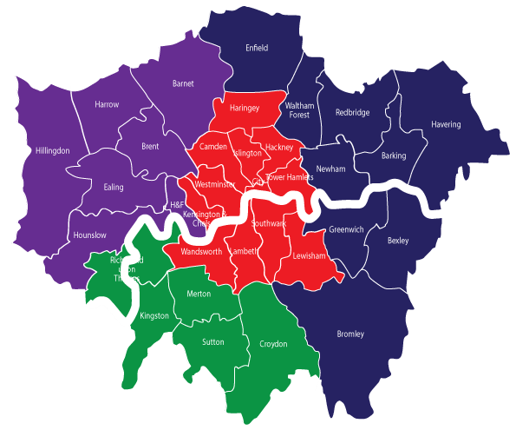
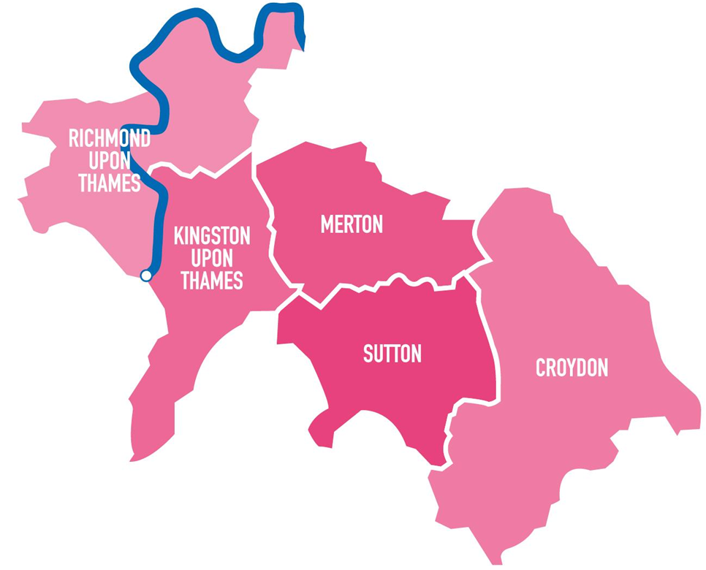
Connect to Work – In south London
Connect to Work will be delivered in clusters of local authorities. In London, as set out by the Department for Work and Pensions (DWP). the funding will be devolved to the South London Partnership.
This programme will be delivered by a specialist employment support provider(s), spanning four of the SLP boroughs, with Croydon Council, as the accountable body

Slide 5
South London Partnership have a track record of delivering programmes across the sub-region, supporting south Londoners improve their health, well-being and economic resilience.
Notes:
SLP either commission or are directly responsible for the delivery of a range of programmes, focused on supporting the all residents of south London to access support to get the right skills to get a good job. And make sure that the businesses across south London have a supply of highly skilled residents to harness local opportunities.
Within skills and employment SLP delivers programmes on behalf of the five boroughs CRKMS, with strategic guidance from the SE Alliance. Examples include IH that looks to advocate for those who face barriers to employment through connecting, communicating, consultation and collaboration, …BIG South London … (Business Innovation & Growth) offers support to boost startup and business growth in the subregion working with HE, building networks, funding opportunities and co working spaces.
Additionally, they commission delivery of specific resident pathways provision such as Ingeus and Reed in partnership.

Slide 6
Connect to Work: Key Facts for South London Partnership Programme
5 Year Programme
(4 years of new starts and 1 years for follow on support)
1400 people supported every year (at peak delivery)
50% of all starts expected to be helped into work

Slide 7
Connect to Work is different from other DWP programmes, and has been codeveloped with national and local experts to ensure the programme delivers impactful outcomes
There are two models of support being provided through the programme:
IPS: Individual Placement and Support - personalised and strength-based approach to support people experience mental health difficulties, to find a job of their choosing.
SEQF: Supported Employment Quality – a model to ensure everyone with a disability and/or neurodivergence seeking paid employment receive high-quality support to find, maintain, and flourish in well-matched employment
Providers will need to undertake self-assessments and external quality assurance assessment to ensure they meet minimum service standard levels.
Providers will need a range of referral organisations and have strong community outreach to identify ‘hidden unemployed’.
Employment Specialists should have an average maximum active caseload of 25
Employment Specialists only providing SEQF support should operate a smaller caseload, with an average maximum caseload size of 20
Notes:
Connect to Work is different from other DWP programmes, and has been codeveloped with national and local experts to ensure the programme delivers impactful outcomes
There are two models of support being provided through the programme:
IPS: Individual Placement and Support - personalised and strength-based approach to support people experience mental health difficulties, to find a job of their choosing. (75% if all starts)
SEQF: Supported Employment Quality – a model to ensure everyone with a disability and/or neurodivergence seeking paid employment receive high-quality support to find, maintain, and flourish in well-matched employment (25% of all starts)
Providers will need to undertake self-assessments and external quality assurance assessment
to ensure they meet minimum service standard levels.
Providers will require specialist practitioners to deliver support services.
Employment Specialist should have an average maximum active caseload of 25
Employment Specialist only providing SEQF support should operate a smaller caseload, with an average maximum caseload size of 20

Slide 8
Connect to Work: The Participant Journey
Awareness
Engagement &
Onboarding
Provision
Identification
Introduction
Eligibility
Referral to Provision
Supported Employment
End of Provision
Introduction Channels
Primary
GPs
Primary Care
Health Providers
VCSE
Local Authorities
Secondary
JCPs
Employers
Getting on Programme
Apply for programme
Pre screening
Initial meeting
Identifying support
Providing Support
Vocational profiling
Job matching
Employer Engagement
On and off the job support

Slide 9
Keys To Success
Model of Support are specific and defined however we have influence to create a local service:
Referrals – identifying strong referral pathways, through a wide range of local organisations, to reach beneficiaries
Integration – minimising duplication and driving efficiency and effectiveness of the programme by working with and aligning to existing provision
Employer Engagement – Person first approach will require support from a wide range of employers
Quality – driving quality through robust programme management and capacity structures

Slide 10
Next Steps
Stakeholder engagement events
Specification design
Delivery plan
Procurement

Slide 11
Thanks, and Questions
Email:
Polly.Persechino@southlondonpartnership.co.uk
Kirsty.hogg@southlondonpartnership.co.uk
Visit: https://southlondonpartnership.co.uk/connect-to-work/

