Slide 1
No Wrong Door South London: Integration Hub
South London Partnership
South London Integration Hub
How can we help?

Slide 2
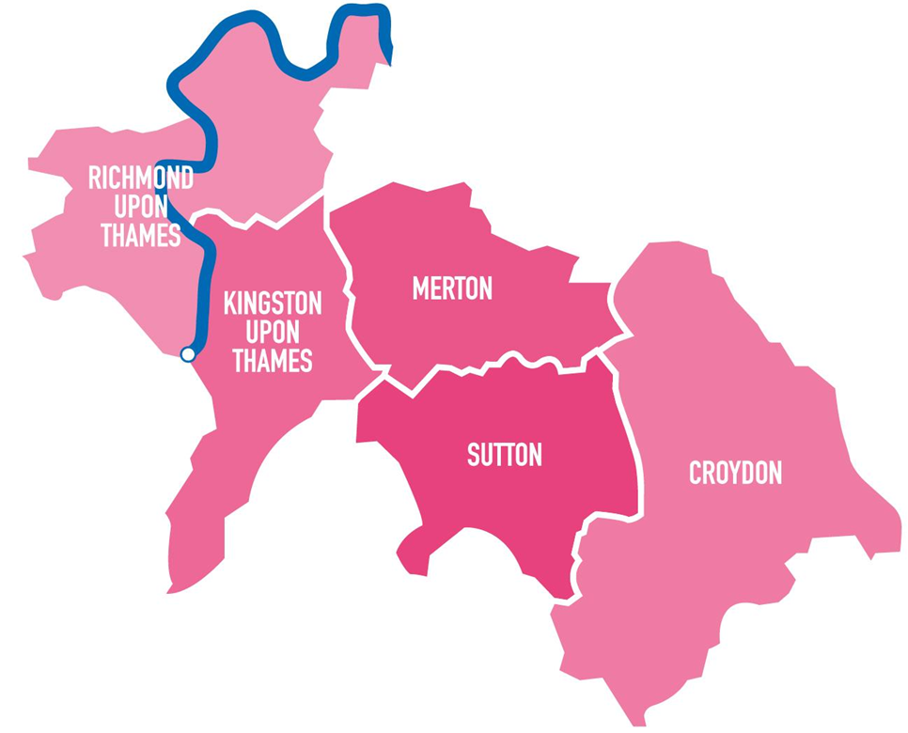
South London Partnership?
The South London Partnership is a sub-regional collaboration of five London boroughs: Croydon, Kingston upon Thames, Merton, Richmond upon Thames and Sutton.
Our vision
South London Partnership is committed to securing a skills system that:
equips our young people and all our residents with relevant skills, versatility, adaptability and resilience to secure sustainable employment and support their wider wellbeing throughout their lives, and
supports the growth and productivity of the sub-regional economy, ensuring that existing and future employers can access a ready pool of suitably qualified, resilient workers and can secure learning and training to support their workforce and business development.
Our priorities
Support all residents towards or into work and to progress through their career
Increase employer participation and investment in skills
Align the skills offer to our growth and strategic sectors

Slide 3
What does SLP do?
Notes:
BIG South London … (Business Innovation & Growth) offers support to boost startup and business growth in the subregion, including programmes, building relationships with HE, networks, funding opportunities and co working spaces.

Slide 4
2024-5 delivery
Resident Engagement
Residents that reside in Richmond, Kingston, Merton, Sutton or Croydon
Communications
Targeted communications campaigns
Pathways and Partnerships
Pathways for young people
People out of work seeking a job
Economically inactive individuals
People with a disability
Women returning to work
Women from global majority groups
People with long term health conditions
Communications plan/timetable (including bulk mailing)
Pathways for returners
Pathways for women
Supporting SEND forums with supported internships
Partnership meetings and VCSE upskilling
Business engagement (mapping, events, employer resources)
Bulletins
Newsletters
Online employment, skills and training signposting resource (website updates)
Practitioner and VCSE upskilling
Communities of Practice
Skills & Employment Alliance, partnership agreements and badging
Inclusive Employment Series (employer training/ upskilling)
Skills & Employment Community of Practice
Disability, Health and Employment Community of Practice
Toolkits
Social media

Slide 5
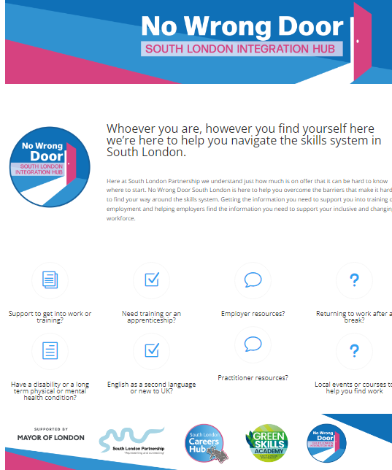
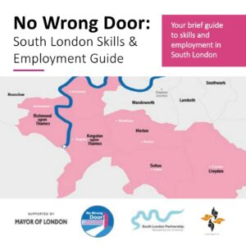

Slide 6
How can we help?
Connect
Communicate
Consult
Collaborate

Slide 7
Useful Links
Email
Kirsty.hogg@southlondonpartnership.co.uk
admin@southlondonpartnership.co.uk
Connect to Work
https://southlondonpartnership.co.uk/connect-to-work/
Local Skills Improvement Plan
https://southlondonpartnership.co.uk/south-london-skills-improvement-plan/
Integration Hub
https://southlondonpartnership.co.uk/no-wrong-door-south-london-integration-hub/

