Slide 1
MENSHED

Slide 2
MENShed@goodfoodmatters

Slide 3
Talk, connect and create at Croydon’s Men’s Shed
Good Food Matters Men’s Shed in new Addington provides a safe space for people to come together and take care of their mental health while learning new skills, such as gardening, food growing, woodwork and being out in nature.

Slide 5
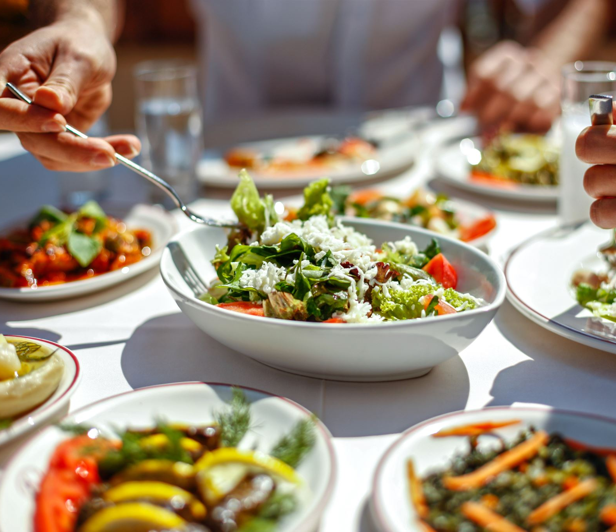
Our community project at Good Food Matters in Mickleham Way, New Addington CR0 0PN –
welcomes men of all ages to join weekly activities and eat together every Friday from 11.00am to 3.00pm.
Share a meal and re connect

Slide 7
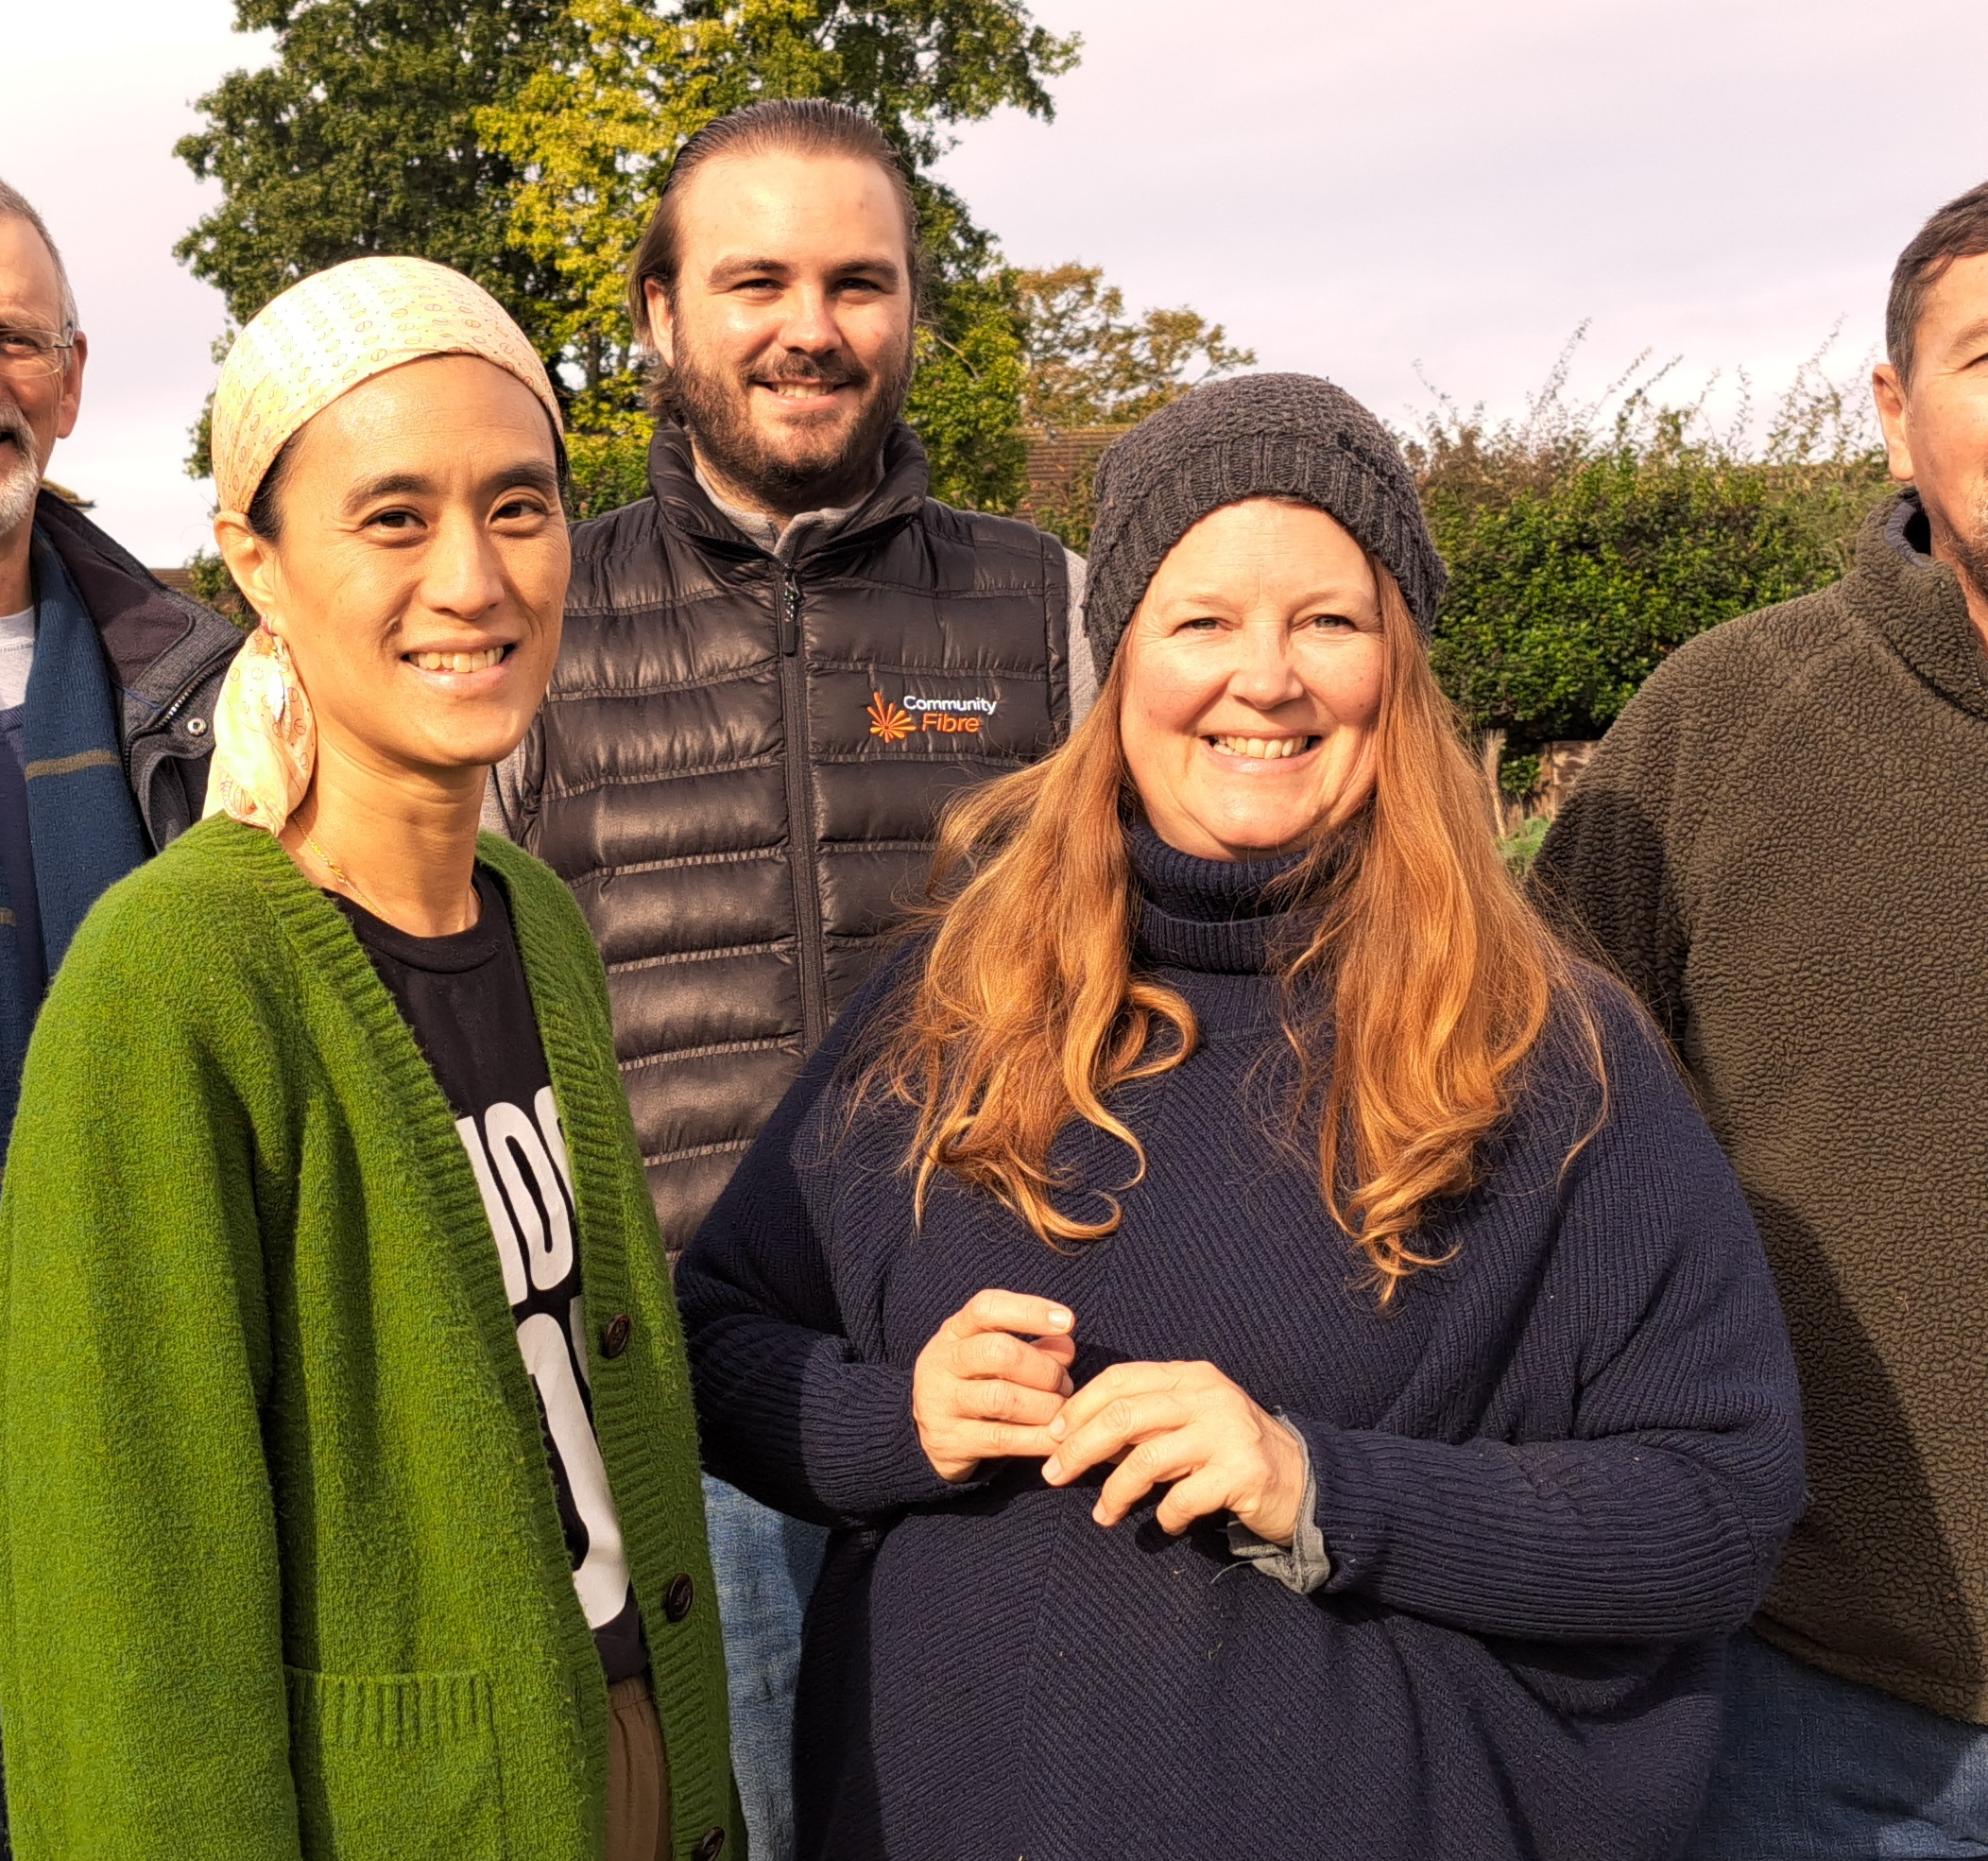
Learning skills , enjoying being outside and connecting socially

Slide 8
Space to be you

Slide 9
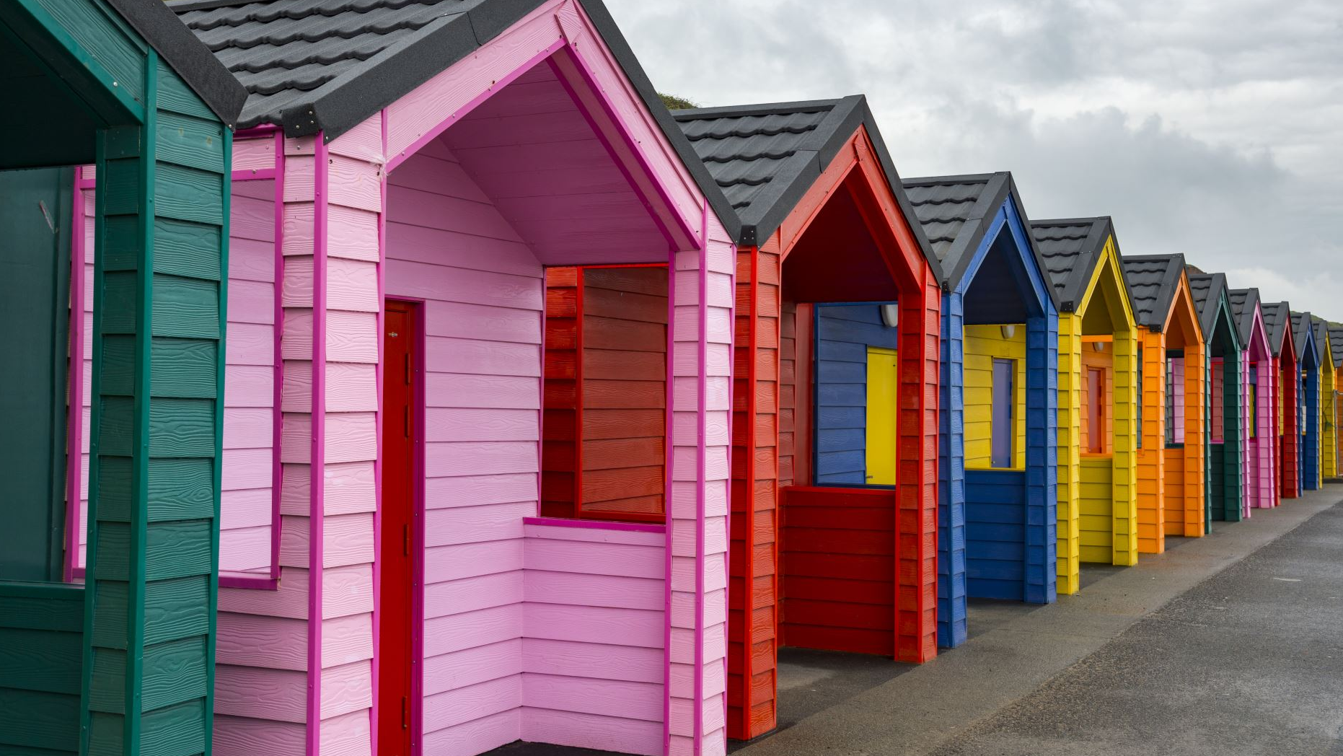
The activities are often similar to what people might traditionally do in their garden shed, but with the additional aims for groups of men to be part of a community, feel a sense of fulfilment and achievement and enjoy time together to benefit their health and wellbeing.
Croydon’s Men’s Shed community project is also intergenerational, and women can take part if they wish to attend.

Slide 10
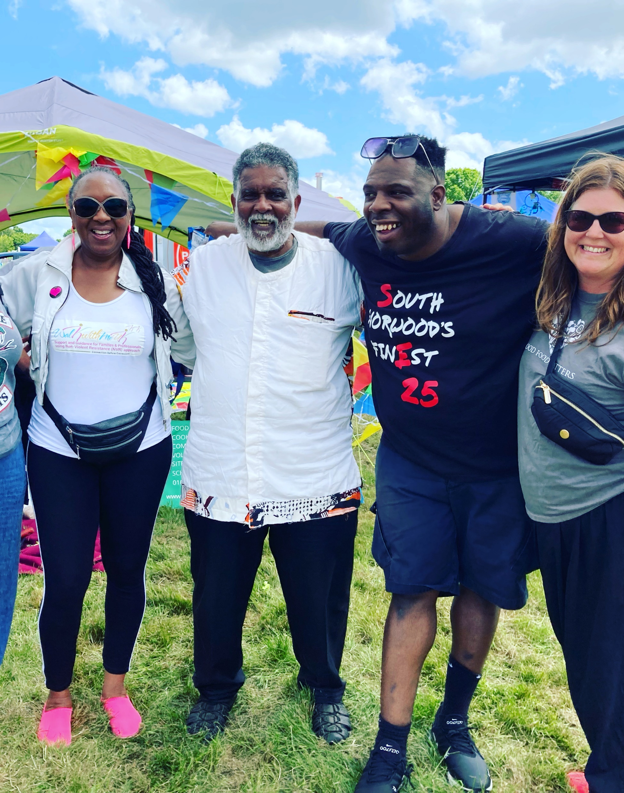
Join us
Ben Elliot Sur, support worker at Croydon’s Men’s Sheds, said: “Following the pandemic we found people do not feel the same as before and may not be in the same rhythm of life.
Our Men’s Shed in Good Food Matters provides the community with a space to work things out, gain skills and be active.
Some use us as a recommendation for employment, and retired people often welcome the opportunity to get back into a routine. This is a win-win situation for those that come and join us.”

Slide 11
Scott from Selsdon, who attends Croydon’s Men’s Shed: “Places like Men's Sheds are good for men and people in the community as it teaches you a lot.
Coming here is also good for my mental health. I am a young carer and I spend a lot of time looking after my mum at home.
Getting out and learning news skills, especially in nature, working with my hands and doing something physical is beneficial to me. I would definitely recommend Men's Sheds to others because it's also fun.”

Slide 13
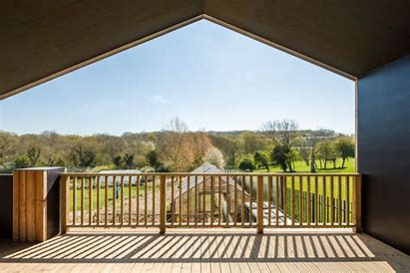
Refer a client or just join us for lunch and see if you enjoy it?

