Slide 1
South West London
Voluntary, Community and Social Enterprise Alliance
Sara Milocco
SWL VCSE Alliance Director

Slide 2
The SWL VCSE Alliance wants to:
Be a link between local voluntary and community sector organisations and other partners within our ICS
Share valuable insight and information and promote shared learning and collaboration
Be a strategic partner within the ICS and support the transformation and care services for local people
Often called the third sector, civil society or the not for-profit sector. Charities are the largest single category. Others include community benefit societies and co-operatives, not-for-profit community businesses or community interest companies (CICs), credit unions and small informal community groups. Primary purpose is to create social impact rather than profit.

Slide 3
Voluntary sector in South West London?
Examples include:
RASASC (Rape and Sexual Abuse Support Centre)
Home-Start (providing one to one support in people's homes for parents under the age of 5)
Day Centres for over 65s
Women's Well Being groups
Mentoring organisations for young people
5,565 organisations
Croydon 1,900 Kingston 575
Wandsworth 1,390 Merton 400
Richmond 800 Sutton 400
1.56 million residents

Slide 4
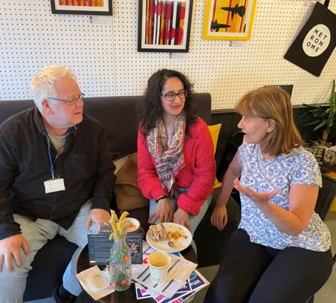
Alzheimer’s Society
A chance to talk about memory worries:
Large national charity with local presence delivering a Metronome café’ in Morden.
Resilience: Many people have concerns about their memory but aren’t sure where to turn - which is the idea behind the cafe.
People worried about their memory, or that of a friend or family member, can pop into, Morden’s Metronome café to talk to the experts - or just enjoy a free cup of tea or coffee and a chat. The project is part of the Health on the High Street initiative, jointly funded by NHS South West London and Merton Council, which seeks to bring wellbeing services into communities by working with businesses, libraries and other facilities.
Our aim is to get people to drop in for a coffee, so they can chat about anything that’s bothering them. People have questions about dementia – what exactly is it, how you get it, what you should do if you’re worried?
Bill Gibbons of Alzheimer’s Society
Alzheimer's Society (alzheimers.org.uk)

Slide 5
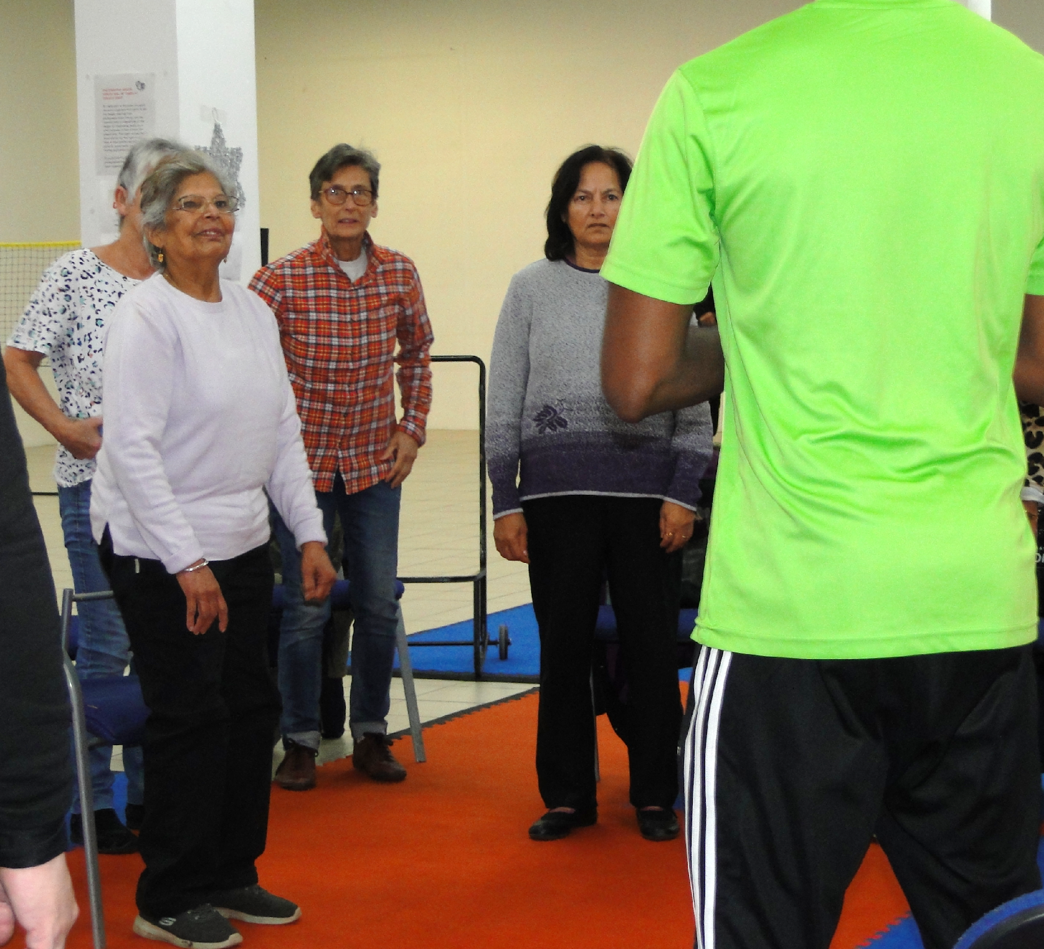
New Addington Good Samaritans:
A space for independency in older age
Well established, small community organisation offering a “Pop in”, a space for social interaction and food to New Addington older residents.
Social isolation: Community, Food, and Social Interaction for local elderly with poor mobility and living by themselves. They have a mini-bus service that supports residents attending. The jumble room where residents sell their wool and can buy clothes at a discount has been a lifeline to those who lack the means and capacity to make trips to shops in their surrounding area.
Resilience: Residents: A place of Friendship. can engage with anything from Bingo to getting their haircut.
Health inequalities: One of the most deprived wards in Croydon. Seeing 70-100 residents per week, with some coming back 5 times a week.
I would see nobody if it weren’t for this Pop in.
It kept me sane through the death of my husband.
Resident
https://tinyurl.com/3m8knhht

Slide 6
Local directories
Croydon Simply Connect Croydon and themed flyers at Directories - Croydon Voluntary Action (cvalive.org.uk) - mental health, autism, homelessness.
Merton Merton Connected - will be soon refreshed
Richmond VCConnect Online Directory - Search Results (vcconnectsystem.org.uk)
Sutton VCConnect Online Directory - Home Page (vcconnectsystem.org.uk)
Kingston upon Thames Connected Kingston
Wandsworth Care Alliance Care4me | your community directory

Slide 7
Local CVSs (infrastructure organisations)
Croydon Croydon Voluntary Action; BME Forum, Asian Resource Centre Croydon, CNCA
Merton Merton Connected
Richmond Richmond CVS
Sutton Community Action Sutton
Kingston upon Thames Kingston Voluntary Action
Wandsworth Wandsworth Care Alliance; Wandsworth Empowerment Network

