Slide 1
South West London
Voluntary, Community and Social Enterprise Alliance
Sara Milocco
SWL VCSE Alliance Director
sara.milocco@cvalive.org.uk

Slide 2
Voluntary sector in South West London
5,565 organisations
Croydon 1,900
Wandsworth 1,390
Richmond 800
1.56 million residents
Kingston 575
Merton 400
Sutton 400
Examples include:
Approximately 50% registered charities
Based on estimates provided by local VCSE infrastructure organisations

Slide 3
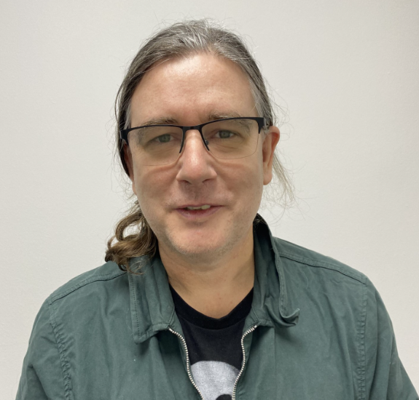
SWL VCSE ALLIANCE’S STRUCTURE
SWL VCSE Alliance
Croydon Voluntary Action | Kingston Voluntary Action | Merton Connected | Richmond Community Voluntary Sector | Community Action Sutton | Wandsworth Care Alliance
Frontline VCSE leader Older/frail people (Croydon) | Frontline VCSE leader Workforce development (Kingston) | Frontline VCSE leader Young people (Merton) | Frontline VCSE leader Long term conditions (Richmond) | Frontline VCSE leader Young people (Sutton) | Frontline VCSE leader Mental Health (Wandsworth)
Leadership group
SWL VCSE Alliance Director
Chas De Swiet, Sound Minds
chas.deswiet@soundminds.co.uk
Integrated Care Board
Integrated Care Partnership

Slide 4
SWL VCSE representatives
SWL ICS Health Inequalities Board, John Azah, Kingston Race and Equalities Council, john.azah@kingstonrec.org
SWL ICS Mental Health Partnership Group, Karen Stott, Off the Record Croydon, karenstott@talkofftherecord.org
SWL Workforce Partnership Group (difficult to recruit roles), Jason Lamont, Kingston Centre for Independent Leaving jason.lamont@kcil.org.uk
SWL Workforce Partnership Group (apprenticeships), Roberto Mobile, Need2Succeed, roberto@need2succeed.co.uk
SWL CYP and Maternity Partnership, Ann Hagell, Habitats and Heritage, a.k.hagell@btinternet.com
SWL ICS Community Based Support for older/frail people, Shane Breannan, StayWell services, shane.brennan@staywellservices.org.uk
SWL ICS Digital Board, Kate White, Kingston Voluntary Action (Superhighways), katewhite@superhighways.org.uk
SWL ICS Perinatal Programme Partnership Group (PPG), Alberta Atkinson, Home-Start Sutton, alberta@homestartsutton.org.uk

Slide 5
Croydon: Croydon Mental Health Alliance, hosted by Croydon Voluntary Action
Wandsworth: Mental Health Providers Forum, hosted by Community Empowerment Network
Wandsworth: BME Mental Health Forum, hosted by Community Empowerment Network
Wandsworth & Richmond: Wandsworth Mental Health Stakeholder Forum, hosted by Public Health
Richmond: Richmond Mental Health and Wellbeing Alliance, hosted by the Local Authority
Kingston: Kingston Mental Health and Wellbeing Group, hosted by Healthwatch Kingston
Kingston: BME Mental Health Network, hosted by the Local Authority
Sutton: Voluntary Sector Forum, hosted by Community Action Sutton
Merton: Health and Social Care Forum, hosted by Merton Connected
Mental Health Forums in SWL VCSE
cvalive.org.uk.xlsx

Slide 6
Valuing and resourcing
VCSE as equal partners. Enablers that would support work in partnership and integration in the local care system include:
Funding:
Realistic time frames for applications; organisations feel there are lots of expectations from the ICS for what are complex applications to be completed within a short window.
Commitment to longer term funding.
Feedback on failed bids.
Funding model for small grassroot organisations (i.e. someone to fundraise on behalf of small VCSE groups).
“What is next” final quarter support provided by funder and VCSE infrastructure organisations in collaboration.
Commissioning and contracting:
More influence over what is commissioned. Prevention is important.
A healthy level of risk – commissioners to try new solutions and options – being more curios and flexible.
Longer leading time to tender submissions.
Being able to shape and change during a contract.
Better communication with commissioned organisations (i.e. if the service specifications get changed before re-commissioning, such changes should be discussed with the provider and its service users; if re-commissioning moves to SWL rather than local level, a line of communication needs to be kept open with services presently commissioned).

Slide 7
Next steps
A Commissioning and Funding VCSE strategy/guidelines
Collaborating on the engagement of VCSE in Mental Health providers collaborative
Two new voluntary sector representatives to be appointed to the SWL Mental Health Partnership group
More in person events
The NHS to share MH statistics and data with VCSE organisations (in a simple format by using infographics / images with key facts, videos) and VCSE organisations to share examples of good practice with NHS colleagues.

