Slide 1
The impact of sexual violence and RASASC’s services
Abby Preston – Training, Prevention and Outreach Manager

Slide 2
“Sexual violence and abuse is any behaviour of a sexual nature which is unwanted and takes place without consent or understanding.”

Slide 3
Rape Assault by penetration Sexual Assault Sexual Harassment Child Sexual Abuse Sexual Exploitation Image Based Sexual Abuse (‘Revenge’ Pornography, Cyber-flashing, and Up-skirting) Organised and Ritual Abuse
And many more……..
Notes:
Whilst sexual violence can and does affect people from all social groups, it is a type of violence that is acknowledged by the United Nations and also the UK as a form of violence against women and girls in that it disproportionately is perpetrated against women and girls by men and boys.
Where men and boys experience sexual violence, this is also disproportionately perpetrated by other men and boys.
What this means is sexual violence is being perpetrated and experienced in a very gendered way, which also creates particular gendered impacts and barriers to coming forward for men and women who’ve survived some form of sexual violence.
Alongside sex and gender, people’s space to speak out and report is also affected other social inequalities around ethnicity, religion, disability, age, class and sexuality.
sexual violence is also perpetrated in many different contexts; intimate relationships, friendship groups, families, groups/gangs, online, in public, in conflict, work places and institutions – schools, residential homes, religion, etc. creates further complexity, silence and feelings of disempowerment in how we speak out, respond, challenge and prevent sexual violence.
All these forms of sexual violence are connected on what we call a continuum of sexual violence, where someone has multiple experiences which often overlap.
There is a significant overlap with experiences of domestic and relationship violence – oftentimes the media paints a picture of sexual violence as something that is perpetrated by a stranger but the reality is that in the vast majority of cases, the perpetrator is someone known to the survivor (a partner, family member, someone in a trusted relationship)

Slide 4
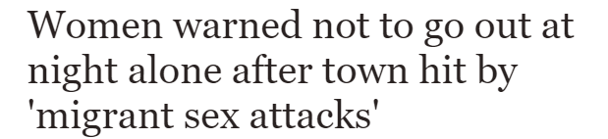
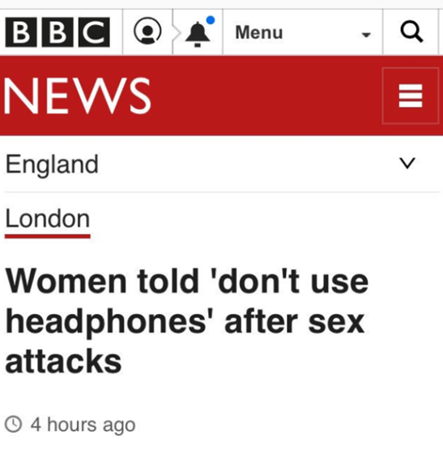
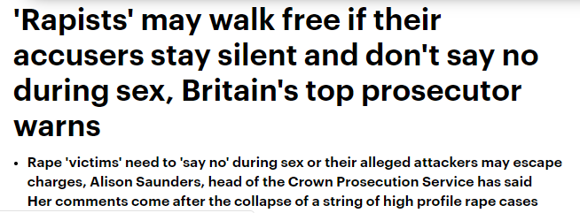
Notes:
When you start to look at what the media tells us about sexual violence, you see that there are a lot of messages about who and what is responsible. Sexual violence occurs in what is often referred to as ‘Rape Culture’ where prevention messages around sexual violence overwhelmingly focus on telling women they need to protect themselves from being raped – rather than tell everyone – particularly perpetrators, who are mainly men and boys – not to rape or abuse.
It also perpetuates myths about whether women are to be believed, when they do come forward, as well as inaccurate information about who experiences sexual violence, who are potential perpetrators, how is sexual violence perpetrated, in what contexts and for what reasons.
There are specific myths that create barriers for survivors to come forward and these often relate to the idea that rape is about sex and sexuality, when in reality it is about power and control. Many people know the person who raped or abused them which is an added barrier to disclosing – for women particularly this is around 90-92% of experiences.

Slide 5
Impact of Myths on Societal and Institution Responses
Silence survivors
Excuse perpetrators
Bias in Criminal Justice System
Rape Culture
Notes:
Impact of rape culture and myths:
The myths about sexual violence have a huge impact on our perceptions and beliefs about sexual violence, particularly about who and what is responsible. This often means those who have experienced sexual violence (mainly women) are blamed or held responsible in some way, whilst those who perpetrate sexual violence (mainly men) are excused or their actions are minimised. The media portrayal creates a skewed and narrow view of who can experience sexual violence, who perpetrates it and for what reasons. This inaccurate portrayal, also creates barriers for many people to name their experiences as sexual violence or harassment.
This results in a society and culture which;
Silences survivors (fears won’t be believed, will be blamed, maybe I did lead him on etc.)
Excuses perpetrators
Bias CJS and University Investigations; 1.4% of reported rapes to police are currently being prosecuted by CPS, end-to-end review of CJS is currently taking place to examine failures of the CJS to respond to all forms of sexual violence from report to court.
Rape culture – sexual violence is normalised and minimised, seen as inevitable and something that we need to protect ourselves from.
In some areas of society there has been a focus on challenging cultures of ‘victim blaming.’ There has been less focus on challenging and changing the culture of victim-blaming, where sexual violence is minimised, and perceived as ‘normal’ or ‘inevitable’. By changing the focus and challenging the abusive behaviour, where those who perpetrate acts of sexual violence are held accountable, we can start to create space for survivors to seek support and work together to prevent sexual violence in the first place.

Slide 6
Abused Angry Anxious Ashamed Alert Alone Betrayed Confused Detached Disconnected Dismissed Dirty Desolate Embarrassed Exhausted Empty Frightened Frustrated Guilty Helpless Humiliated Isolated Lonely Lost Numb Powerless Sad Shocked Scared Stigmatised Stuck Self-blaming Terrified Useless Vulnerable Violated Weak Withdrawn Worthless
Notes:
Highlight the varied impacts for survivors emotionally and psychologically, yet also socially and spiritually, e.g. on their education, friendships, relationships, relationship with themselves and their bodies.
There’s no ‘right’ or ‘wrong’ way to feel after sexual violence and it will be different for each person, also changing day to day, month to month and year to year – not necessarily linear, though!

Slide 7
Alcohol Drugs Self injury Eating ‘dis’orders Distractions Overwork Over exercise Mental health presentations Denial Forgetting Dissociate Minimise Rationalise
Activism , Arts, Counselling , Talking, Silence & many more…
Notes:
Anyone who has experienced trauma in their life will find ways to cope and to survive. Here are some of the ways someone who has experienced sexual violence may respond as a way of surviving and coping with the emotional, psychological, physical and social impacts of sexual violence. This includes accessing support, becoming involved in activism, wanting to support others, etc. It’s also really common for someone to carry on as ‘normal’ or appear as if nothing has happened – this is our survival in action.
We all draw on different ways to cope and we respond in their own way – there are no right or wrong ways to respond and good or bad ways of coping – there are simply ways of coping. Someone copes the best they can in that particular moment or moments. And the many different ways in which we respond, cope, resist have particular functions in someone’s life.
Oftentimes responses will focus on the way that someone is coping and not what is underneath it - Seeking to understand what is underneath the behaviour for someone is crucial to being able to create a space for them to share their experience and decide to have further support if they want to.

Slide 8
Empowerment Model
Sexual violence takes power away (power over)
Empowerment = enabling power of survivors (power with/to) – increase ‘space for self’ and ‘space for action’
Facilitating survivors to connect with and access their own power
Right to make their own decisions and for these to be respected
Understanding everyone is the expert on their own lives.
Engaging the mechanism of choice
Notes:
Briefly introduce the empowerment model.
Because sexual violence is about asserting power over someone and ignoring their choices, support has to be about empowerment. This is how we work. The empowerment model is a holistic model developed by Rape Crisis, based on our specialist experience working with survivors. The empowerment model aims to facilitate survivors ability to take back choice and to develop trust in themselves.
You would have noticed we use the term survivor and not victim – whilst we acknowledge someone has had a moment or many moments of victimisation at the hands of a perpetrator, we also recognise they have survived it, and that this would have taken every ounce of strength, courage, resilience, determination, creativity to survive and rebuild their lives. For this reason, it is important to invite survivors to make their own choices, right from the beginning of your interactions.

Slide 9
24/7 Rape and Sexual Abuse Support Line Counselling
Massage Therapy Advocacy Casework Training and Prevention
Consultancy
Notes:
Services are self-referral, in line with the empowerment model.
Services are for female survivors who live/work or study in South London, 4+.
Services are provided from our main building in Croydon, as well as from our 5 satellites in Kingston, Southwark, Bexley, Greenwich and Lambeth, as well as remotely (online/via telephone).
Counselling
Fully qualified and experienced counsellors who specialise is working with sexual violence.
Member of the British Association for Counselling and Psychotherapy.
We offer up to a year of counselling and also have some group therapy following individual therapy.
We have an adults department, and a CYP / Children and Young Person’s counselling department – who also supports parents/carers.
We also offer massage therapy to some of our clients.
Advocacy
Female survivors aged 12+
Support for survivors of rape and CSA who have reported or are thinking about reporting to the police.
Service includes; attending SARCS, Police appointments, Court Proceedings as well as Court Familiarisation, explaining legal process and providing emotional and practical information and support.
Clients can access 6 weeks grounding sessions pre-trial, with a RASASC counsellor.
Casework
Practical support around housing and benefit issues.
Training and prevention
Training for a range of multi-agency practitioners on understanding and responding to sexual violence
Prevention – work aimed at young people in schools and other youth settings, focused on challenging harmful myths and stereotypes and promoting positive messages about consent and relationships

Slide 10
Notes:
Any survivor 16+ as well as those supporting them
Confidential and free
Phone and online chat
24/7 and 365 days a year
Offers a emotional and practical support

