Slide 1
Expert employability support for jobseekers

Slide 2
Better of Calculation – Returning to Work​
This will give you an estimate of:​
how your benefits will be affected if you start work or increase your hours (what to consider) ​
the benefits you could get (means versus non-means tested)​
how much your benefit payments could be​
Good to know:​
We make cross-service referrals with housing and welfare benefit services to better manage migration into work and in work benefits (i.e. housing benefit adjustments)

Slide 3
Better of Calculation – what to think about
You’ll need accurate information about your:​
savings​
income, including your partner’s/housemates (from payslips, for example)​
existing benefits and pensions (including anyone living with you)​
outgoings (such as rent, mortgage, childcare payments)

Slide 4
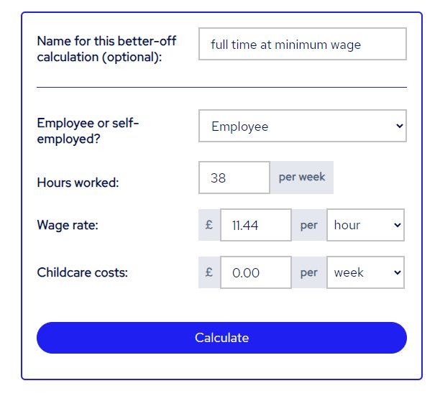
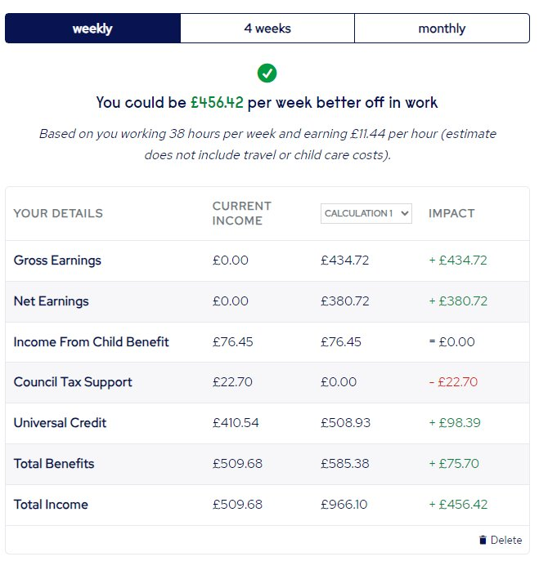
Better of Calculation – Example

Slide 5
Referrals – Work Routes Work and Health Programme
Refer someone
Good to know​
If you would like to discuss co-location arrangements, then we would welcome the opportunity to explore this further with you.
Please contact Ursula Johnston, Strategic Relationships Manager.​
​

Slide 6
Universal Credit - Collection
Follow the link to the GOV.UK website for information for stakeholders and partners

