Slide 1
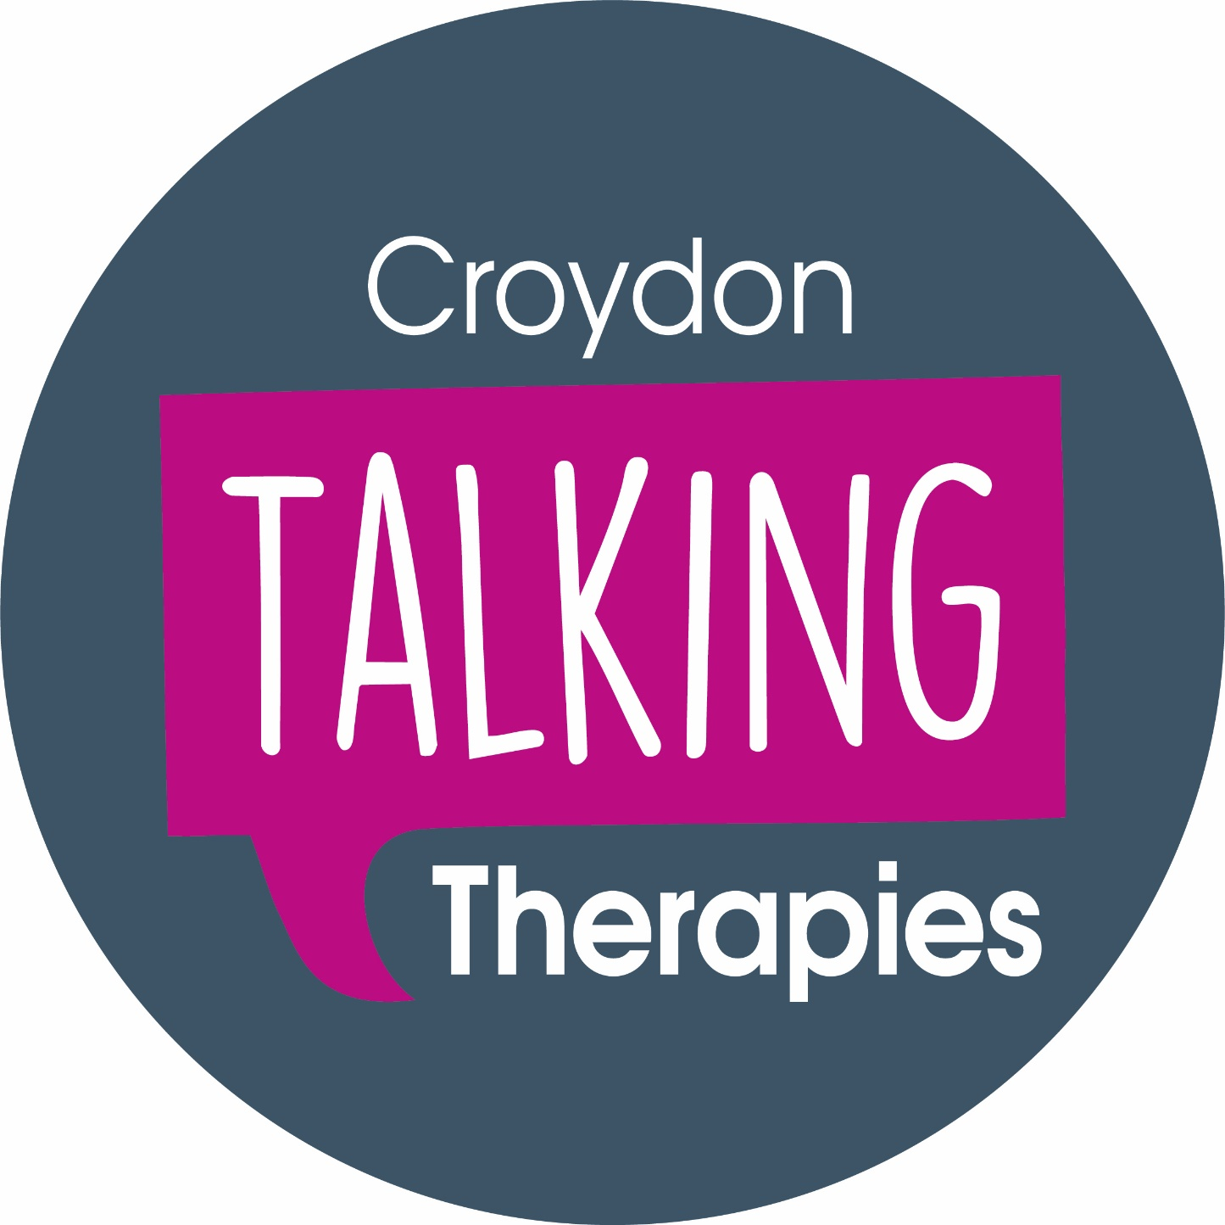
Andrew Harris, Senior Clinical Team Lead
Andrew.Harris@slam.nhs.uk

Slide 2
Agenda
Who we are & what we do
Who we help & what support we offer
How people can access our service & what happens when they do
How we can maintain resilience & wellbeing

Slide 3
Who we are
Primary Care Talking Therapies Service
Part of South London & Maudsley NHS Foundation Trust
Large team of different professionals
Assistant psychologists
Psychological Wellbeing Practitioners (PWPs)
Cognitive Behavioural Therapists
Counsellors (via partner Care To Listen)
Employment Support Advisors (via partner Work Well Croydon)
Based at Bethlem Royal Hospital, Beckenham, with satellite sites across the borough
Notes:
Highly trained & skilled from world leading institutions

Slide 4
Who we help
People with common mental health problems
Depression
Generalised anxiety (problems with managing worrying)
Panic disorder & agoraphobia
Health anxiety
Social anxiety
Obsessive Compulsive Disorder (OCD)
Post-traumatic Stress Disorder (PTSD)
Specific phobias
Mild insomnia
Distress in managing long term health conditions
Asylum seekers
Aged 17 and over (no upper age limit)
Registered with a Croydon GP or live in the Borough

Slide 5
What we do
Groups based on principles of cognitive behavioural therapy (CBT)
Supported online guided self-help based on CBT (SilverCloud)
1:1 guided self-help based on CBT
1:1 CBT (also EMDR, IPT, behavioural couples therapy for depression)
1:1 counselling (via partner Care To Listen)
Employment support (via partner Work Well Croydon)
Face-to-face, phone or video calls
Mainly 9.00-17.00 weekdays, but some early morning & evening availability

Slide 6
What does our therapy look like?
Time-limited
Up to 6 sessions for online/guided self-help & counselling
Up to 12 sessions for CBT
Proactive & collaborative
A ‘doing’ as well as a ‘talking’ therapy
Focussed on making changes in the present
Part of an ongoing process of understanding, learning, practising, reviewing, taking forward

Slide 7
What we don’t do
Treat children 16 years or younger
CAMHS
Directly treat alcohol/drug/substance misuse
Manage active suicidality or risk to others
Assessment & Liaison Service / A&E
Work with complex/severe & enduring problems
Complex PTSD, including from childhood abuse
Psychosis e.g. schizophrenia
Bipolar disorder
Personality disorder
Organic problems e.g. dementia

Slide 8
How people can access our service
Self refer online:
https://croydontalkingtherapies.nhs.uk/
Or Google ‘Croydon Talking Therapies’
Self refer by phone: 0203 228 4040
Referral from GP/other professional

Slide 9
What happens when people refer
May be screened to find out more information
Registered & sent booking link for initial telephone triage
Brief (up to 45 minutes) call to explore main problem & consider options
If offered treatment:
Booked into next appointment, or
Added to waiting list
If not, given information about accessing alternative support
Notes:
Currently no waiting list for first line options

Slide 10
Thank you
Questions?

