Slide 1
CREATE BELONG GROW
Notes:
At SU
We believe that everyone can transform their life through creative community.
We believe in the power of artistic practice to create meaning and purpose in life.
We focus on the possibilities, not on the limitations or on the illness.

Slide 2
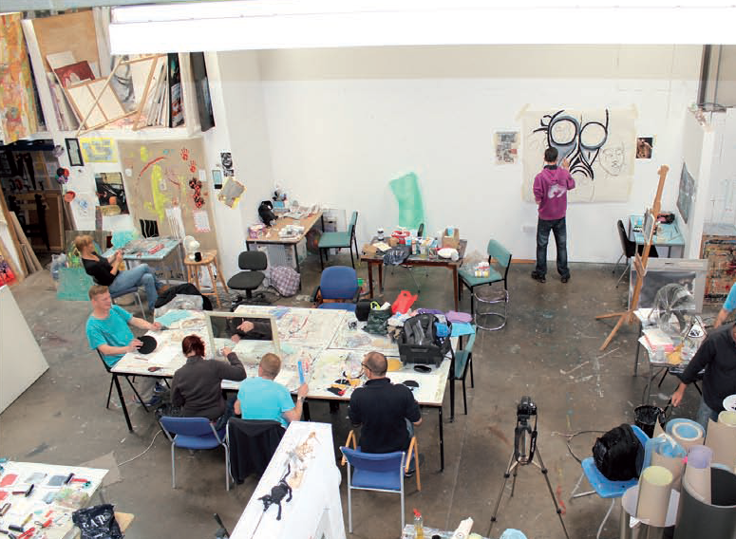
Notes:
Who are we and why are we different?
Who is this service for?
Adults 18+ interested in creative arts, living with wide range of mental health conditions and on their recovery journey.
We usually work with people who have been through a mental health crisis (the full spectrum of conditions including dual diagnosis and additional such as physical or learning difficulties. So the group is inclusive and non diagnosis specific.
SU Model:
Our way of working is characterised by how Art, Education and Group interactions/ therapy come together in one integrated package.
This model is unique because while influenced by both art education and psychotherapy, in practice it challenges both - the traditional relationship of student =teacher or therapist=client.

Slide 3
Notes:
What is the main service offer?
Therapeutic art studio group in the established Studio Upstairs model
Facilitated by 2 studio managers per group, HCPC registered, clinically supervised, trained as Art Therapists and artists
Organised forums, outings, events, publications and exhibitions
Regular individual reviews of set goals
Shared reviews of artwork and group feedback
Opportunities for volunteering, exhibiting and learning skills in this area
Art materials, specialist equipment and training to use them
When: one or two days per week, for 3-6 months+, up to 6 hours per day, 10am -5pm
Additionally we run workshops and online groups.
During and post covid we have also offered online groups, mainly for Merton residents, though there were few joining from Croydon.

Slide 4
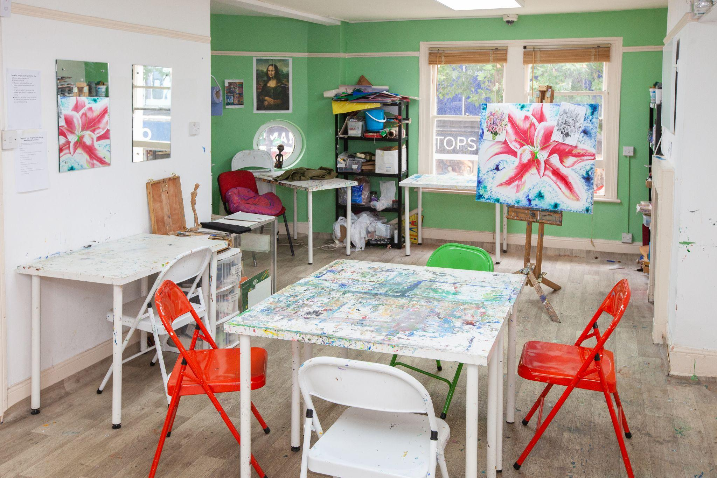
Notes:
This is what the Croydon Studio looks like now
We have groups running on Tuesday and Thursday and occasional projects and workshops during the rest of the week.
We usually use exhibitions to create further awareness of our work and to weaken the stigma around ill mental health.

Slide 5
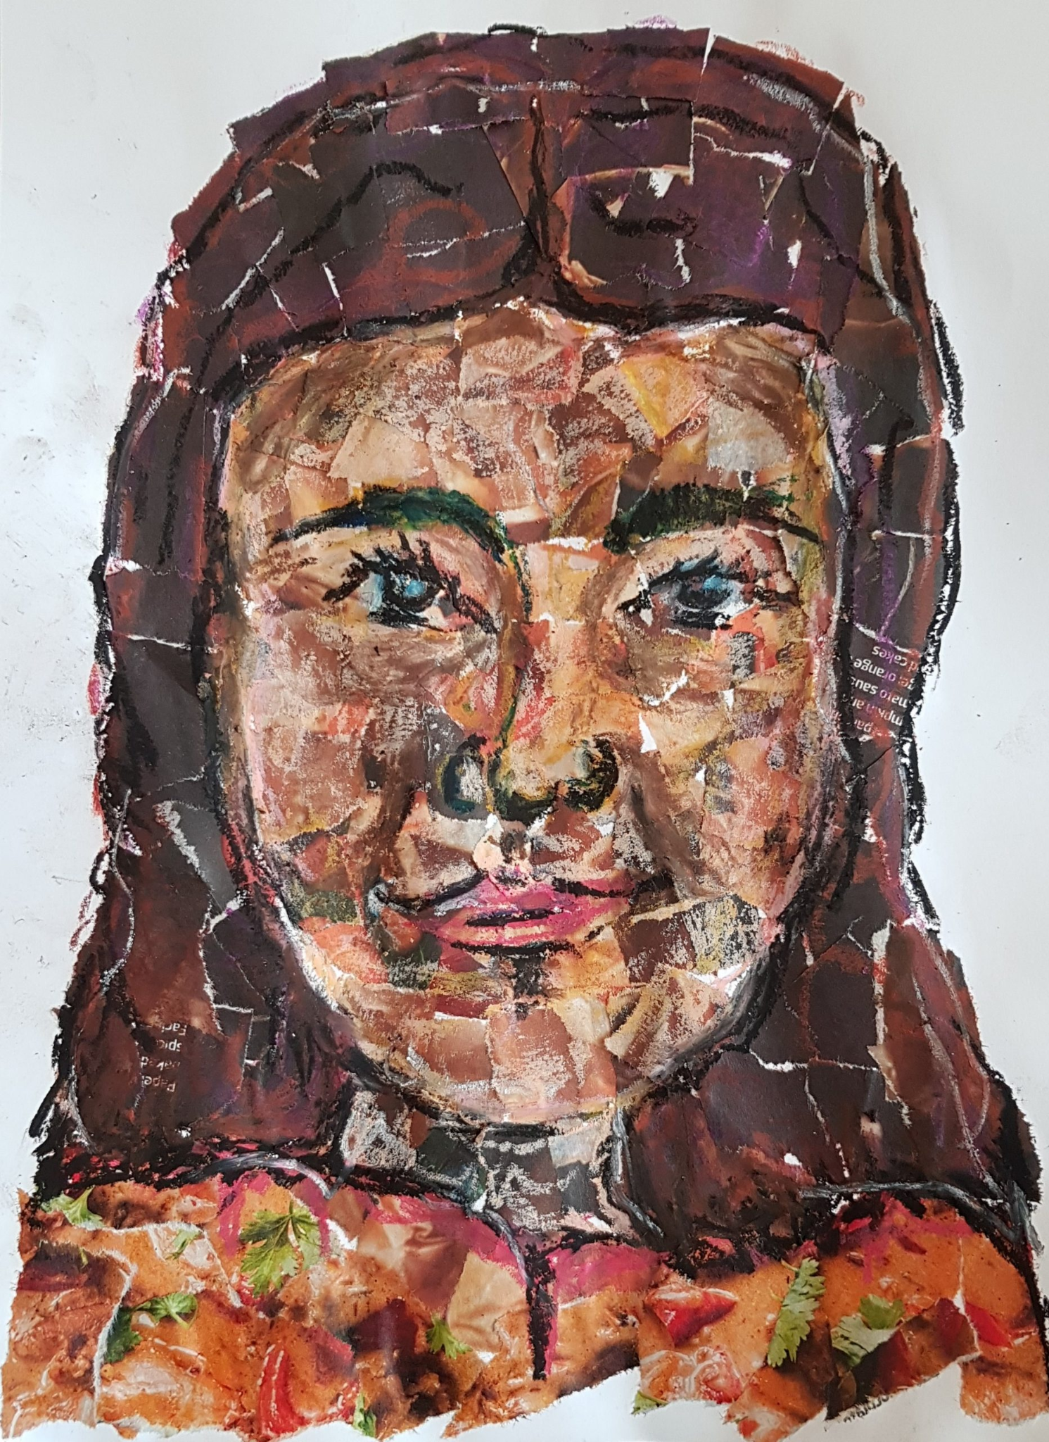
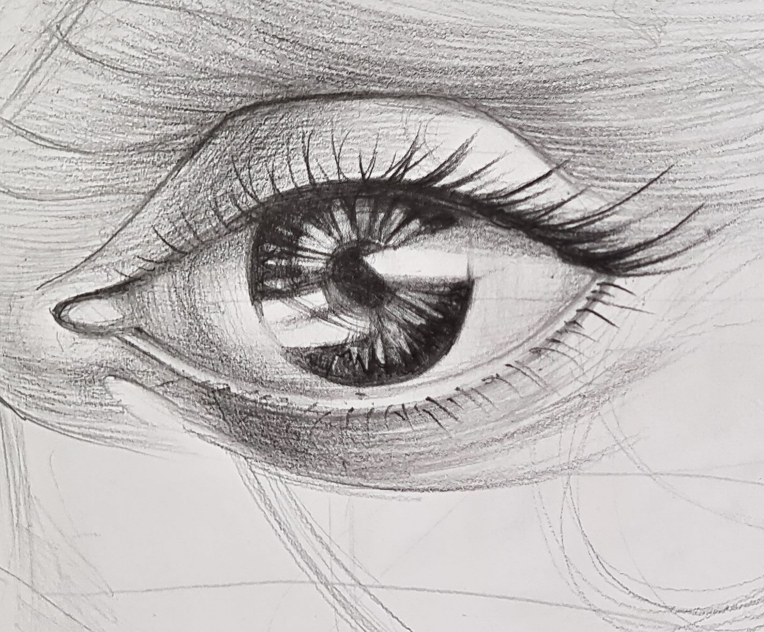
Notes:
I will quote some feedback on the group members experience
“It has been one anchor during this very difficult lockdown period, as it was also winter. I am grateful to feel comfortable being in a group even though I have been going through very intense emotions, situations and mental health difficulties. I finally got to learn different art techniques in a non-competitive environment, and I was able to finally finish a few paintings due to a desire to show something to you each week and to contribute to the exhibition. I started an acrylic painting in April 2020 and never finished it, so it has been amazing to have so many pieces of art and to really enjoy watercolours, patterns, circles, collage, acrylics and the clay.”
“I wasn't too keen when the social prescriber shared the group. I had previously only done 1:1s so I never had been in a group thing and I am interested in art but never done it myself. But since joining, it has changed my mind about groups. I will definitely join a group in the future, which i never would have done before. Maybe like a book club, or a watercolour course. It changed my mind positively.”

Slide 6
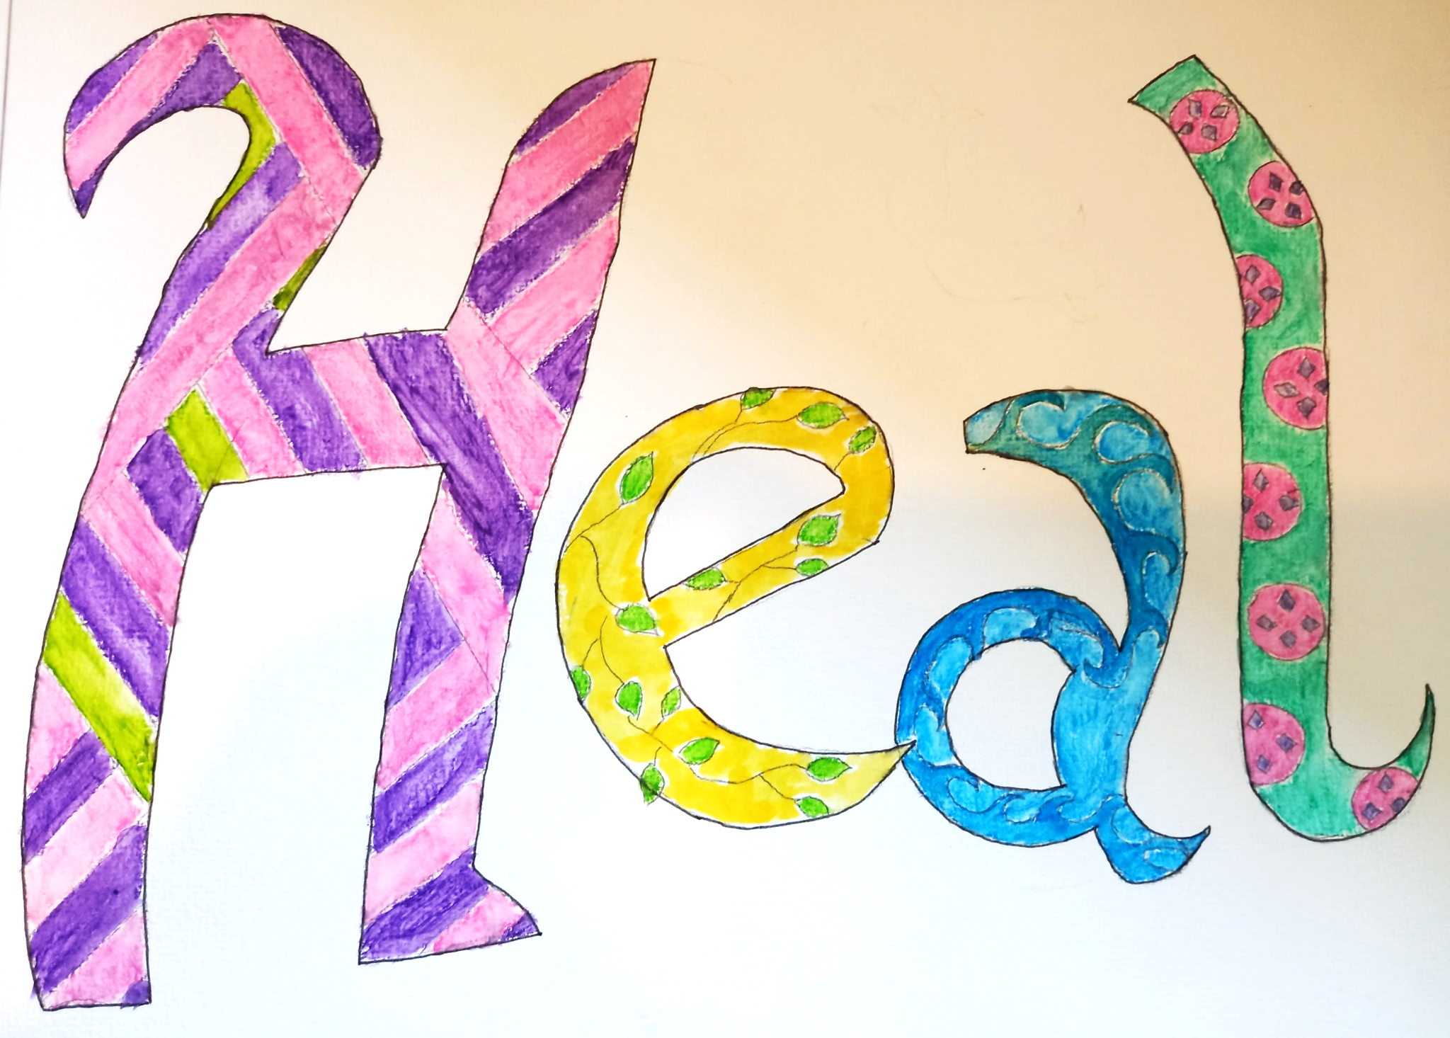
Notes:
I wanted to use bright colours that would appeal to the eye on first sight and to use patterns to add texture. It was very therapeutic to create this piece, as it has been a while since I have made art work.

Slide 7
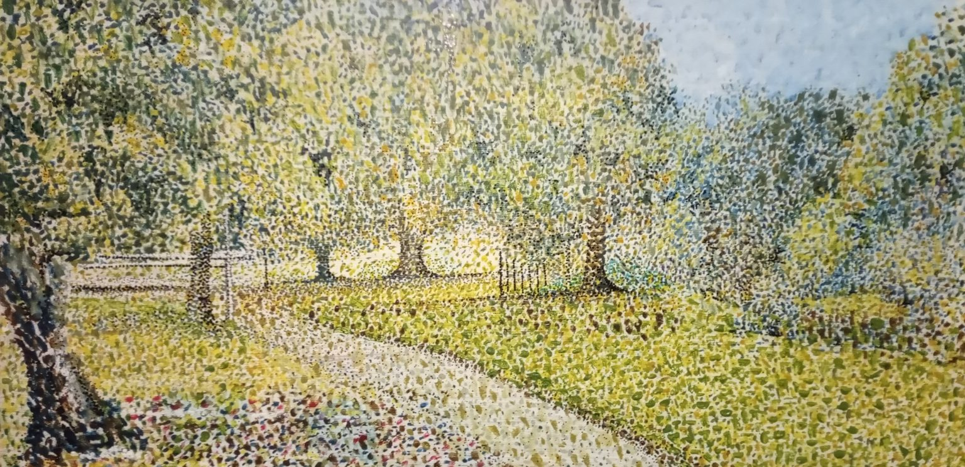
Notes:
Cost (2023)
£78 per session through either NHS Care plan or Adult Social Care support
£68 per day session on standard level of PIP, £78 per day on enhanced
£31 per day if not eligible for above, on low income and self-funding (limited places dependent on funding ad initial assessment)
The places are free when funded by a project grant (such as now from One Croydon and for Central West catchment area and for one year).

Slide 8
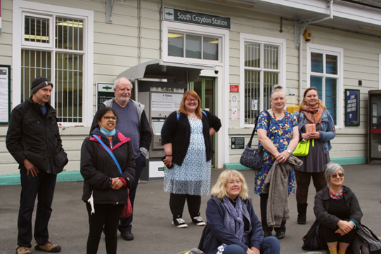
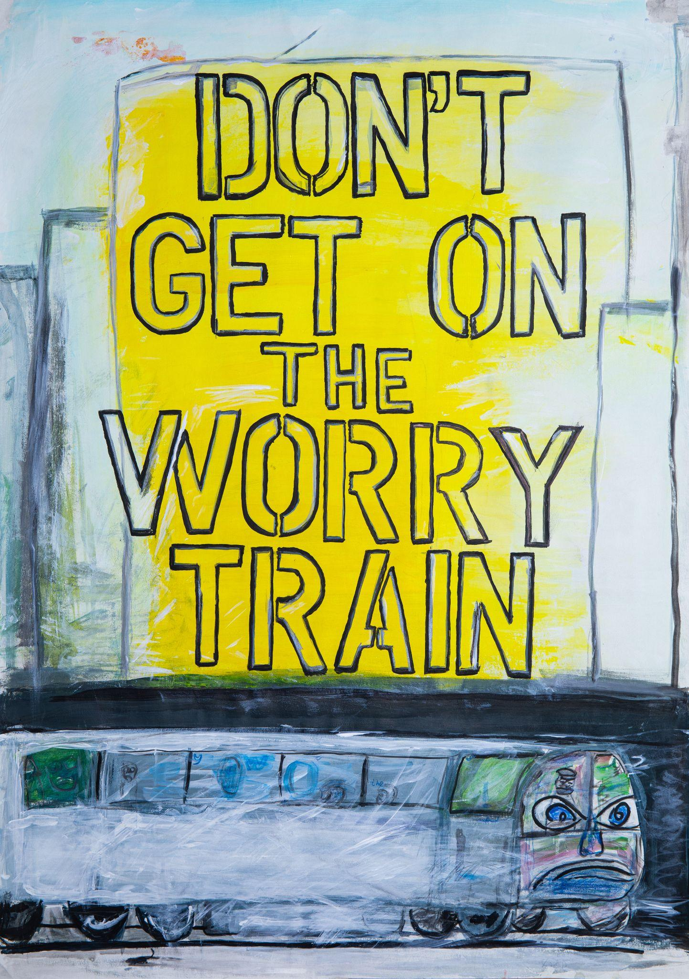
Notes:
An image from our South Croydon Station Project
Why and how to Join
Why Join Studio Upstairs? Information for potential members:
TO CREATE & LEARN:
You will have one day per week in the studio to make art. You can use the shared art materials as well as bring your own. You will learn new techniques at workshops from guest artists and peers. There are organised visits to galleries and museums.
TO FIND MEANING & GROW:
The Studio Managers are available to listen and support you to achieve your goals. By regularly immersing yourself in a supportive and creative environment, you can develop your art practice in a supportive, therapeutic environment.
TO SHARE AND BELONG:
The regular group provides an opportunity for socialising and connecting with a community of creatively minded people. You can share your art with the group with the option to participate in exhibitions, publications or to sell work in the online shop.
TO CONTRIBUTE: There are volunteer roles to take responsibility for the studio.
“Studio Upstairs helps me to express myself creatively and provides me with a welcoming and supportive community”. (Studio Member)

Slide 9
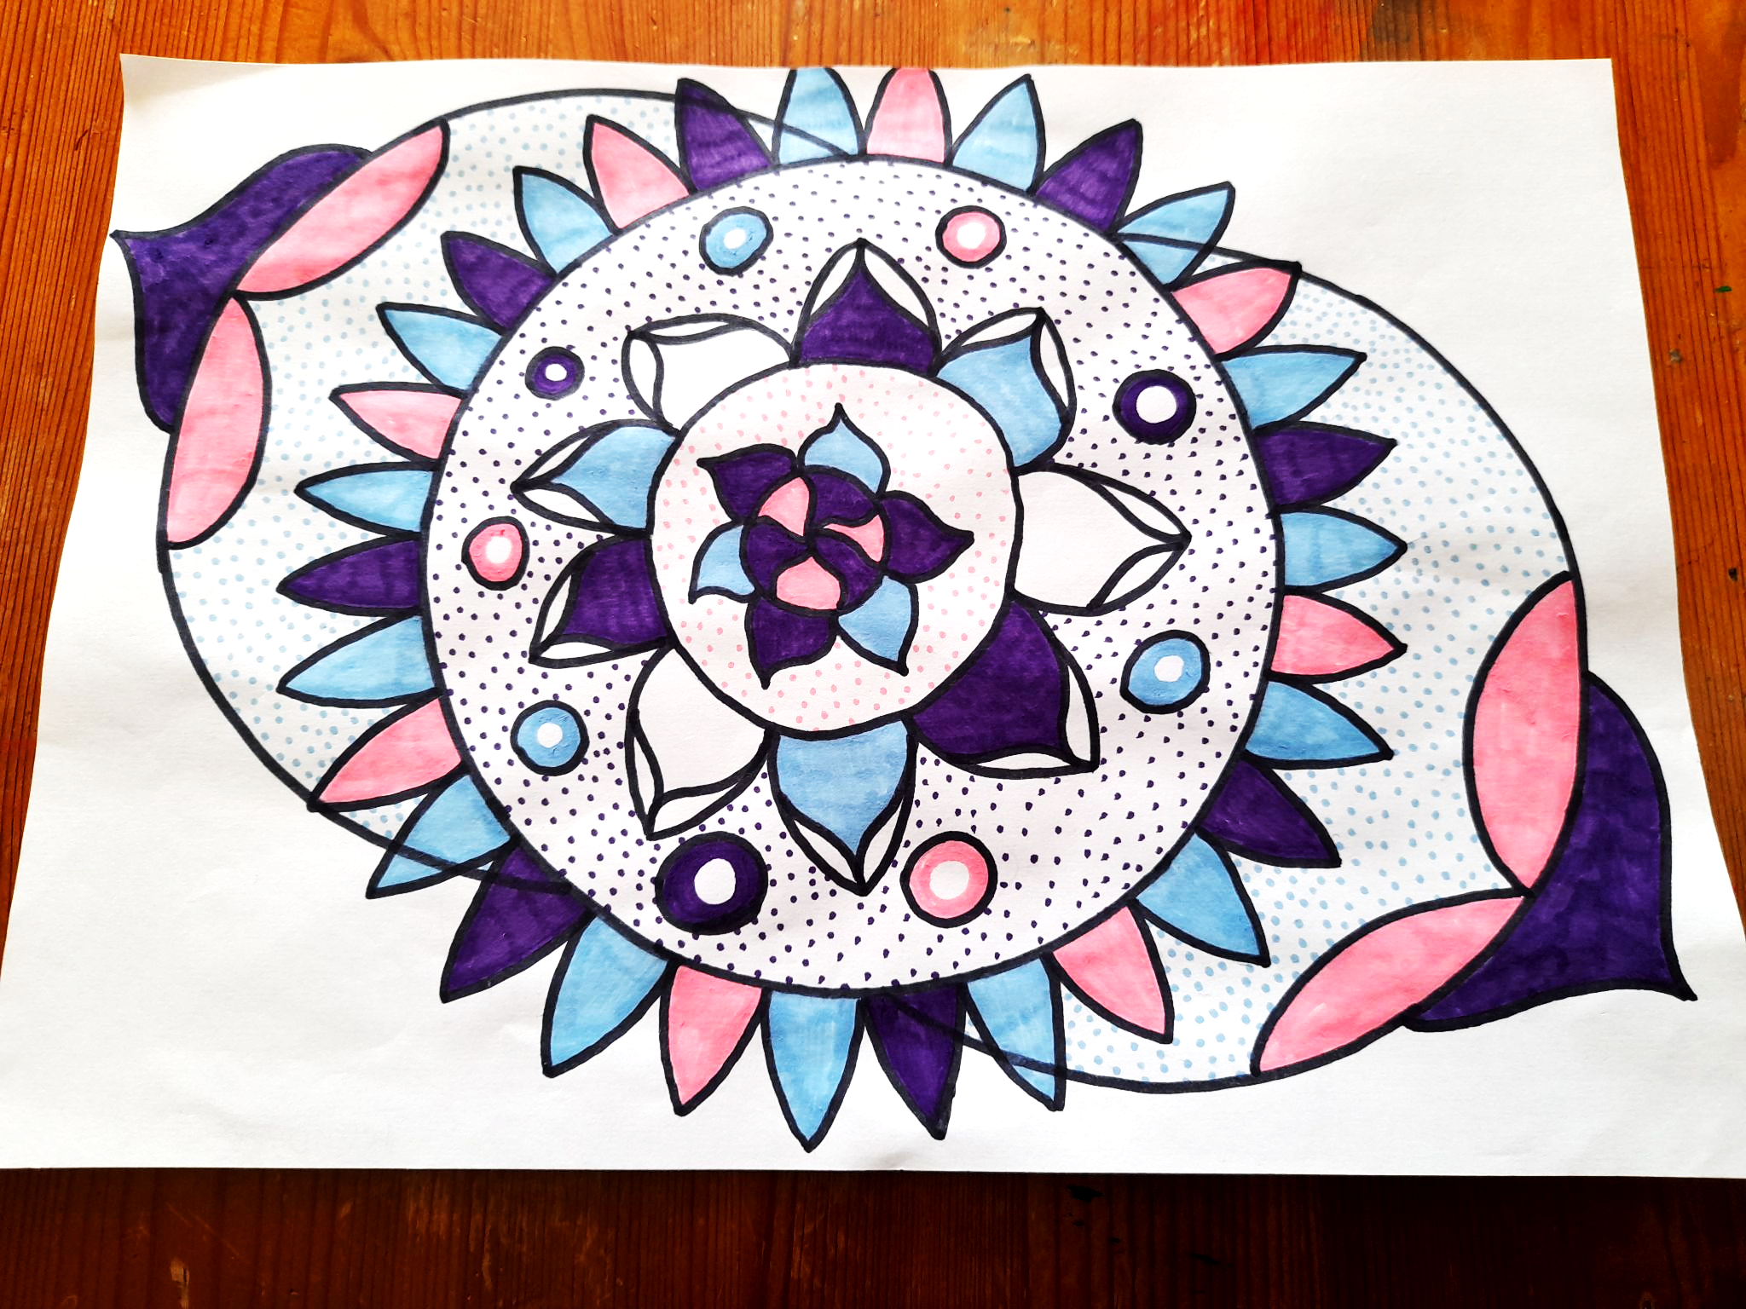
How to make a referral
southlondon@studioupstairs.org.uk
www.studioupstairs.org.uk
Notes:
People can be referred by completing the referral form online or enquiry via email or phone.
There an initial meeting / assessment and we offer free trial session.
We have an information sheet which you can use as a reference in discussion with the cliens.
………………..
Any Questions?
‹#›

