Slide 1
england.shelter.org.uk/housing_advice/homelessness/get_help_from_the_council/how_to_ask_the_council_for_help (The above link includes a template letter to make a homeless application)
How to ask the council for help
Ask for help if you're homeless now or could be in the next 8 weeks.
This is called making a homeless application.
Most people can get some help from the council's homeless team.
The council should make it easy to ask for help. You could contact them by:
phone call
online form
email to the homelessness team
going to the council offices in person
Accessing information in a way that the person understands:
The council should help you to understand any support they give. For example, they should:
get you an interpreter if you need one
give you information in a language or format you understand
Tell the council if you cannot pay for a service like translation.
It could be discrimination if you ask for help with these things but they refuse.

Slide 2
Things that help build a legal case:
E I R C
E = Evidence
I = Identify
R = Report
C = Connect
If you are seeing systemic issues impacting someone housing or access to homeless support, share it with Rhi at South West London Law Centres so we can collectively challenge these issues.

Slide 3
​
SWLLC can help with some of the housing related issues that can lead to homelessness. ​
Some housing issues will require early and immediate advice to prevent the issues escalating. ​Such as money advice to avoid rent arrears. People can attend our Turn Up Tuesdays at our Croydon offices!
We also have a 'Duty Scheme' at Croydon County Court which provides on the day advice and representation. Make sure the resident asks for the 'duty solicitor' when attending court. It is really important they attend court and take any relevant documents with them.
​ Some issues may also require your support to help with a situation...

Slide 4
How to make strong referral to SWLLC
Is the issue something we assist with
Are there any key dates (ie: court hearings, appeals, reviews)
Has a formal complaint been made by the resident (if relevant)
Is the person legal aidable
Does anyone in the household have a disability and/or health issues, how severe is the health issue – is there evidence
If asking for help because a homeless application has been refused, outline why the application has been refused and why you/they think the refusal is wrong ie: the person has been found not in priority need

Slide 5
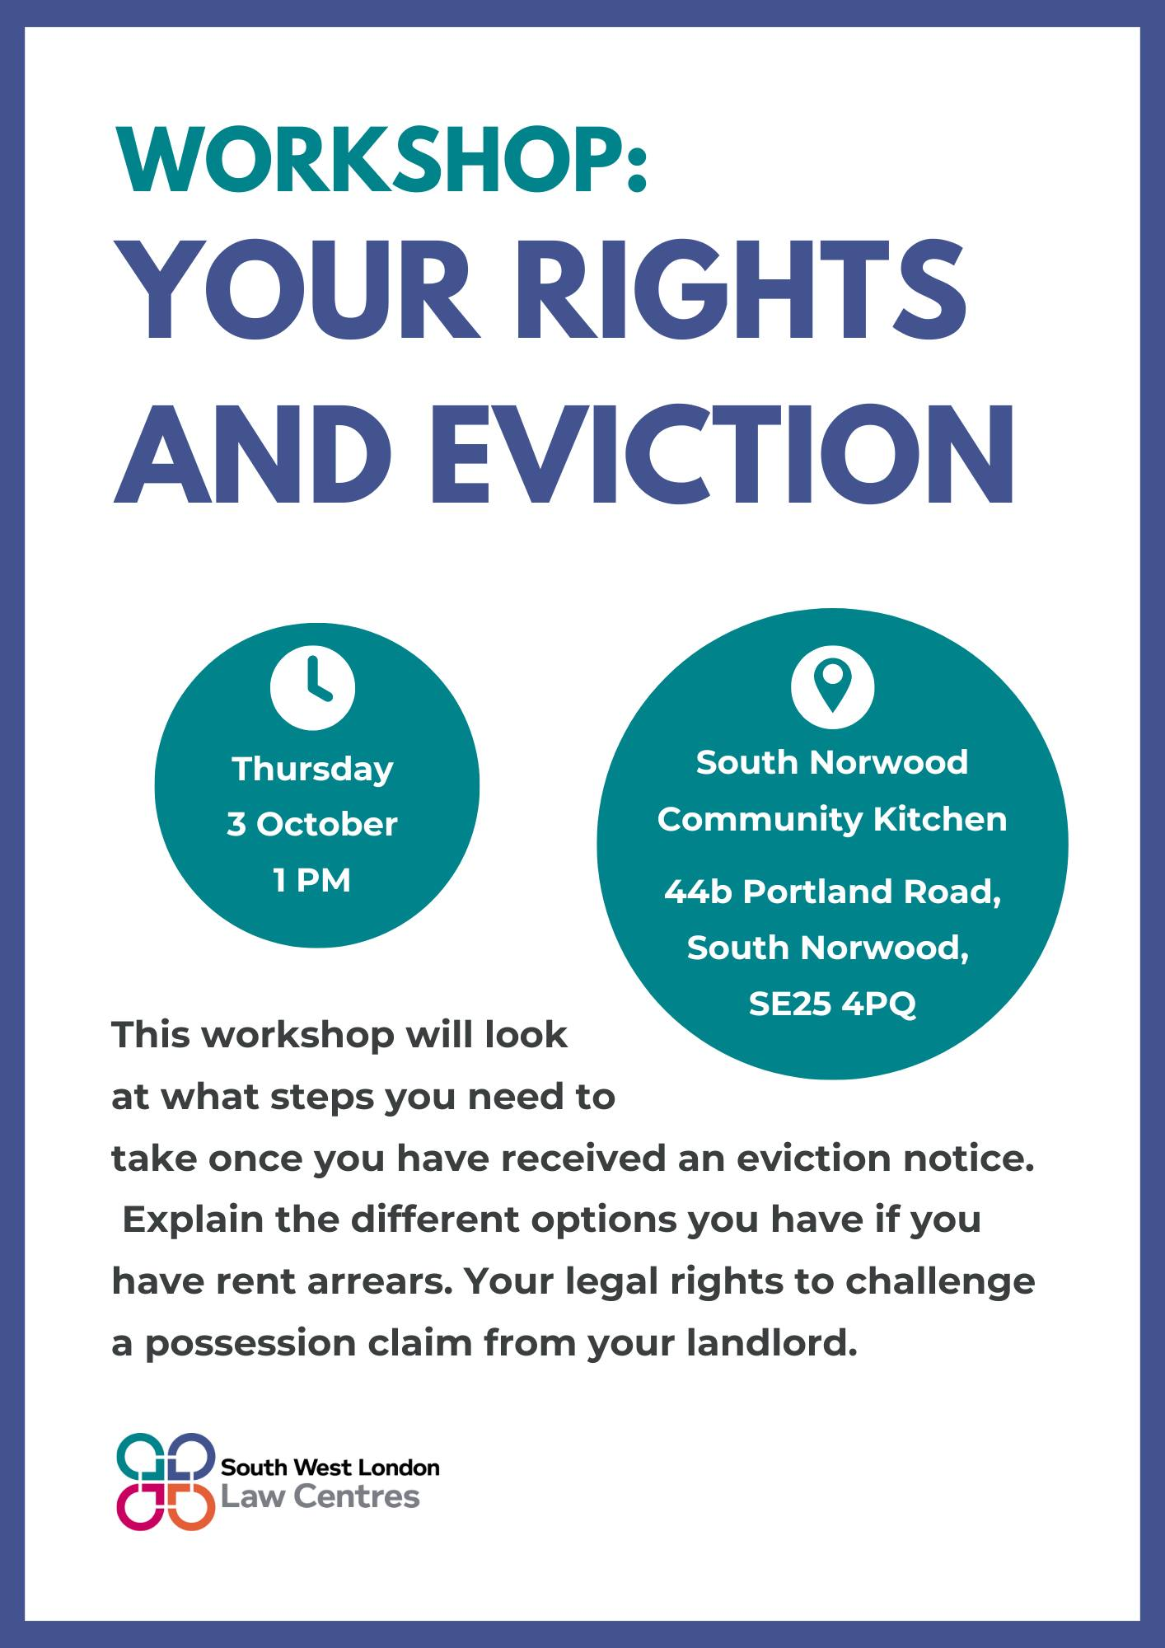
We are at South Norwood Community Kitchen on the 1st Thursday of the month from 1pm!
Carrying out 'Know Our Rights' workshops or 1 to 1 advice
Holding our Temporary Accommodation Action Groups
This week we have a "Your Rights and Eviction" workshop ---->
On the 17th October we have an online lunch time workshop on:
1. Landlord refusing to return tenancy deposit
2. Landlord refusing to carry out repairs
3. Wanting to leave a rented property before the
Sign up to our Social Justice Network to get updates by emailing community@swllc.org saying "sign me up".

Slide 6
What is priority need? A priority need is a reason the council must give you more help with your homelessness if you are homeless now or could be homeless in the next two months. If you are homeless and have a priority need the council should give you emergency housing if you require it.
Some priority needs are absolute such as:
If you are pregnant or have children (under 18), homeless because of *domestic abuse, aged 18 to 20 and were in case when aged 16 to 17.
Domestic abuse includes:
*Intimate partners, ex-partners, family members or individuals who share parental responsibility for a child. There is no requirement for the victim and perpetrator to live in the same household. If the person at risk is under 16, this may be considered child abuse.
What does vulnerable mean? The local authority may insist you need to be vulnerable to receive their help. In housing law, this means you are more at risk if you are homeless than most other people.
You may be able to demonstrate the person you are supporting is more vulnerable because of:
An illness, disability or serious health condition
(there are also some special conditions you may be considered priority need)
~ Evidence to prove illness, disability or serious health condition will be really important ~
If anyone would like to learn more about this you could complete the Law for Life guide on "Home to Support Homeless People and Those Threatened with Homelessness" https://www.advicenow.org.uk/lawforlife/how-support-homeless-people-and-those-threatened-homelessness

Slide 7
Complaints are a formal route for residents or groups to raise an issue – when to make a complaint to the council
When to make a complaint to the council - raising issues through the formal complaint process can be a really good way to escalate an issue when the council isn't acting appropriately.
It is good to report the issue first and raise a complaint if not dealt with.
Depending on the type of housing issue, going through the formal complaint process also allows you to escalate the issue to Local Government and Social Service Ombudsman or the Housing Ombudsman.
The Local Government and Social Service Ombudsman (www.lgo.org.uk/how-to-complain) says it:
"The Local Government and Social Care Ombudsman (LGSCO) looks at complaints about councils and some other authorities and organisations, including education admissions appeal panels and adult social care providers (such as care homes and home care providers)" the things this ombudsman covers include: the council handling of homeless applications, possessions kept in council storage, if there is a failure to deal with repairs in temporary accommodation.
The Housing Ombudsman (www.housing-ombudsman.org.uk) says:
"We investigate complaints from residents about landlord’s housing management – for example, property condition and repairs, charges, complaint handling and how a landlord is responding to antisocial behaviour that is affecting a resident in their home."
To escalate issues to the Ombudsmans you often need to have exhausted the local authority complaint procedure. You can raise a complaint by visit this webpage: www.croydon.gov.uk/council-and-elections/make-comment-or-complaint-and-have-your-say/comments-and-complaints-procedures/making-complaint
Or complaints can also be submitted in writing, by email, or by telephone to:
Complaints Resolutions Team 7th Floor, Zone D Bernard Weatherill House 8 Mint Walk Croydon CR0 1EA
Phone: 020 8726 6000 ext 44010 Email: complaints@croydon.gov.uk

Slide 8
Nightwatch -
Is anyone from Nightwatch in the room?
What support could this forum offer to Nightwatch?

