Slide 1
The Future of Commissioning…
Bianca Byrne, Director of Commissioning, Policy & Improvement, Adult Social Care & Health
Hilary Williams, Interim Joint Director – Transformation & Commissioning, CHS & SWL ICB Croydon Place
November 2023

Slide 2
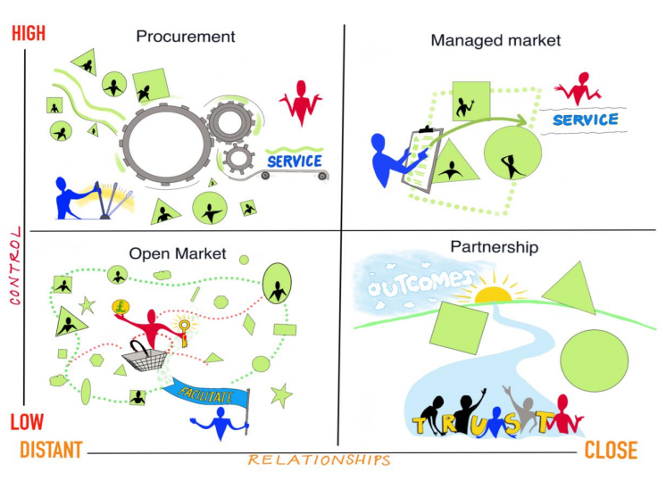
…is relational!
Choice & control
Long-term stability & outcomes
Notes:
Delivery of the Croydon Renewal plan and MTFS are imperative to the future functioning of the council. Leadership, strong governance, robust internal controls and delivery are essential components of the improvement journey and imperative to rebuilding trust with our community and staff. We must collectively, and I will personally, remain focussed on driving the cost of care down through savings on both placement spend and commissioned contracts, however alongside delivering the immediate and required savings – I will lead the team to be more intelligent about the way we commission services and support our operational teams to access the right services at the right time for people to ensure the long term sustainability of the Directorate.
The Adult Social Care Strategy sets out the vision for how we will deliver services moving forward, it is a critical document to communicating how we will do this to both our community and our staff, with robust delivery managed and monitored through the Improvement Plan. I will work alongside the senior management team, and lead by example in modelling the energy, drive, pace and enthusiasm to ensure the strategy and improvement plan are delivered. Commissioning is an essential component in the plan to ensure that the services we design and develop are best value, outcomes focussed, strengths-based and at every stage of intervention maximise independence and manage demand.
Working with our health colleagues to support the transition to an Integrated Care System and deliver the Health & Care Plan is critical to both system sustainability and ensuring that ASCH remains a strong and influential partner in delivery of the best health and care outcomes for the people of Croydon. I am working alongside our health and voluntary sector colleagues to design the future governance arrangements and ways of working to ensure this happens and will progress development of integrated commissioning intentions and plans.
I will provide and nurture strong Leadership across the system, the Directorate and within my team. I have a motivational, energetic and enthusiastic style and a deep passion for delivering the best quality outcomes and services. I am change-oriented and highly experienced in leading on and delivering large change programmes. I recognise and value every member of staff’s contribution and lead from the front – talking the talk but also walking the walk. Collective and individual responsibility. Own mistakes and learn from them
And so to the Art of Commissioning… I will co-design with the team a model of commissioning that is creative, co-produced and asset-based, driven by a strong evidence-base and delivering new approaches that deliver better outcomes with and for our community.

Slide 3
Key ingredients for a successful long-term relationship
Equal and shared responsibility – individual, community, ‘commissioner’, ‘provider’
Collaboration and trust – innovation willingness and capacity, freedom to experiment, moving away from transactional mentality
Comprehensive co-production – acknowledging the responsibility of our impact, not in silo but as a wider economy
Integrating mechanisms for commissioners and provider – e.g. joint service design and assessment, joined up approach to user and community co-production
Multiple funding mechanisms – match funding, social investment, joint funding agreements
To procure or not to procure? – flexible (or no?!) procurement and contracting mechanisms
Learning and measuring – moving towards an approach where evaluation is the way to measure progress and success
Notes:
Delivery of the Croydon Renewal plan and MTFS are imperative to the future functioning of the council. Leadership, strong governance, robust internal controls and delivery are essential components of the improvement journey and imperative to rebuilding trust with our community and staff. We must collectively, and I will personally, remain focussed on driving the cost of care down through savings on both placement spend and commissioned contracts, however alongside delivering the immediate and required savings – I will lead the team to be more intelligent about the way we commission services and support our operational teams to access the right services at the right time for people to ensure the long term sustainability of the Directorate.
The Adult Social Care Strategy sets out the vision for how we will deliver services moving forward, it is a critical document to communicating how we will do this to both our community and our staff, with robust delivery managed and monitored through the Improvement Plan. I will work alongside the senior management team, and lead by example in modelling the energy, drive, pace and enthusiasm to ensure the strategy and improvement plan are delivered. Commissioning is an essential component in the plan to ensure that the services we design and develop are best value, outcomes focussed, strengths-based and at every stage of intervention maximise independence and manage demand.
Working with our health colleagues to support the transition to an Integrated Care System and deliver the Health & Care Plan is critical to both system sustainability and ensuring that ASCH remains a strong and influential partner in delivery of the best health and care outcomes for the people of Croydon. I am working alongside our health and voluntary sector colleagues to design the future governance arrangements and ways of working to ensure this happens and will progress development of integrated commissioning intentions and plans.
I will provide and nurture strong Leadership across the system, the Directorate and within my team. I have a motivational, energetic and enthusiastic style and a deep passion for delivering the best quality outcomes and services. I am change-oriented and highly experienced in leading on and delivering large change programmes. I recognise and value every member of staff’s contribution and lead from the front – talking the talk but also walking the walk. Collective and individual responsibility. Own mistakes and learn from them
And so to the Art of Commissioning… I will co-design with the team a model of commissioning that is creative, co-produced and asset-based, driven by a strong evidence-base and delivering new approaches that deliver better outcomes with and for our community.

Slide 4
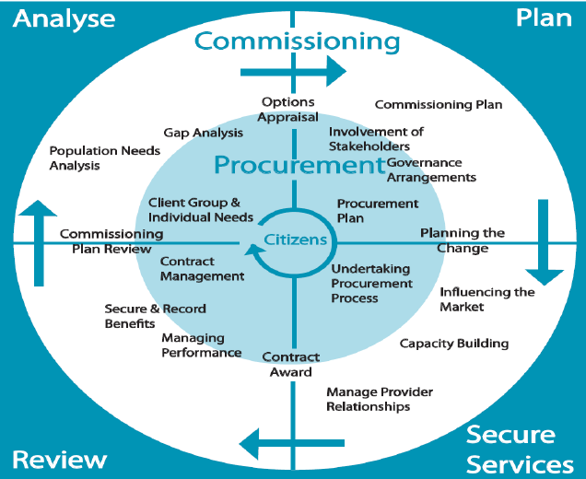
Locality & strategic
Locality Commissioning Model
Local Community Plans
Community-led activity
Impact & outcomes
Notes:
Delivery of the Croydon Renewal plan and MTFS are imperative to the future functioning of the council. Leadership, strong governance, robust internal controls and delivery are essential components of the improvement journey and imperative to rebuilding trust with our community and staff. We must collectively, and I will personally, remain focussed on driving the cost of care down through savings on both placement spend and commissioned contracts, however alongside delivering the immediate and required savings – I will lead the team to be more intelligent about the way we commission services and support our operational teams to access the right services at the right time for people to ensure the long term sustainability of the Directorate.
The Adult Social Care Strategy sets out the vision for how we will deliver services moving forward, it is a critical document to communicating how we will do this to both our community and our staff, with robust delivery managed and monitored through the Improvement Plan. I will work alongside the senior management team, and lead by example in modelling the energy, drive, pace and enthusiasm to ensure the strategy and improvement plan are delivered. Commissioning is an essential component in the plan to ensure that the services we design and develop are best value, outcomes focussed, strengths-based and at every stage of intervention maximise independence and manage demand.
Working with our health colleagues to support the transition to an Integrated Care System and deliver the Health & Care Plan is critical to both system sustainability and ensuring that ASCH remains a strong and influential partner in delivery of the best health and care outcomes for the people of Croydon. I am working alongside our health and voluntary sector colleagues to design the future governance arrangements and ways of working to ensure this happens and will progress development of integrated commissioning intentions and plans.
I will provide and nurture strong Leadership across the system, the Directorate and within my team. I have a motivational, energetic and enthusiastic style and a deep passion for delivering the best quality outcomes and services. I am change-oriented and highly experienced in leading on and delivering large change programmes. I recognise and value every member of staff’s contribution and lead from the front – talking the talk but also walking the walk. Collective and individual responsibility. Own mistakes and learn from them
And so to the Art of Commissioning… I will co-design with the team a model of commissioning that is creative, co-produced and asset-based, driven by a strong evidence-base and delivering new approaches that deliver better outcomes with and for our community.

Slide 5
Thank you for your passion and dedication!
Notes:
Delivery of the Croydon Renewal plan and MTFS are imperative to the future functioning of the council. Leadership, strong governance, robust internal controls and delivery are essential components of the improvement journey and imperative to rebuilding trust with our community and staff. We must collectively, and I will personally, remain focussed on driving the cost of care down through savings on both placement spend and commissioned contracts, however alongside delivering the immediate and required savings – I will lead the team to be more intelligent about the way we commission services and support our operational teams to access the right services at the right time for people to ensure the long term sustainability of the Directorate.
The Adult Social Care Strategy sets out the vision for how we will deliver services moving forward, it is a critical document to communicating how we will do this to both our community and our staff, with robust delivery managed and monitored through the Improvement Plan. I will work alongside the senior management team, and lead by example in modelling the energy, drive, pace and enthusiasm to ensure the strategy and improvement plan are delivered. Commissioning is an essential component in the plan to ensure that the services we design and develop are best value, outcomes focussed, strengths-based and at every stage of intervention maximise independence and manage demand.
Working with our health colleagues to support the transition to an Integrated Care System and deliver the Health & Care Plan is critical to both system sustainability and ensuring that ASCH remains a strong and influential partner in delivery of the best health and care outcomes for the people of Croydon. I am working alongside our health and voluntary sector colleagues to design the future governance arrangements and ways of working to ensure this happens and will progress development of integrated commissioning intentions and plans.
I will provide and nurture strong Leadership across the system, the Directorate and within my team. I have a motivational, energetic and enthusiastic style and a deep passion for delivering the best quality outcomes and services. I am change-oriented and highly experienced in leading on and delivering large change programmes. I recognise and value every member of staff’s contribution and lead from the front – talking the talk but also walking the walk. Collective and individual responsibility. Own mistakes and learn from them
And so to the Art of Commissioning… I will co-design with the team a model of commissioning that is creative, co-produced and asset-based, driven by a strong evidence-base and delivering new approaches that deliver better outcomes with and for our community.

