Slide 1
Croydon Drop In
Supporting infants, children, young people and families
for 45 years 1978 – 2023
Information, Advocacy, Counselling, Outreach, Training
and Health Education in Communities & Schools
020 8680 0404
www.croydondropin.org.uk
enquiries@croydondropin.org.uk

Slide 2
Who are we?
qYoung People’s Participation Group qOutreach - Talkbus qCounselling for 10-25 year olds qCounselling in Educational Settings qAdvice, Rights & Advocacy Service qParent Infant Partnership (0-2 yr olds)
qGo Further Go Higher Transition Service qMental Health Support Teams in Schools (partnered with Off The Record)
rParent/Carer Support:Help Is At Hand

Slide 3
The current picture:
Anxiety is the default presenting issue
40% of Young People coming through our door report having suicidal thoughts
40% of Young People coming through our door are reporting self harm
Increased sleep difficulty, lower attention spans, poor nutrition, lack of exercise, intrusive technology
Socio-economic pressures, climate change and low confidence about the future
Volume of workload and the fastest-growing population of young people in London
Fluctuations in the workforce since Covid
Short-term funding hinders ability to plan longitudinal service delivery or offer job security
Increased competition for funding and scarcity of opportunity from regional/national Grants & Trusts
A Borough in exceptional financial difficulties
An exceptionally talented and resourceful local Voluntary Sector

Slide 4
The Talkbus & Outreach Team
A Safe Space for children, young people & families
Operating in numerous locations across Croydon
Friendly and welcoming staff
Main current presenting issues: anxiety, low mood, suicidal ideation, self-harm, family & peer relationships, exam stress, personal safety, sleeping difficulty
Two separate rooms offering privacy
Potential footfall per annum = 5500 individuals
Coming to a neighbourhood near you!

Slide 5
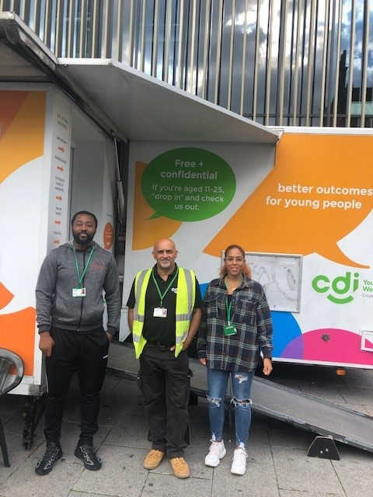
Outreach/Talkbus Service
Safe Space creating an environment for children and young people who may be in crisis, to receive help and advice through Croydon Drop In services with support from SLAM, CUH, LBC and the ICS. This service will help ensure that young people have access to appropriate care and support in the community.
Go Further Go Higher: support for apprentices, FE students, Undergrads and Postgrads returning to Croydon looking for support with Mental Health issues.
Young People’s Participation Group: for 16-21 year olds who have accessed Mental Health services – make friends, volunteer for CDI and give back!
Custody Suite Project: partner with Off The Record working with 10+ yr olds who’ve been detained in custody and nedding ongoing support.
Help Is At Hand: Parent & Carer Helpline 07592 037 823 1pm - 6pm Monday to Friday
Croydon Young People’s Engagement Group commissioned by SWL ICS CYP MH Transformation.
Health Education workshops delivered to Primary, Secondary Schools & FE settings (Sexuality & Gender Identity, Drugs & Alcohol, Sleep, Knife Crime, Stretched Not Stressed)
‘A Cronx Tale’: educational animated film themed on gangs and youth violence (released in Autumn 2023)

Slide 6
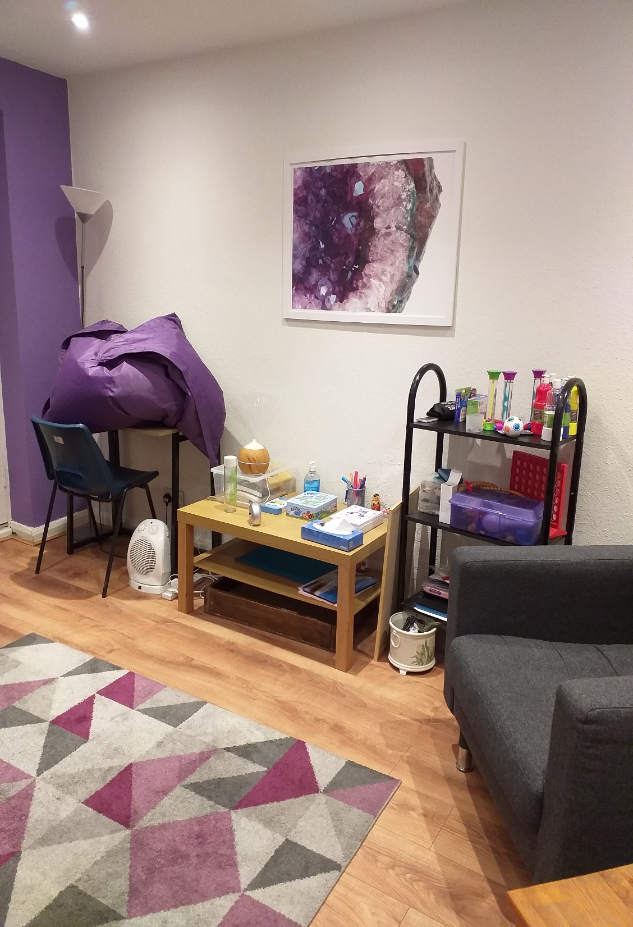
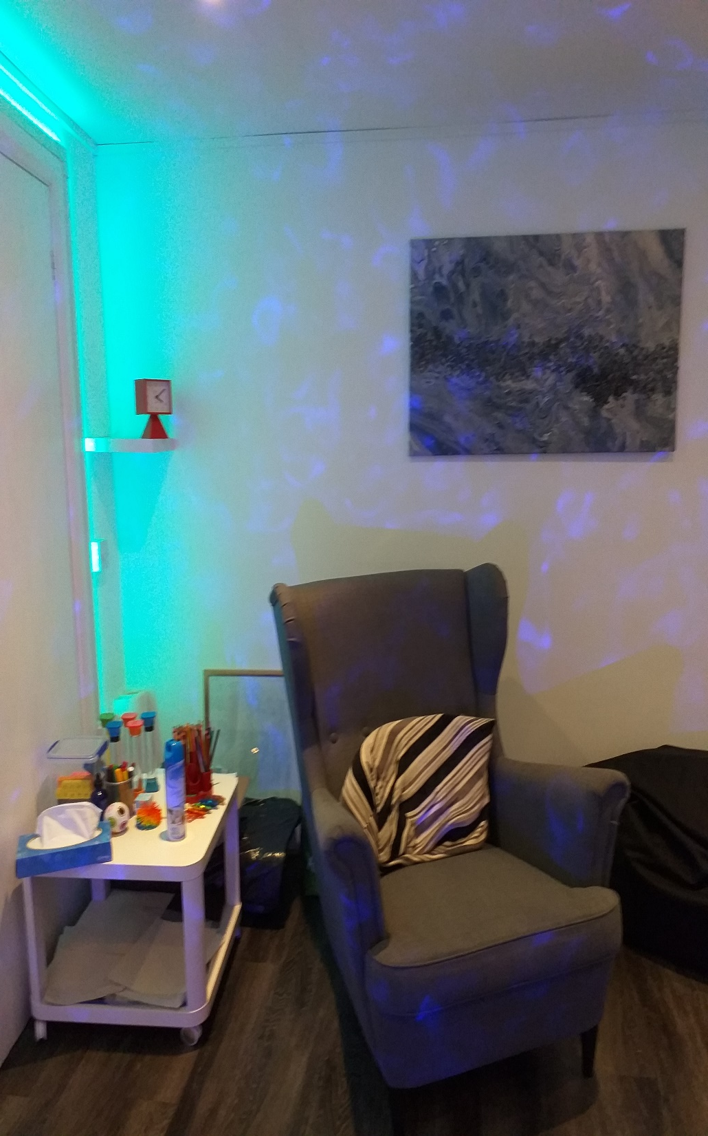

Slide 7
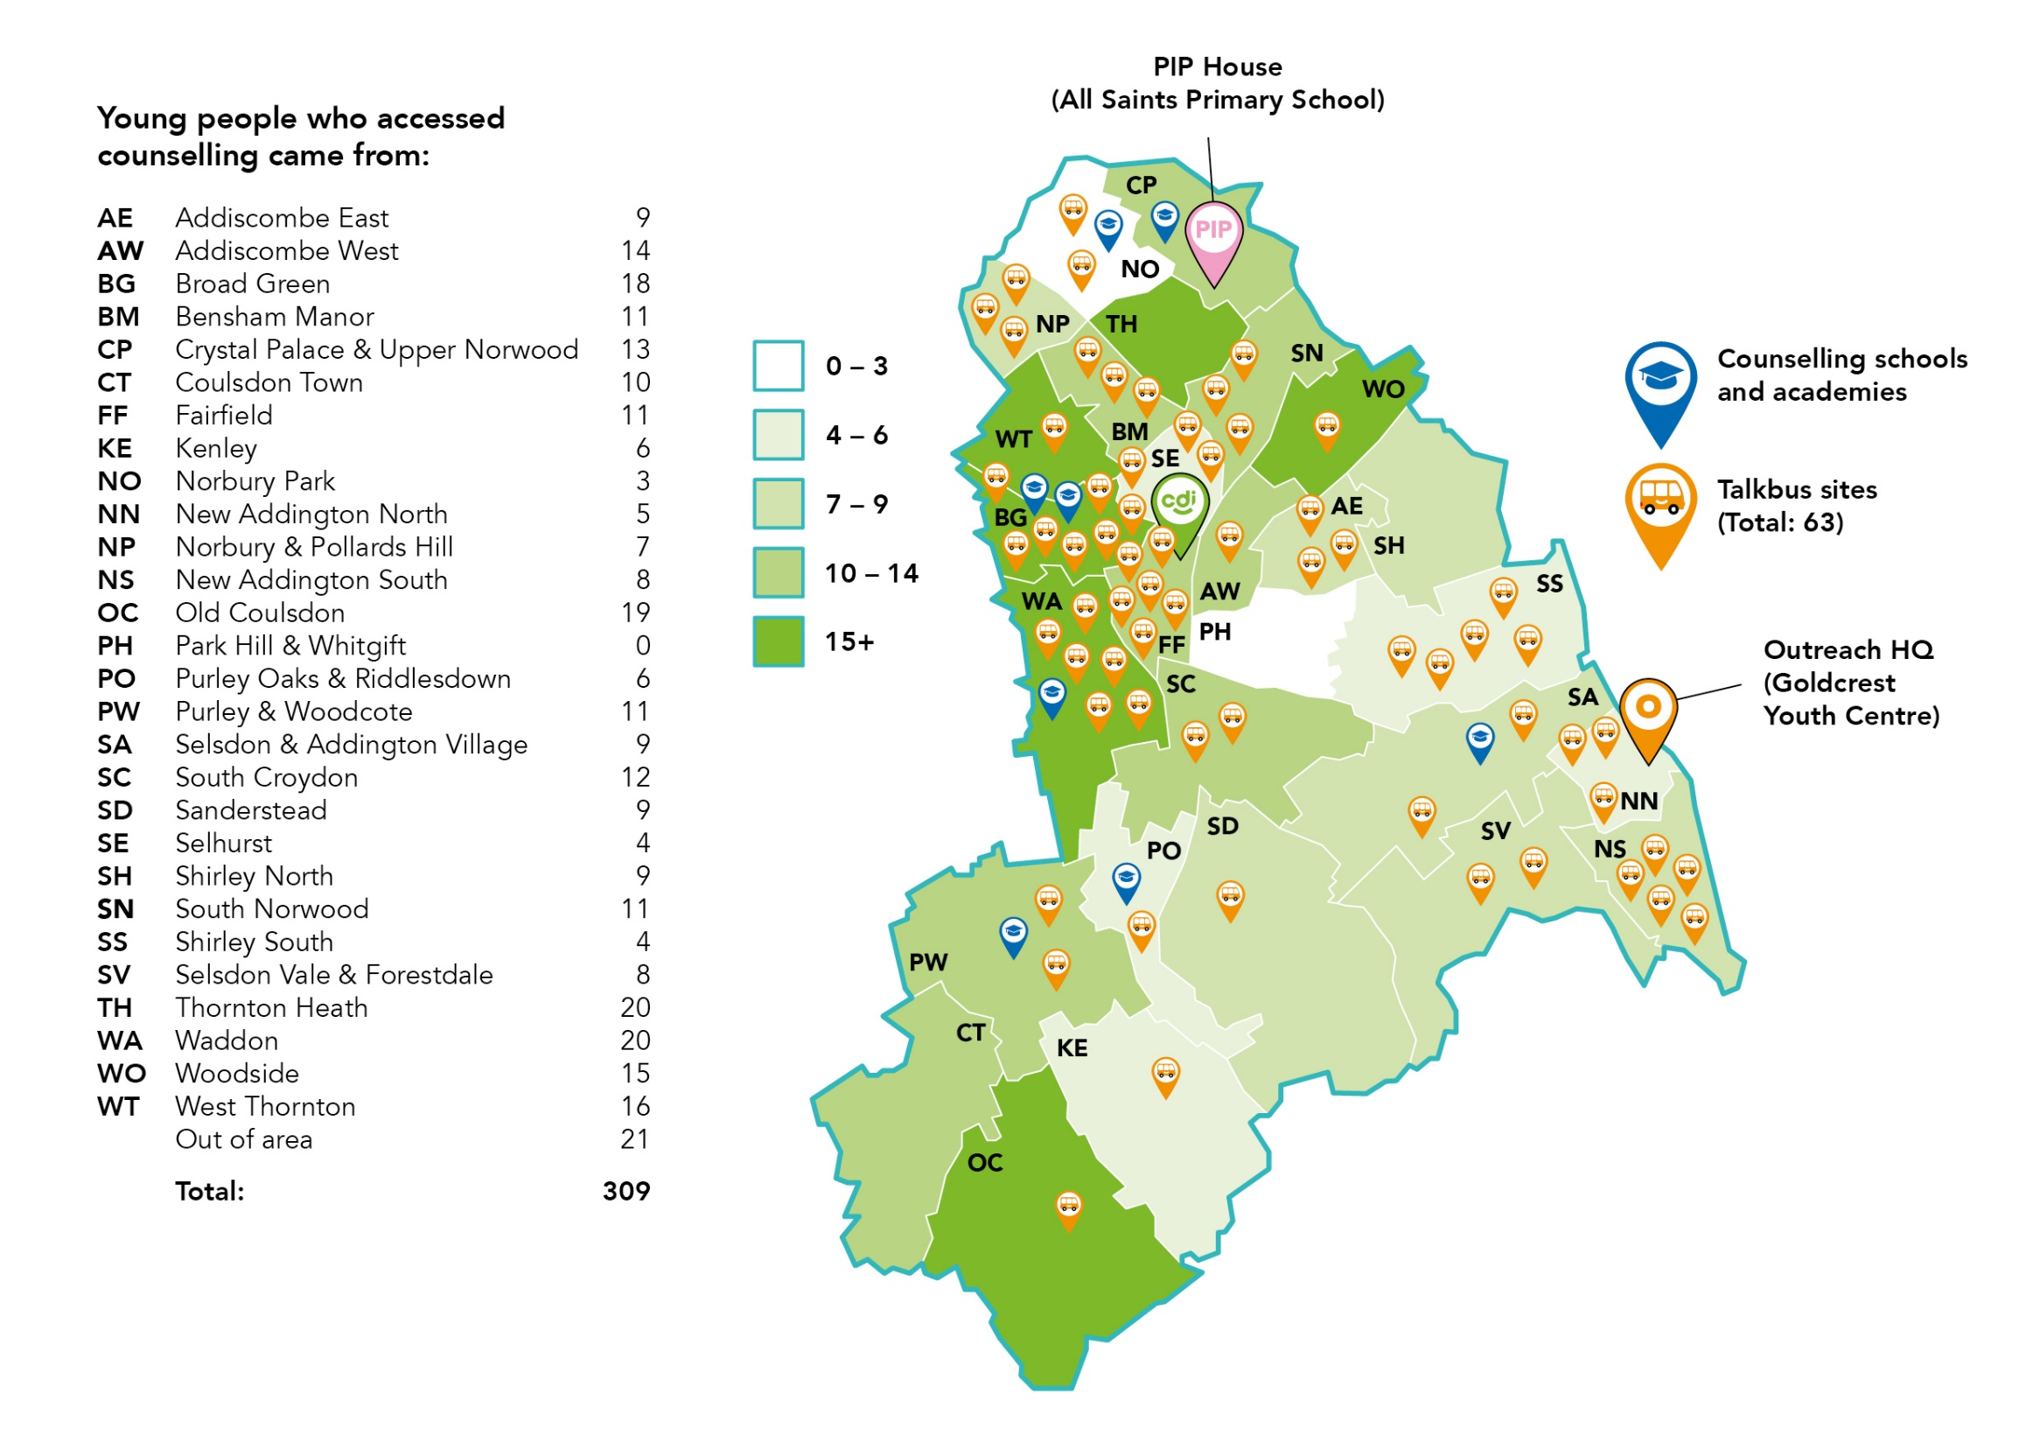

Slide 10
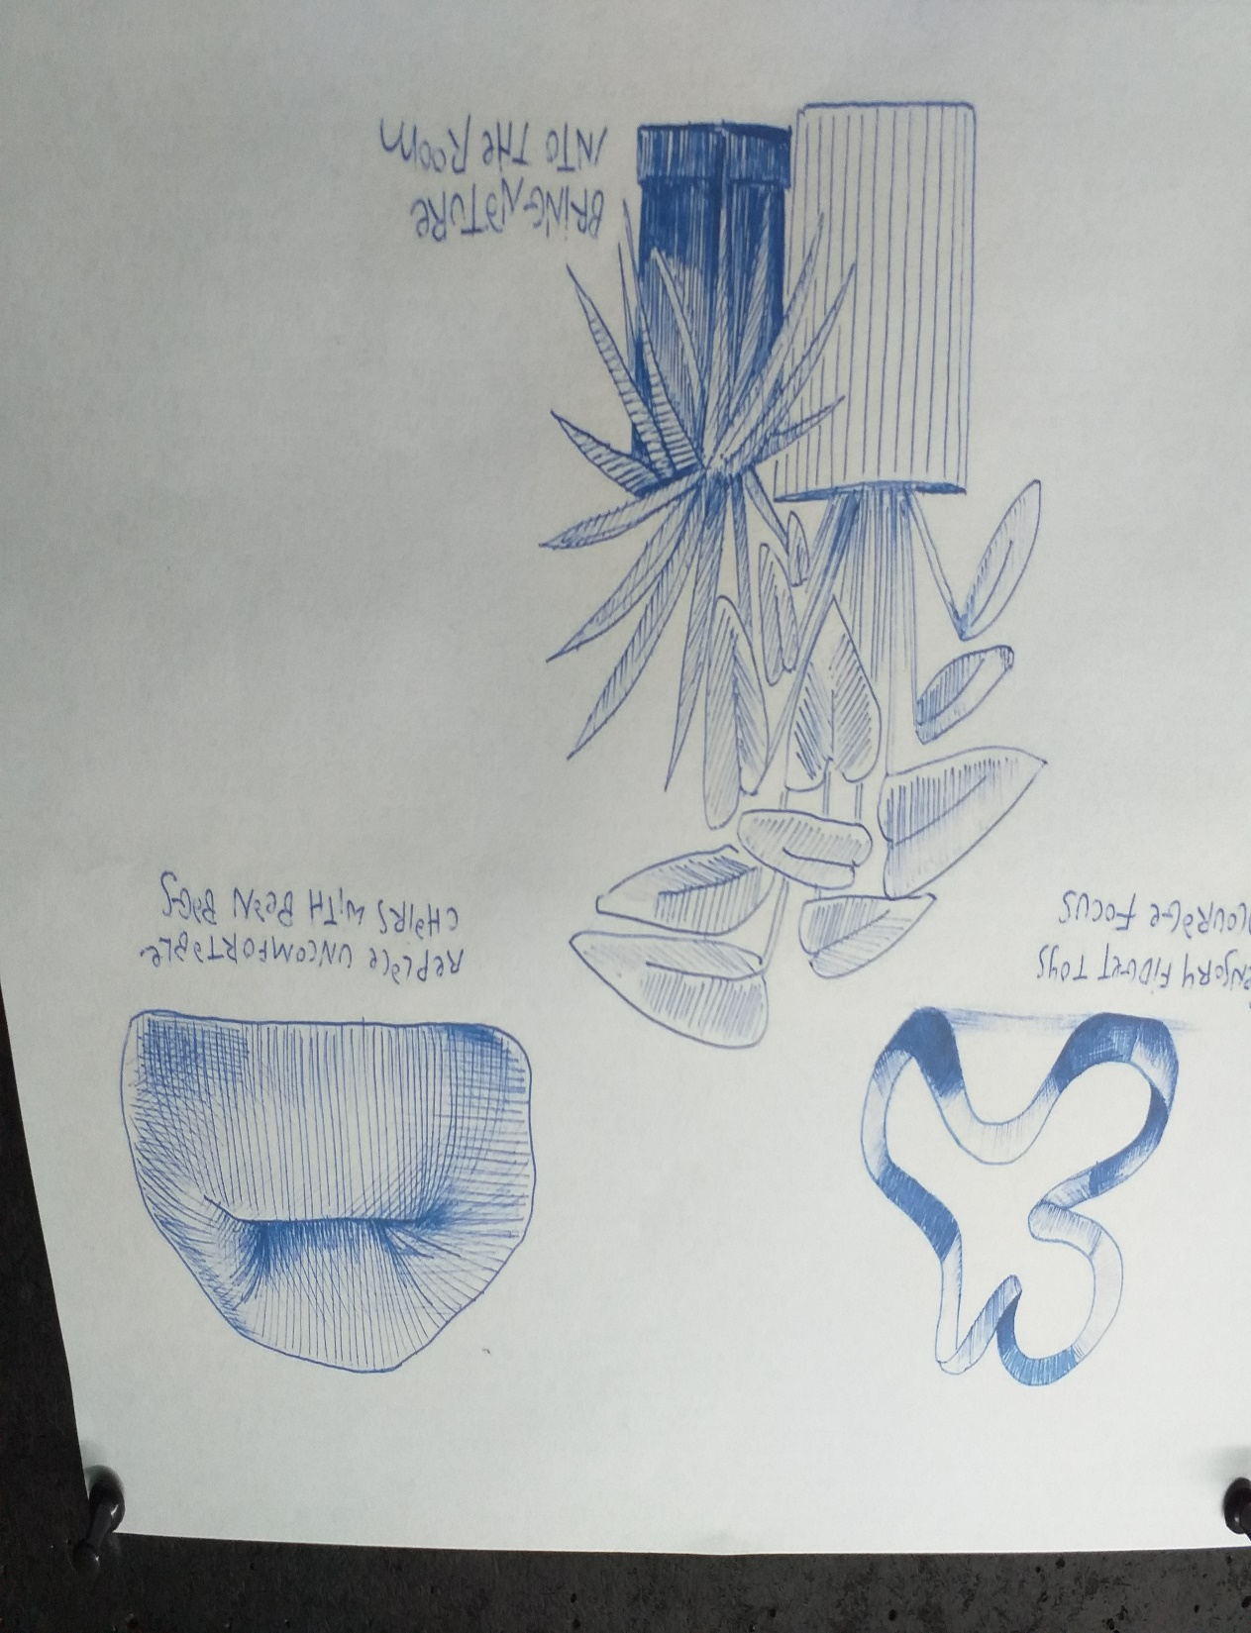
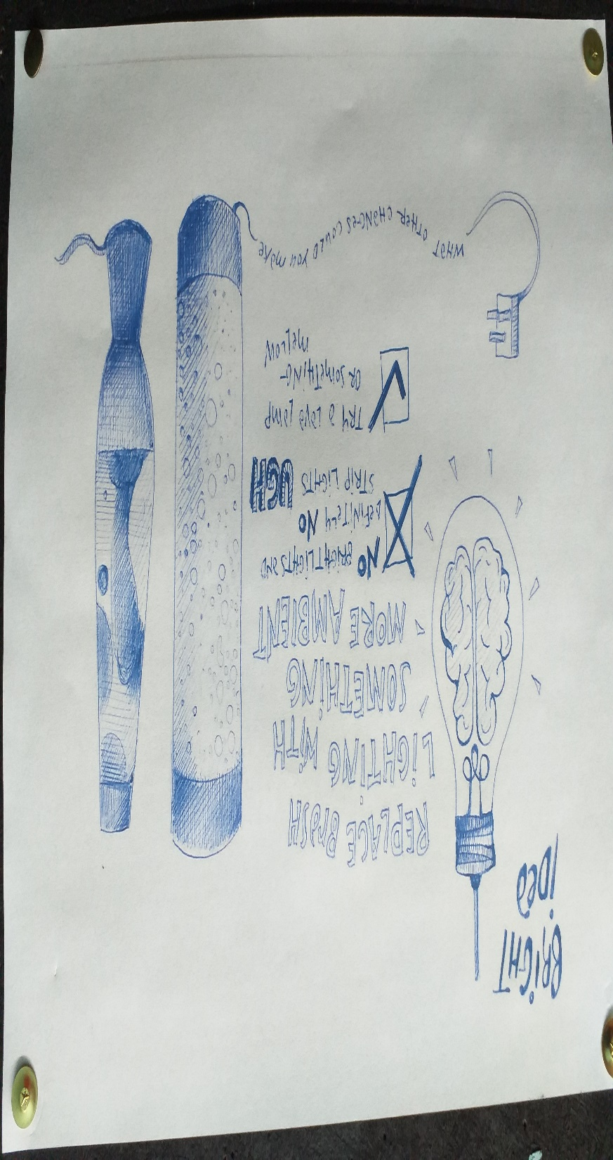
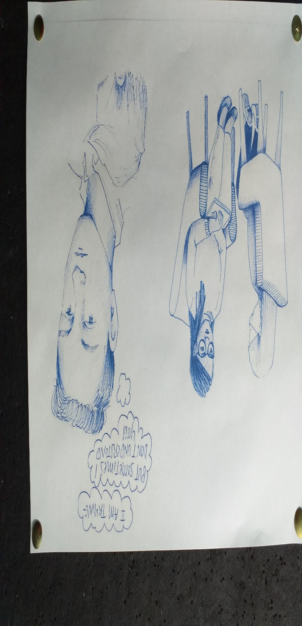

Slide 11
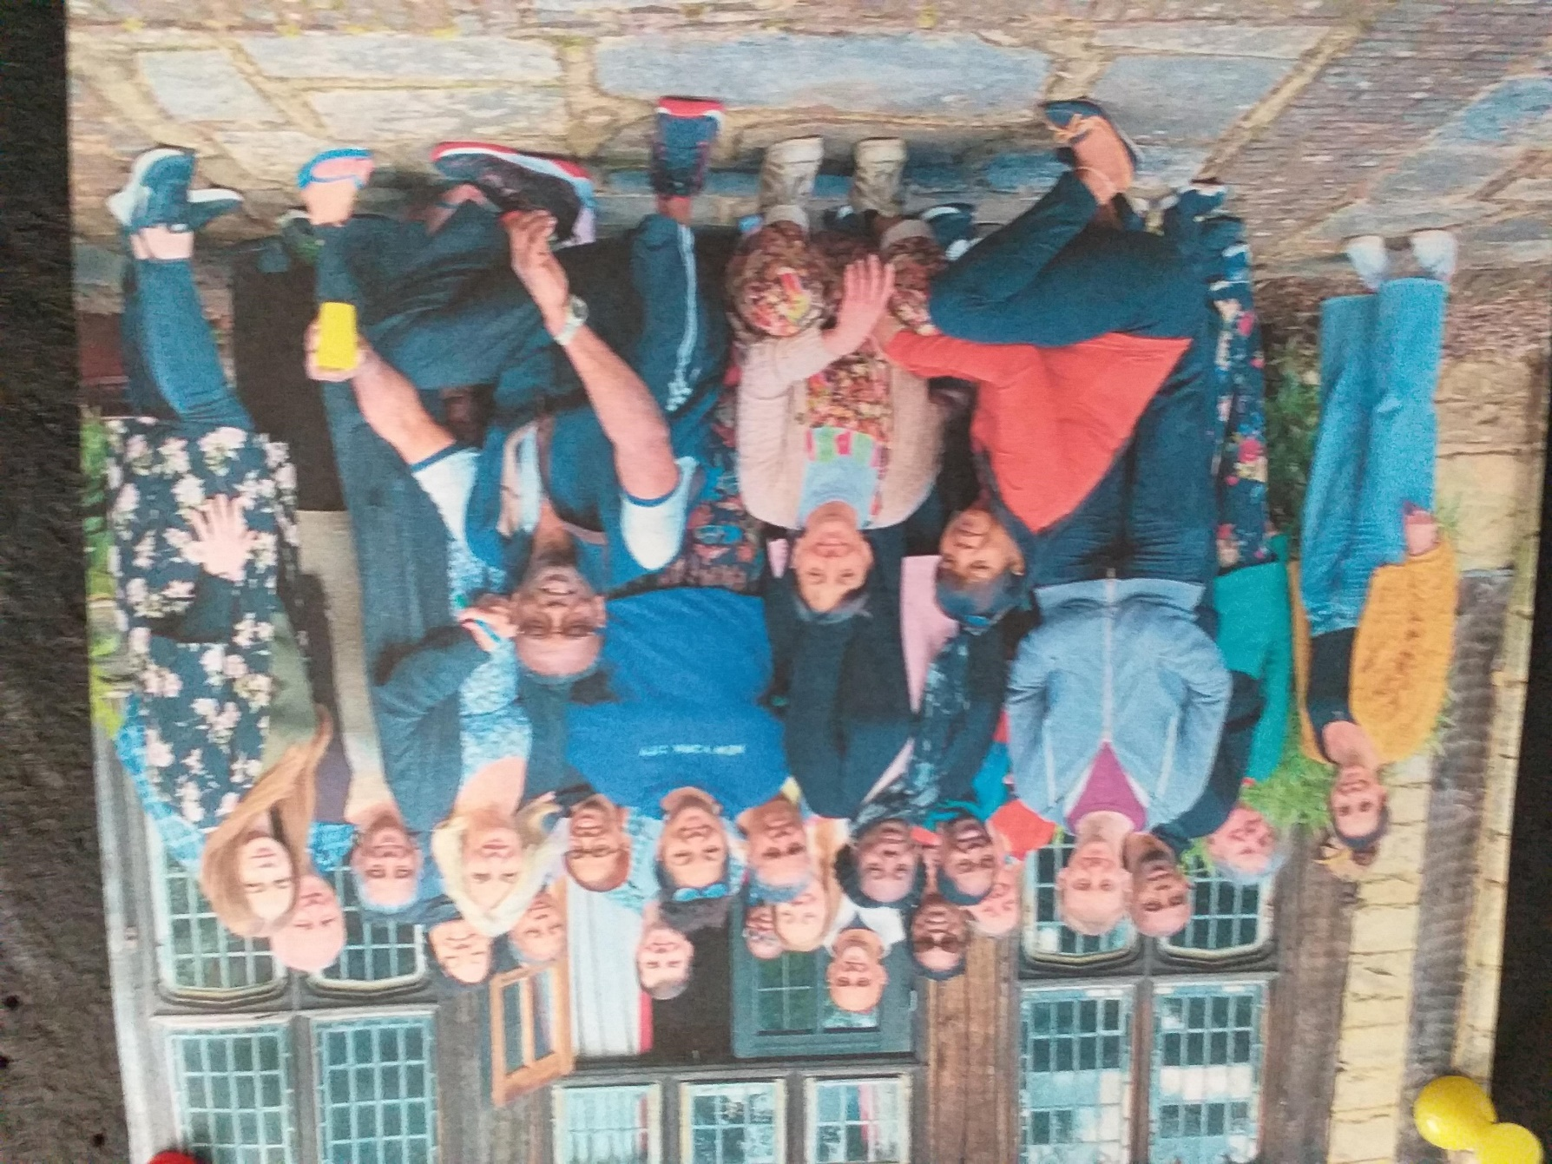

Slide 12
Thank you for listening – any questions?
Rhona Kenny – Head of Therapeutic Services
rhonakenny@croydondropin.org.uk
Croydon Drop In
Supporting infants, children, young people and families
for 45 years 1978 – 2023
Information, Advocacy, Counselling, Outreach, Training
and Health Education in Communities & Schools
020 8680 0404
www.croydondropin.org.uk
enquiries@croydondropin.org.uk

