Slide 1


Social value in commissioning
By Sarah Ireland
July 2015
Notes:
emind us of our journey so far and our successes
Set the post May 2015 context
….and explore the new Make or buy approach…

Slide 2

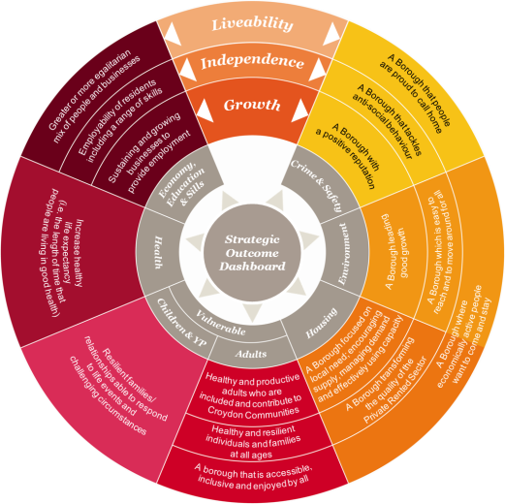

Strategic context: The Croydon Challenge
Liveability – harnessing the resources of our strategic partners and suppliers to contribute to the delivery of the borough’s strategic outcomes
Independence - investing in local people and
community groups to build resilience and
self-sufficiency
Growth – supporting local businesses
(esp. SMEs), employment and the development
of the local supply chain

Slide 3

A strategic commissioning framework
We:
take an outcomes based approach to commissioning
understand needs and priorities
ensure value for money
involve customers and service users
are honest about the financial and legislative frameworks
support market development to ensure there is a mixed economy of providers
build the capacity of our local third sector and small businesses
promote investment in the local community
work jointly with other relevant local and regional commissioners

Slide 4
Make or Buy Framework
Private Outsource
Private Sector/Social Value /CSR
BUY
Public Outsource Voluntary Sector, Social Enterprise
Outcomes Direction
Risks & Challenges Direction
The challenges & risks facing the service which needs to addressed by the Make or Buy decision
The impact on the outcome in relation to Make or Buy decision
SERVICES
Cost/Income Direction
Performance Direction
The financial position that needs to addressed by the Make or Buy decision
The performance position that needs to addressed by the Make or Buy decision
Collaborative
Joint Ventures/Shared Services
In-House
MAKE

Slide 5
Voluntary sector commissioning principles
Focus on outcomes for local people
Aligned with Ambitious for Croydon, the Community Strategy and the Corporate Plan
Shaped by recommendations of the Opportunity and Fairness Commission
Support voluntary, faith and community sector strengths in developing community responses to local issues
Stronger Communities Fund as a key opportunity to apply principles

Slide 6
Further opportunities
Principles will be applied to all voluntary sector commissioning
Upcoming opportunities 2015-18 include:
  Preventative services information and advice
  Youth services
  Carers support
  Housing services

Slide 7
Grant funding
Active communities fund to help communities to become more resilient, develop their own ideas and do more for themselves.
Micro Grants - up to £1,000 for start-up or pilot projects and small-scale community events. Applications considered every two months.
Small Grants - £1,001 to £5,000 for up to a year with possibility of second year if project is successful. Two rounds of funding each year.
Three overarching priorities:
  Developing active and inclusive communities
  Helping people care for one another’s health and wellbeing
  Tackling poverty and social exclusion
Projects must be based in Croydon
Applicants should have expenditure of less than £30,000 per annum.
Applicants must meet the council's requirements on governance, management, financial competence and equalities
Projects must demonstrate good value for money

Slide 8
Service commissioning
Through ‘make or buy’ all reviews will consider third sector commissioning opportunities
Opening up more service commissioning opportunities to local SMEs and voluntary sector
Value Croydon programme to leverage resources of partners and deliver added social benefits
Social value approach in all service commissioning to enhance community benefits and support local voluntary sector

Slide 9
Upcoming service commissioning projects
Integrated wellbeing service
Public health services DPS
Refresh of Integrated Framework
Community meals
Corporate catering provision
Carers hub
Croydon Rent in Advance Scheme (CRIAS)
Services for 65s (OBC APA)
Best start programme – community support and parenting
Independent fostering agencies
Alternative education provision
15 hours SEND child care
5-19 commissioning
Semi independent accommodation

