Slide 1
Commissioning principles
Sarah Ireland
Director of Strategy, Communities and Commissioning
November 2015
Notes:
emind us of our journey so far and our successes
Set the post May 2015 context
….and explore the new Make or buy approach…

Slide 2
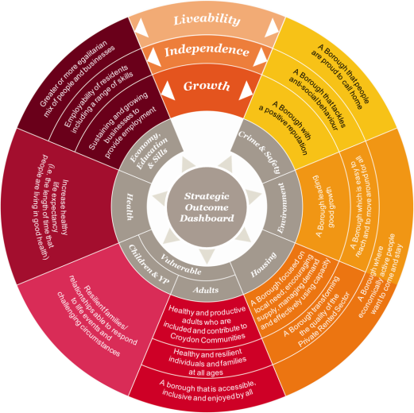
Strategic context
Liveability – harnessing the resources of our strategic partners and suppliers to contribute to the deliveryof the borough’s strategic outcomes
Independence - investing in local people and
community groups to build resilience and
self-sufficiency
Growth – supporting local businesses
(esp. SMEs), employment and the development
of the local supply chain

Slide 3
A refreshed definition of commissioning
Commissioning is the process for deciding how we deliver improved community outcomes in the most efficient way within the total resources available.
The Council has adopted an asset based commissioning approach which focuses on existing strengths, skills and resources as the building blocks for addressing need and achieving outcomes.

Slide 4
Asset based approach
Deficit commissioning | Strength Commissioning
Deficiencies | Assets
Services | Investment
Inputs / outputs | Outcomes
Agencies | Associations
Individuals | Communities
Maintenance | Development
People as clients | People as co-producers
Fix issues | Develop potential

Slide 5
Supporting Community Empowerment
Engagement: ‘the process whereby public bodies reach out to communities to create empowerment opportunities’.
Personal action
Partnerships
Social and political action
Community organisations
Small mutual groups
Empowerment: ‘the giving of confidence, skills, and power to communities to shape and
influence what public bodies do for or with them’.

Slide 6
Commissioning principles
Co-operative
Asset based
Focus on outcomes
Equalities and fairness
Risk aware
Encourage third sector participation
Diverse economy of providers
Moral markets
Social value
Integration and partnerships

Slide 7
Make or buy framework
Private Outsource
Private Sector/Social Value /CSR
BUY
Public Outsource
Third Sector, Social Entreprise
Outcomes Direction
Risks & Challenges Direction
The challenges & risks facing the service which needs to addressed by the Make or Buy decision
The impact on the outcome in relation to Make or Buy decision
SERVICES
Cost/Income Direction
Performance Direction
The financial position that needs to addressed by the Make or Buy decision
The performance position that needs to addressed by the Make or Buy decision
Collaborative
Joint Ventures/Shared Services
In-House
MAKE

Slide 8
Why change? – Strategic Decision
Improved outcomes
Same cost
Same outcomes
Less cost
Improved outcomes
More cost
All services be reviewed through the against the context of our financial challenges and agreed outcomes
Detailed options appraisal including in-house option to be prepared for all re-commissioned services
Follow Croydon Challenge design principles
Same or less outcomes and more costs

Slide 9
Risk Transfer
Market conditions
Control
Trading
opportunities
Market shaping
Core services
Key considerations
Greater
Social Value
Local authority ability to attract resource

Slide 10
A new way of thinking
Need
Assets
Outcomes
Resources
Third sector route
Contracted service
Social value
Grant in aid
Pilots and innovation
ABCD
Leveraging external funding
Partnership

Slide 11
Breakout sessions
Q1: What are the potential barriers that the new commissioning principles could create for the voluntary and community sector? How could we overcome these issues?
Q2: What are the opportunities this presents for the voluntary and community sector? How can we work together to maximise the benefits?

Slide 12
Upcoming service commissioning projects
Integrated wellbeing service
Corporate catering provision
Croydon Rent in Advance Scheme (CRIAS)
Services for 65s (OBC APA)
Best start programme – community support and parenting
Independent fostering agencies
Alternative education provision
5-19 commissioning
Semi independent accommodation

