Slide 1
Digital Inclusion
Councillor Mark Watson
Cabinet Member for Communities, Safety and Justice

Slide 2
Why Digital Inclusion is so importantgit
Radio took 38 years to reach 50 million users, TV took 13 years, web took 4 years, Facebook took 10months!
In 2013 36million adults (73%) accessed the internet every day. 89% of young people had a smart-phone or tablet to go on-line, up from 43% in 2010.

Slide 3
Why Digital Inclusion is so importantgit
It is estimated households that are off line are missing out on savings of £560 per year from shopping, paying bills online, or being able to keep in touch with family members or friends
81% of people over 55 say that being online makes them feel part of modern society and less lonely
Croydon Council has a significant financial challenge and needs to protect key services to most vulnerable – residents utilising on-line services can help towards that challenge

Slide 4
Digital inclusion principles
Digital skills – being able to use computers and the internet.
Connectivity – Access to the internet.
Accessibility – services will be designed to meet all users needs, including those dependent on assistive technology to access digital services

Slide 5
Digital inclusion principles
Supporting other key Borough initiatives
Financial Inclusion Principle | What does this mean?
Enabling people to make the most of their money through digital services | Each customer to recognise and have access to the financial benefits of using digital services (paying rent online, requesting benefits) and opportunities to save money through internet deals; freegle, uSwitch, shopping deals, ways to eat healthily for less

Slide 6
How our customers are already using our on-line services A snapshot of My Account statistics

⬧
+93k
Customers signed up to MyAccount
12k
Photos submitted via the mobile app
58K
Reports received via My Account
1350
Appointments made online
8 out of 10 customers said they found MyAccount easy to sign-up to
9 out of 10 customers said they would use MyAccount again
8 out of 10 customers said they would recommend the service to other residents

Slide 7
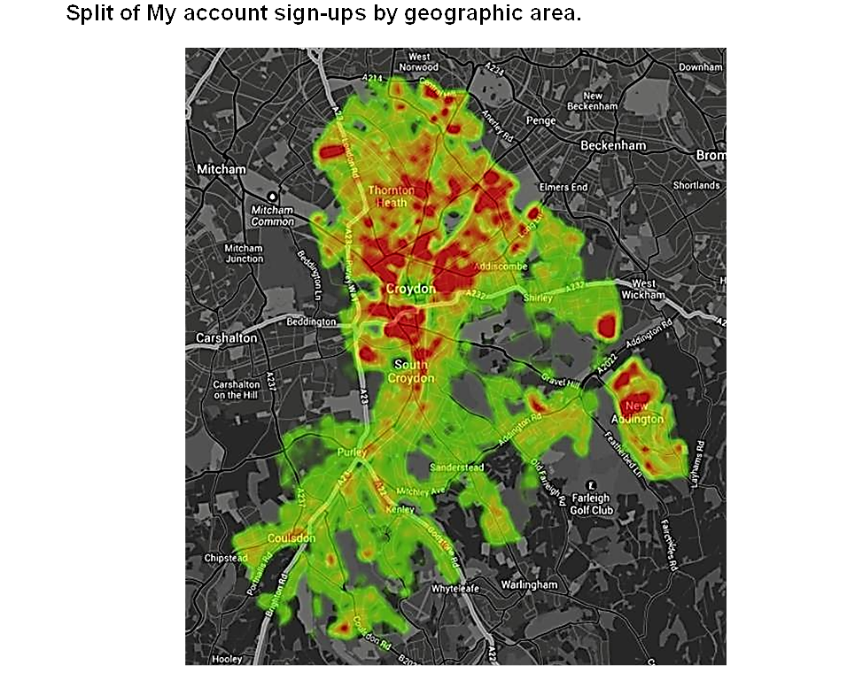
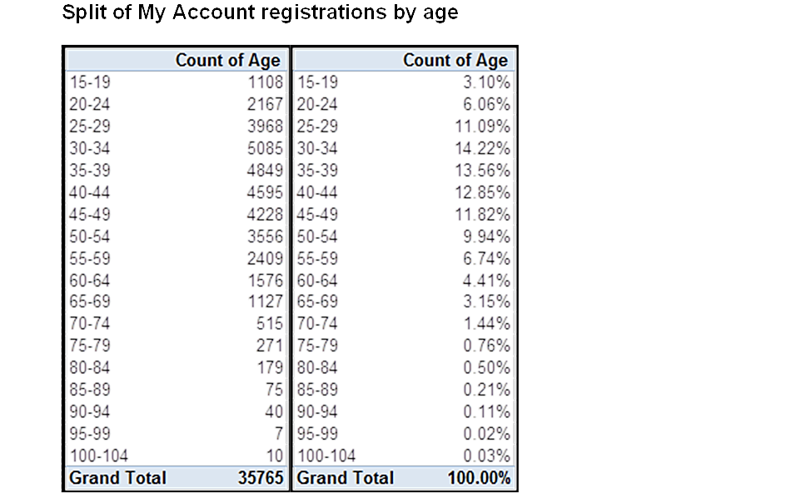
Current Position and Progress to date
Services are being used by various age groups and locations across the Borough
(data as at end 2014)

Slide 8
Further opportunities;
INITIATIVES ALREADY UNDERWAY
Mobile bus – providing support in community.
Access Croydon – arranging training for residents
Council house tenancy sign-up – getting detailed understanding of individual skills and needs
Supporting Community projects – such as Norbury church digital training initiative
Review council buildings and services – opportunity to provide free Wi-Fi access for customers
Initial exploration – working with businesses to trial further initiatives for residents and SME’s later in 2015.

Slide 9
Further opportunities;
HELPING US UNDERSTAND WHERE TO FURTHER FOCUS
What is already being provided effectively in community – lessons we can learn
Which residents’ groups most need support
What is stopping residents from accessing on-line services
How can we help the community help themselves

