Slide 1
CVSA Meeting
17 November 2016
Hamida Ali
CROYDON OPPORTUNITY AND FAIRNESS COMMISSION

Slide 2
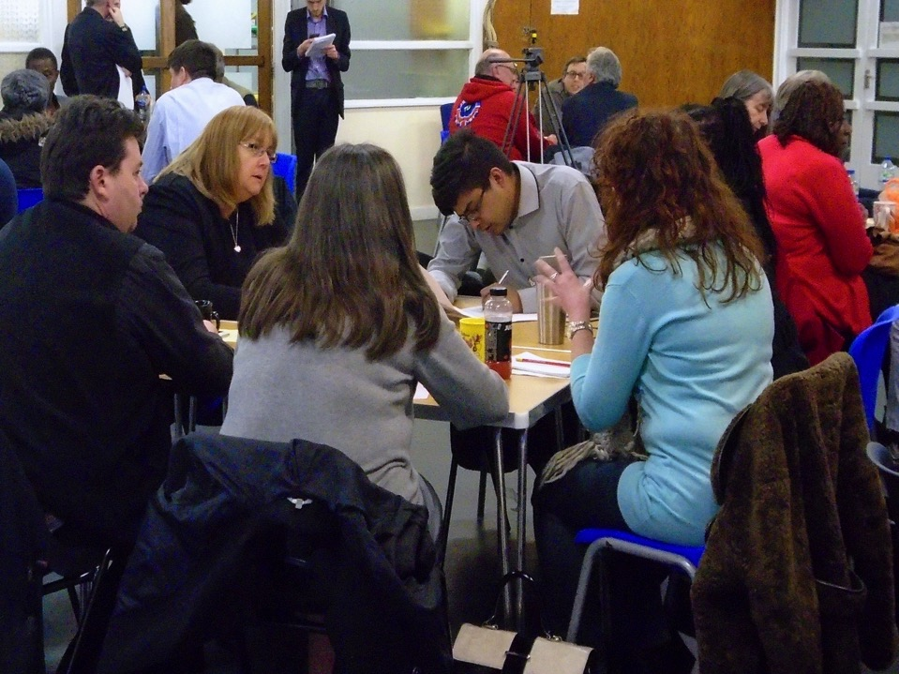
Guided by concerns and aspirations of Croydon
The power to change lives within Croydon
We’ve had to be selective – priority to areas where challenge is great but where we can make a difference
Opportunity and Fairness - about having same chance to live a healthy, happy life – regardless of where you are, who you are or who you know, and being helped through hard times
Interpretation like this, which focuses on start in life, guides the Commission’s work
Opportunity and Fairness in Croydon
Notes:
Thank you very much for the invitation – and the opportunity to speak at your meeting.
Interim report published in October – date
8 months of engagement, research and policy examination work – engaging with more than 3000 people across Croydon – including residents and professionals
Inevitably we’ve had to prioritise a manageable number of issues – from the volume of concerns raised with us
The issues of ‘opportunity’ and ‘fairness’ can also appear to be relatively abstract – what do we mean by them – based on what we’ve heard and from both residents and based on the views of commissioners themselves, we’re focused on life chances regardless of any aspect of someone’s background or identity
Principles – focus on where challenge is big, recognise financial realities, hard to hear, asset based, whole town approach, evidence based, subsidiarity, co-production
We’re currently consulting on our Interim Report – anyone – can respond with their views – to inform the commission as it finalises its recommendations (due end of January 2016)
We’ve highlighted 6 priority areas with suggested ideas – which we’re testing through the consultation – and I’ll go through those in turn

Slide 3
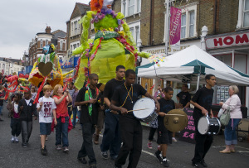
Create bottom up approaches that help people take responsibility for their localities
Increase volunteering and participation in sports and other activities
Develop common understanding between residents and migrants
Devolve power to communities
Encourage local business and regenerate high streets.
Power handed to communities
Notes:
Devolution of power and control was a key theme that came through from the engagement work
Significant levels of community energy across all parts of the borough
Sense of lack of control over local areas
North-South divide in the borough compounds this dynamic
Council is an obstacle – not a facilitator
Our conclusions in this area are aimed at:
> Tapping into and maximizing the impact of community energy
> Sharing insight and experience across residents
> Boosting volunteering – without a capital ‘V’
> Bringing residents together with businesses – Portland Road a perfect example
The challenge is to create an environment that engenders responsibility and nurtures the good things residents and businesses are willing to do to make their area a better place to live.

Slide 4
Spread benefits as broadly as possible
Recruit more local people, with fair levels of pay and employment practices
Shift to innovative higher skill and pay economy that improves employment prospects and wages
Croydon a destination for bringing out the best in all and attracting the best students
Improve diversity of cultural and arts offer
Create evening economy that encourages greater mix of customers, balanced, relaxed and enhances reputation
A more pedestrian and cycle friendly centre
A town centre that lifts the whole borough
Notes:
Whole borough approach
Reflects the commission’s view that the benefits of the town centre regeneration need to benefit every corner of the borough through:
> Widening the Business Improvement District – to include smaller businesses around the Westfield- Hammerson site
> Policy to guarantee more opportunities for local people for job opportunities
> Campaign for a London Living Wage Town
> Promoting a higher wage / higher skill economy
> Campaign for a university campus
> Successful regional culturally diverse arts presence

Slide 5
Early intervention to achieve better educational outcomes
How children with special educational needs and those who experience family bereavement and breakdown can be supported
The role of the community in education and raising aspiration
Role of schools in the community encouraged
Opening up pathways to employment
No child left behind
Notes:
Evidence shows that life chances are determined before birth
Commission took a strong focus on school exclusions
Conclusions are focused on the principle that no child should be left behind:
> Best practice from elsewhere on supporting children and young people with SEND
> Tackling bullying and harassment young people face to and from and at school
> Inspiring young people with role models from all backgrounds
Overall, therefore, the early years challenge is the most profound for the borough as a whole and particularly for children from less well off backgrounds but there are also individual schools in parts of the borough that don’t do well enough.
The early years challenge is compounded by the fact that central government funding for children’s centres is no longer protected and council budgets are being cut significantly.
The early years are the most important in determining a child’s future trajectory. But in Croydon the proportion of children achieving a Good Level of Development by age five is lower than in neighbouring boroughs and the average across England. In the North and West of the borough childhood development is the furthest behind at this stage. Children who are eligible for free school meals are also significantly behind their peers during early development.

Slide 6
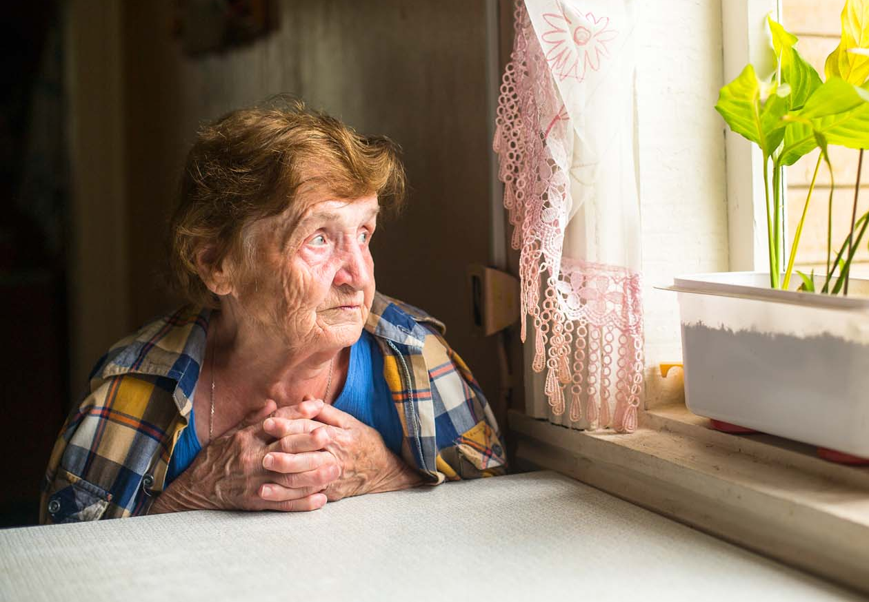
Work with residents to identify all the possible services, points of contact, assets and resources that can be harnessed to make a difference.
Work with communities and private sector to identify underutilised shared spaces that could be used as the basis for new community enterprises.
Integrated working between health services and the community
Social prescribing role to staff in GP practices
Social isolation central outcome for commissioners
An anti social isolation borough
Notes:
Like with each of the other priority areas – there are a whole range of issues within health and wellbeing that we could have focused on
Social isolation was the stand our priority for the commission – and that this should be at the heart of the borough’s public health agenda by:
> Preventing social isolation to be a driving commissioning principle
> Supporting social prescribing
> Linking volunteering opportunities to preventing people from becoming isolated
> Nudging positive behaviour among residents (in tenancy agreements)

Slide 7
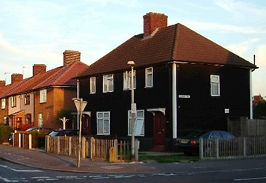
Increase security for those who rent
Using Croydon’s assets to support the homeless
Maximise use of available land and put the community at the heart of the challenge
Encouragement for landlords to help disadvantaged
Use of Social Impact Bonds
Opportunity for major programme for New Addington
Working together to beat homelessness
Notes:
Probably our biggest challenge of all as a town
For the Work stream on housing, this was an immediate and self-evident problem
Focus on homelessness was looking at the problem as a whole – experience in the PRS, temporary accommodation – and not just rough sleeping
Eviction from the PRS is the biggest cause of homelessness now – not family disputes
Our temporary accommodation population is 6 x higher than for the England average
Conclusions have focused on:
> Council fund to support people who need access to money for deposit
> Landlord – or agent? – charter
> Money wise support for residents
> Incentivising people to open their homes to people in need
> Community Land Trust
> Building more housing where the council owns land – New Addington in particular
> Investment in social impact bonds

Slide 8
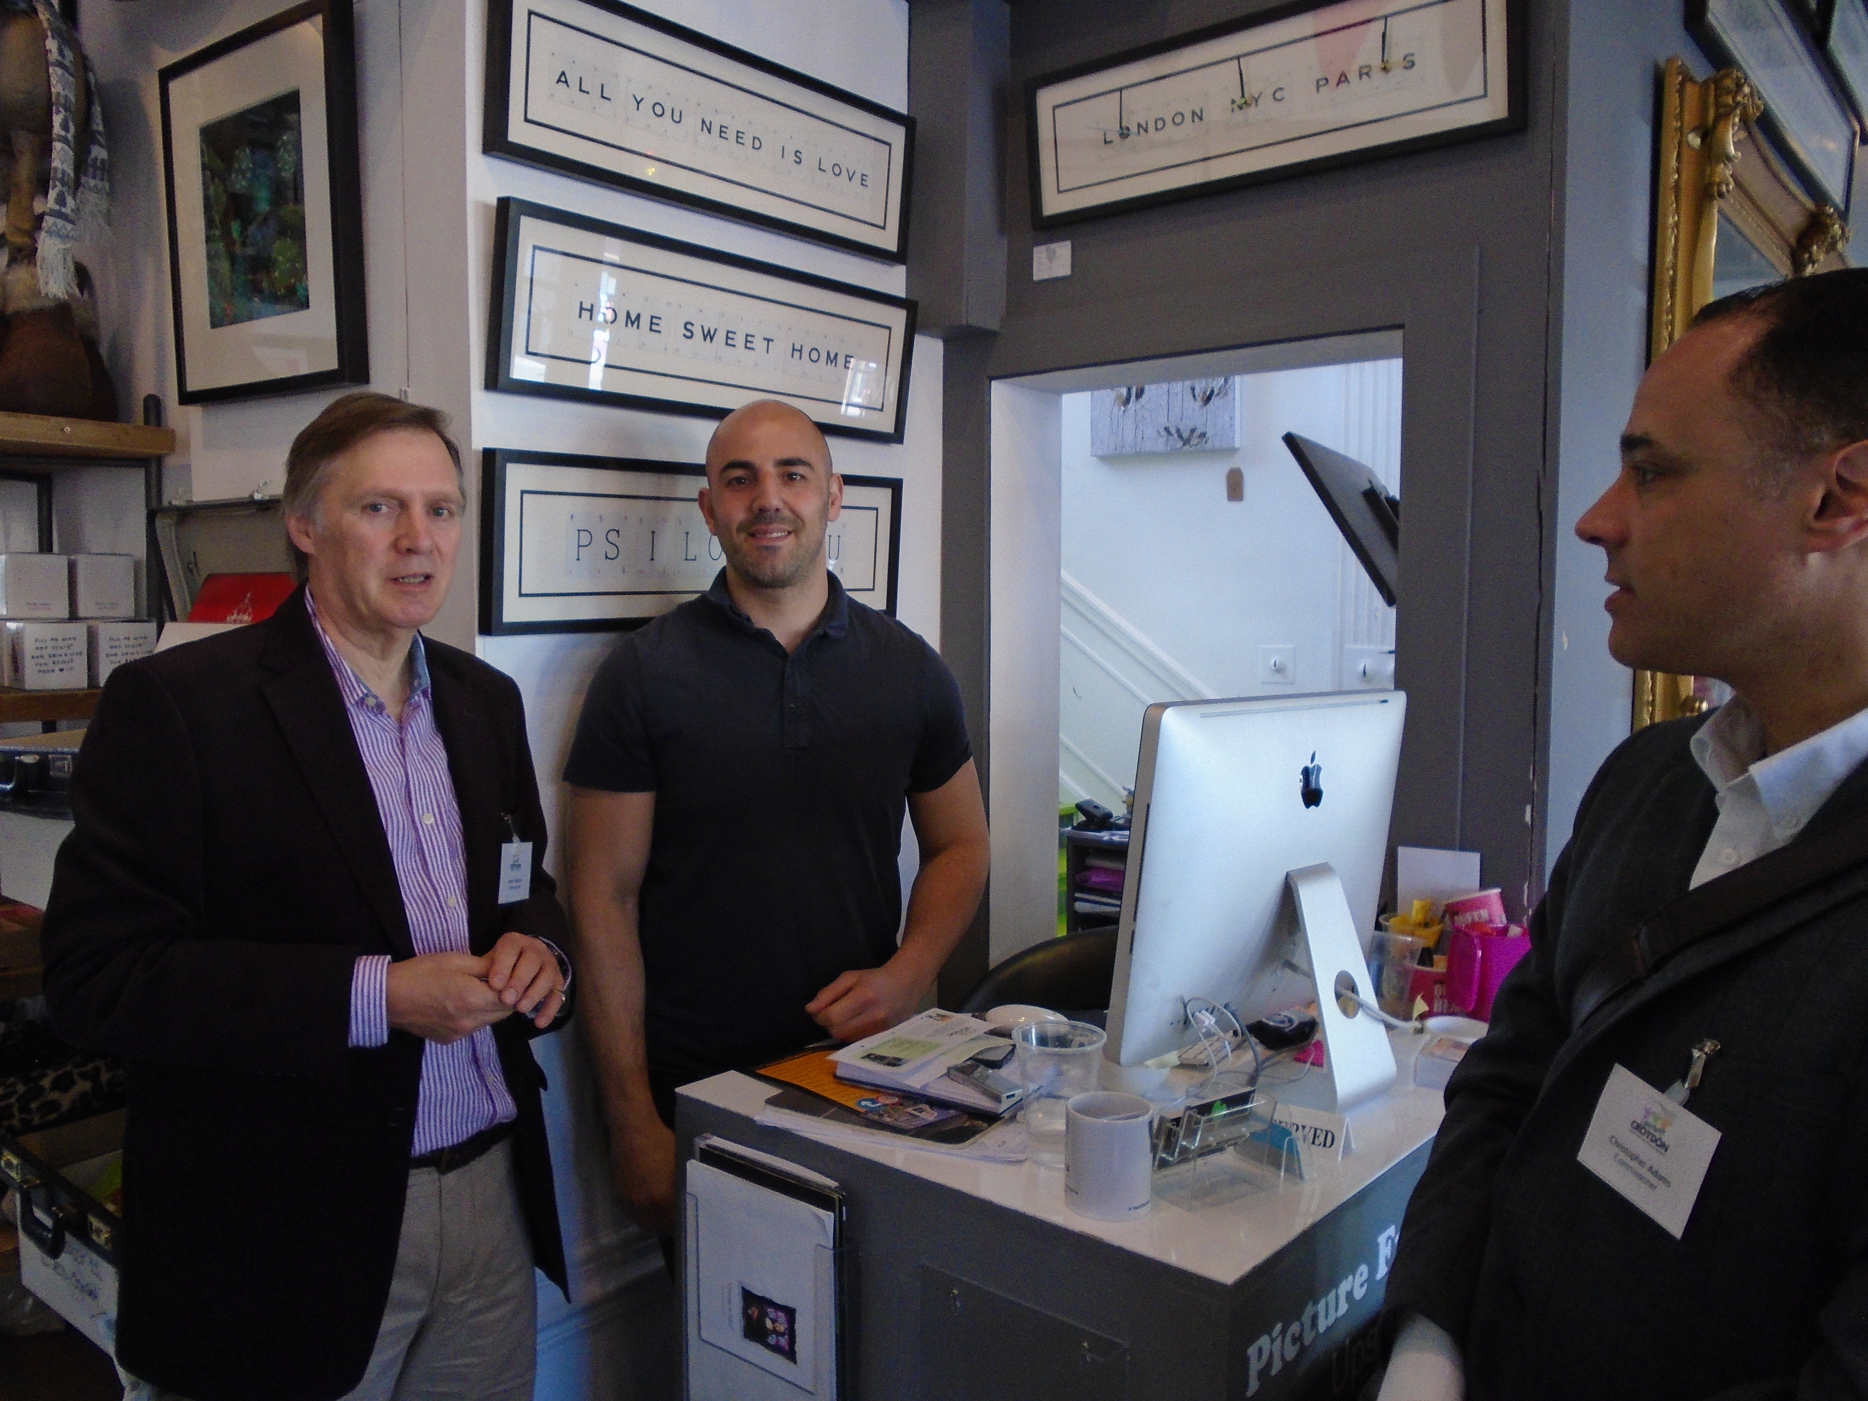
Partnerships between employers and education
Support and encourage businesses to become London Living Wage companies
More employment through work experience
Social lending and peer-to-peer financial support
Childcare provision to utilise social networks
Link between health and employment
Overcome discrimination based on sexual orientation, disability, gender or BAME
GP Surgeries services broadened to broker welfare and employment support
Supporting residents towards better times
Notes:
Work and living standards was a key focus of the commission – indeed this has been the main focus for most of the other commissions before us
We have high levels of people on less than the living wage on Employment Support Allowance
Conclusions and suggested ideas include:
> Supporting First Step – with a work experience placement for every young person in the borough
> Living Wage Borough – (Employment Charter)
> Support for smaller businesses – and more expected from larger businesses
> Locating support towards employment in GP surgeries
> Growing more childcare provision
> Promote greater diversity among leaders in the town
Croydon has high levels of in work poverty and its numbers on Employment Support Allowance have remained after the economic upturn. Croydon enjoys a diverse economy in the area is a cauldron for prosperity but lacks some ingredients that could maximise this resourcefulness.

Slide 9
Focus on implementation of changes:
Engaging with those who to make the changes or who will be impacted on by the changes
Building consensus and commitment to change and setting out details
Developing plans to implement the policies
Next Steps
Notes:
Commission is totally focused on final recommendations
Taking our conclusions to agencies in the borough – who will be responsible for delivery
Consultation is open until 30 November
Final report is due at the end of January 2016

