Slide 1
Making a Difference Programme
Employer Engagement Manager: Rita Fiuza
Phone: 07586 070176
Email: rfiuza@educationdevelopmenttrust.com

Slide 2
Education Development Trust
An international not-for-profit organization working to improve education outcomes and the transition from education to work.
We provide empowering employability and careers services to young people and adults and improve school systems at scale.
For over two decades, we have been designing, pioneering and delivering excellence in the provision of careers and employability advice and guidance
We work hard to give adults better access to an evolving job market and increase their likelihood of thriving in a fast-changing economic landscape

Slide 3
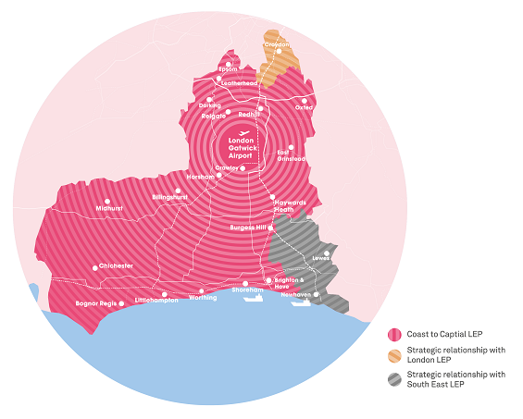
Our Programme
Making a Difference launched on 26th October 2020 and will run for 3 years.
An ESF funded programme offering a tailored programme of support for Unemployed and Economically Inactive Participants.
Covers the Coast to Capital region with a team specifically in place to support Croydon residents.

Slide 4
Our Customers
Resident in LB of Croydon
Over 18 years of age
Unemployed or Inactive - Eligible to work

Slide 5
Priority Groups
Over 50
Lone Parent
Ethnic Minority
Disability or long-term health problems
Without Basic Skills

Slide 6
Participant Journey
1-2-1 Outcome Star
We find out work or training goals and create an action plan
1-2-1 Personalised Coaching
For up to four months – includes revisit of action plan and Outcomes Star
Group Workshops
Including employer opportunities
Final Outcome Star
Participant moves into work, is work ready or moves into training

Slide 7
Making an Impact
96%
of participants would
recommend
Making a Difference
48% of participants leave the programme having moved into employment or active job-searching

Slide 8
Referral Process
JCP or partner organisation’s
Self-referral’s
Contact Us:
01329 559177
mades@educationdevelopmenttrust.com

Slide 9
Contact Information
Rita Fiuza
rfiuza@educationdevelopmenttrust.com
07586 070176
facebook.com/employsupport
twitter.com/employ_support
01329 559177
www.educationdevelopmenttrust.com/making-a-difference

