Slide 1
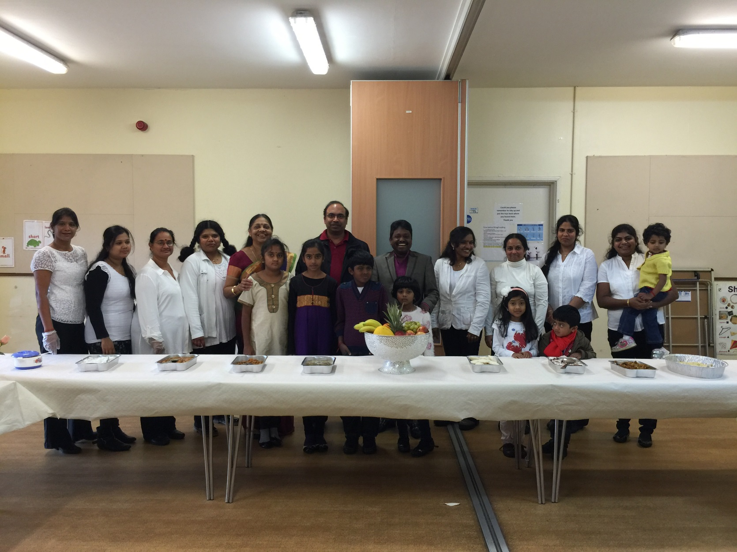
HEALTHY EATING MAKES HAPPY FAMILIES

Slide 2
AIMS OF THE HEATHY RECIPES PROJECT
Many Asian families have high levels of strokes, diabetes, high cholesterol and heart disease compared to other ethnicities. The healthy Recipes programme project will give people opportunities to:
Break the cycle by changing their diets and their lifestyles;
Manage healthier lifestyles and therefore reduce number of sufferers in the future;
Ensure that people still enjoy their own family favourites but with a healthy twist;
Teach their children how to eat well and prepare healthy food.

Slide 3
OUTCOMES !!!!
Improved health and well being;
Get more active - walking, yoga, and exercise;
Eating more healthily and checking food labelling and introducing ‘5 a day’;
Checking weight and BMI;
Stopping smoking;
Speaking to specialists;
Becoming familiar with healthy eating and healthy lifestyles (e.g. versatile packed lunches);
Meet new people and make new friends;
Learn new skills by becoming a health champion;
Increasing self confidence;
Participating in community life;
Bringing out own skills and share with others through sharing recipes, engaging friends and family

Slide 4
Programme
Target 100 Tamil Families in Broad Green and West Thornton areas;
Run three 2 hour workshops;
Create an ongoing support network using local venues and sharing of gifts and skills;
Holding health and well being advice sessions with professionals

Slide 5
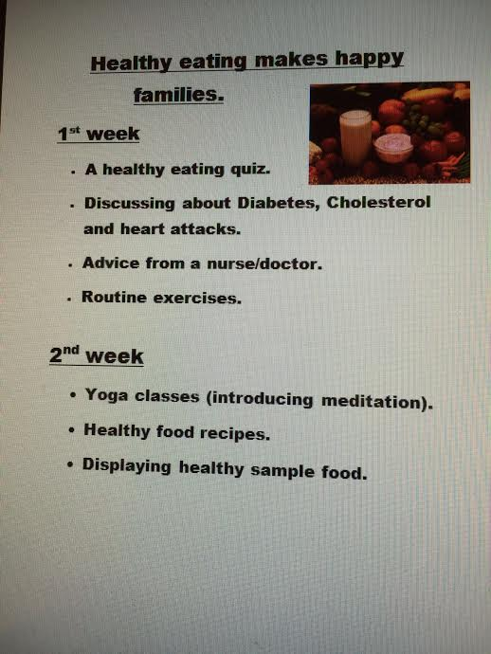
Programme

