Slide 1
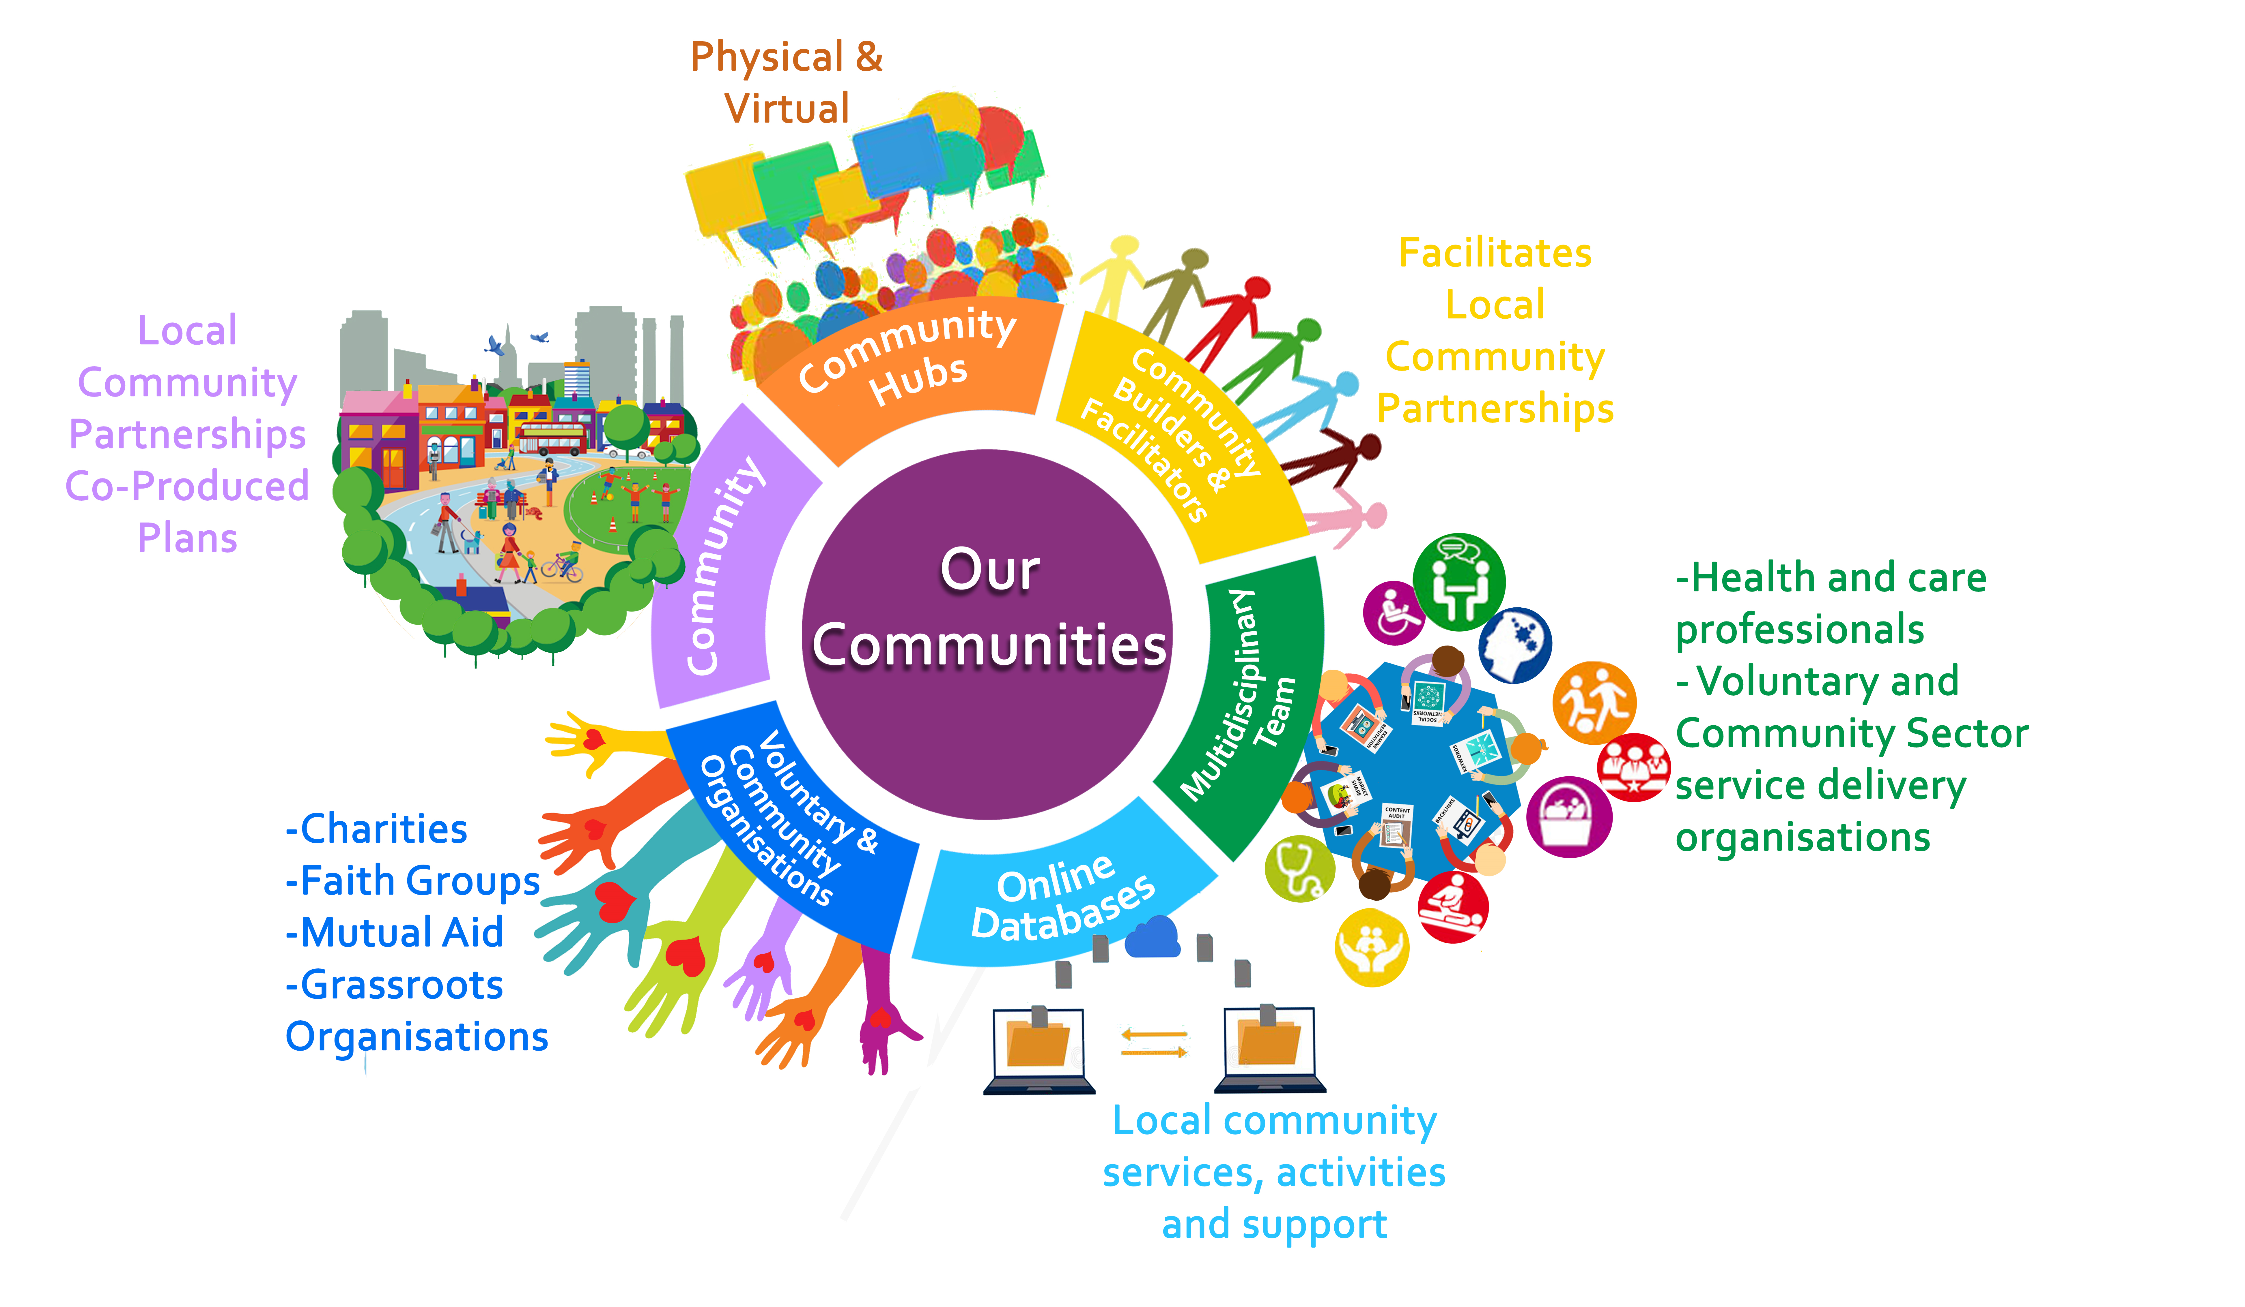
Healthy Communities Together: Empowering and Engaging Local People

