Slide 1
One Croydon Alliance – voluntary sector conference
22 October 2020

Slide 2
Agenda
Introduction to One Croydon Alliance (5 mins, Jill Kyne)
One Croydon Alliance vision for locality working (10 mins, Neil Goulbourne & Rachel Soni)
Integrated Community Network plus and the Local Voluntary Partnership (5 mins, Rachel Flagg/ Jennifer Daniel)
Getting your views on what you’ve heard today (Ima Miah & Rachel Flagg, 25mins)

Slide 3
We are working together to improve health and wellbeing in our community
One Croydon focussed initially on people aged over 65
Initiatives included setting up the LIFE team, GP huddles, telemedicine
The Alliance has now extended its remit to consider the health needs of people of all adults in the borough and eventually the whole population
Infrastructure organisations representing the voluntary sector:
A joined-up approach for people in Croydon
The One Croydon Alliance began delivering real benefits to people in our borough since 2017
Formal partnership between Croydon GP Collaborative, Croydon Council, CCG, CHS, SLAM, and Age UK Croydon
Increasingly coordinating our care and support for the borough
Award-winning Alliance praised for ‘system-wide leadership' and having a 'real impact' in improving peoples’ lives
Rated “GOOD” by the Care Quality Commission for LIFE community reablement service
Croydon is a forerunner in collaborative working

Slide 4
Vision for locality working
Strengths of the partnership:
Infrastructure organisations who represent many voices from across the voluntary sector in Croydon
Vibrant Local Voluntary Partnerships who understand local needs
A Shadow Health and Care board
Areas we want to develop with the voluntary sector:
Our Priorities | Areas we want to develop
Local empowerment – shifting power and authority to local people | We want local people to influence the design of services that improve health and care outcomes We want local people to feel empowered in shaping services specifically in their geographic area and their community We want to enable the voluntary sector to be able to deliver more services and keep people safe
Funding – shifting financial resources to the voluntary sector over the next 5 years | We want to explore how investment in the voluntary sector can help integrate service provision more fully across the partnership We want to create a mechanism for funding approval from across the partners, whilst retaining a sense of independence on decision making, avoiding conflicts of interest between voluntary sector providers We would like to align our local voluntary partnership and local authority small grants pots to decrease pressure on voluntary organisations making multiple applications and increase their sustainability and embed the sector in locality multi-agency working
Commissioning model – intention to commission outcomes rather than activity | We want to explore how technology and other digital platforms can enable us to have an integrated view of the impact of our collective activities on health outcomes We want to improve referral pathways/ client recording and performance information so commissioning can reflect gaps in provision We need to consider how information and data sharing could be improved across the partnership (GDPR compliance etc) We want to implement a shared set of outcomes for Social Prescribing across statutory and voluntary services
Representation – a voice for all voluntary organisations in One Croydon | We want to build on our engagement activity with all voluntary groups in Croydon, through all our One Croydon governance

Slide 5
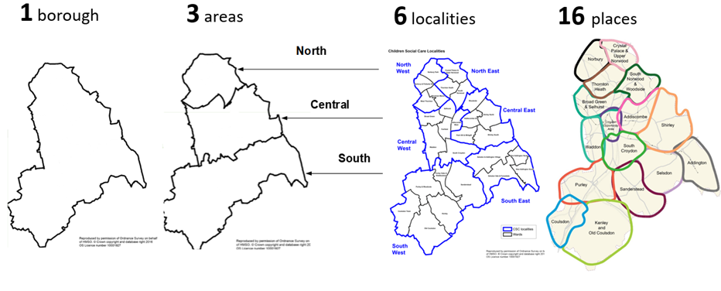
Integration & Localities
Public services get better results by ‘working with’ rather than ‘doing to’ people, drawing on the strengths of individuals and communities to improve outcomes.
Underpinned by ‘Total Place’ an approach that focuses on public services working together for residents, in localities designed around an evidence base of need.
To change the way we work right across the system and throughout, our emphasis on investment in early intervention and prevention.
To target and join up information, advice and guidance, reducing duplication making it simpler for residents to access the support they need.
The language of localities is important – Croydon Borough,
3 Areas, 6 Localities, 16 Places
Localities 5 Principles
1. USE OF DATA &
EVIDENCE
2. PREVENT ISSUES BECOMING PROBLEMS
3. MOVE SERVICES CLOSER TO RESDIENTS
Welfare & Benefits Officer
4. FOCUS ON COLLABORATION
5. INVOLVE RESIDENTS & COMMUNITIES

Slide 6
Front Doors
Safeguarding
Multi-Disciplinary Locality Team – North West
VCS – BLOCK LVP
VCS – SPOT (DP/PHB)
Multi-Disciplinary Locality Team – North East
VCS – BLOCK LVP
VCS – SPOT (DP/PHB)
Description:
Locality MDT - Statutory workforce
(social care, community health, primary care, housing, mental health, gateway)
Voluntary Sector block contract including network of provision VCS orgs for the needs in that locality commissioned through:
Block contract (CCG and Council funded)
Spot Purchased as part of care package with direct payment and personal health budget (e.g. at talking point)
Digital Solutions
Digital Solutions
Multi-Disciplinary Locality Team – Central West
VCS – BLOCK LVP
VCS – SPOT (DP/PHB)
Multi-Disciplinary Locality Team –
Central East
VCS – BLOCK LVP
VCS – SPOT (DP/PHB)
Digital Solutions
Digital Solutions
Multi-Disciplinary Locality Team –
South West
VCS – BLOCK LVP
VCS – SPOT (DP/PHB)
Multi-Disciplinary Locality Team –
South East
VCS – BLOCK LVP
VCS – SPOT (DP/PHB)
Strengths Based Practice

Slide 7
Community Partnership – Block Contract Example (Network of VCS Orgs)
Digital
System
Volunteer Befrienders
(CVA, Age UK, Council Helpline)
Companionship
Community Connectors
(CVA, ABCD Team)
Mutual Aid Volunteers (Covid 19, Mutual Aid)
Social Activities
Food Bank Volunteers (Croydon Foodbank Network)
VCS Specialist Services
Social Prescribing Link Workers
(One Croydon, LW Forum)
NHS Support
Enterprise Hub
(CVA Hub)
Locality Statutory MDT

Slide 8
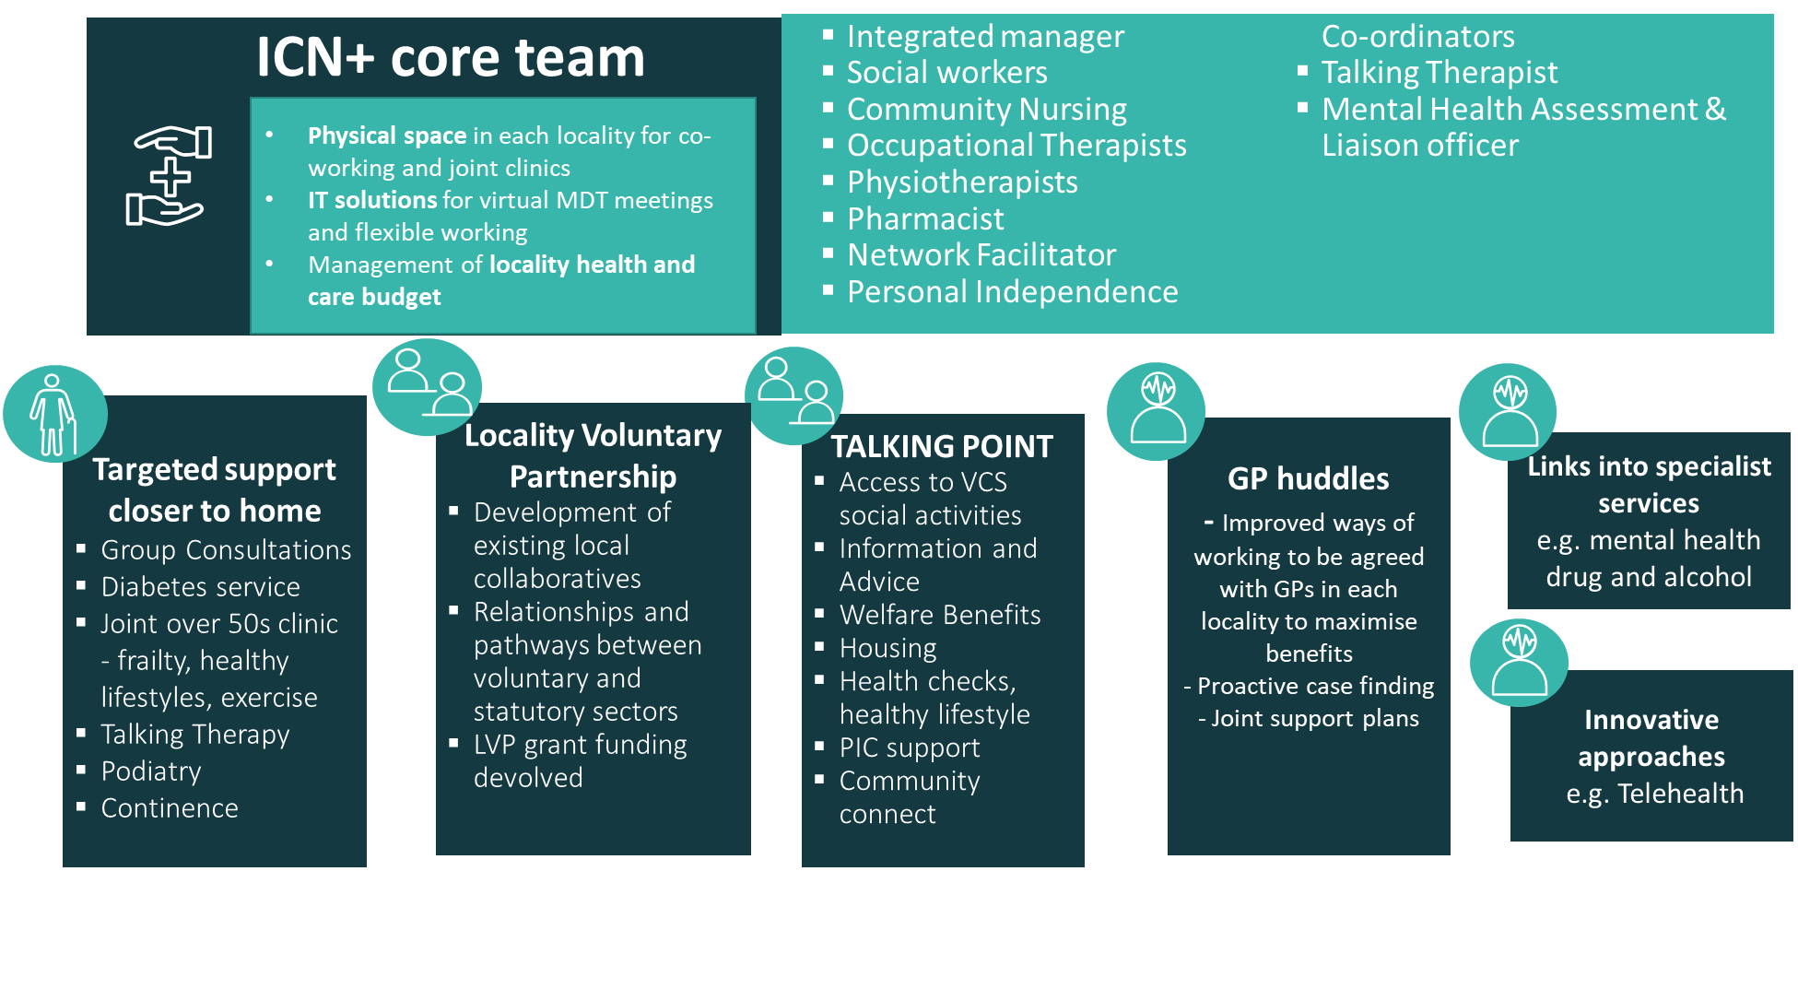
Features of Integrated Community Network and learning

Slide 9
Question and Answer session with One Croydon
Discussion and feedback from voluntary sector partners on what you have heard today:
1. What do you think about what you’ve heard today?
2. What are the challenges and opportunities for locality working?
3. How can One Croydon support the Local Voluntary Partnerships?
4. How does One Croydon ensure that all voices are heard from the voluntary sector?
We would like to hear from you and welcome more comprehensive feedback, please contact the programme team: one.croydon.alliance@croydon.gov.uk

