Slide 1
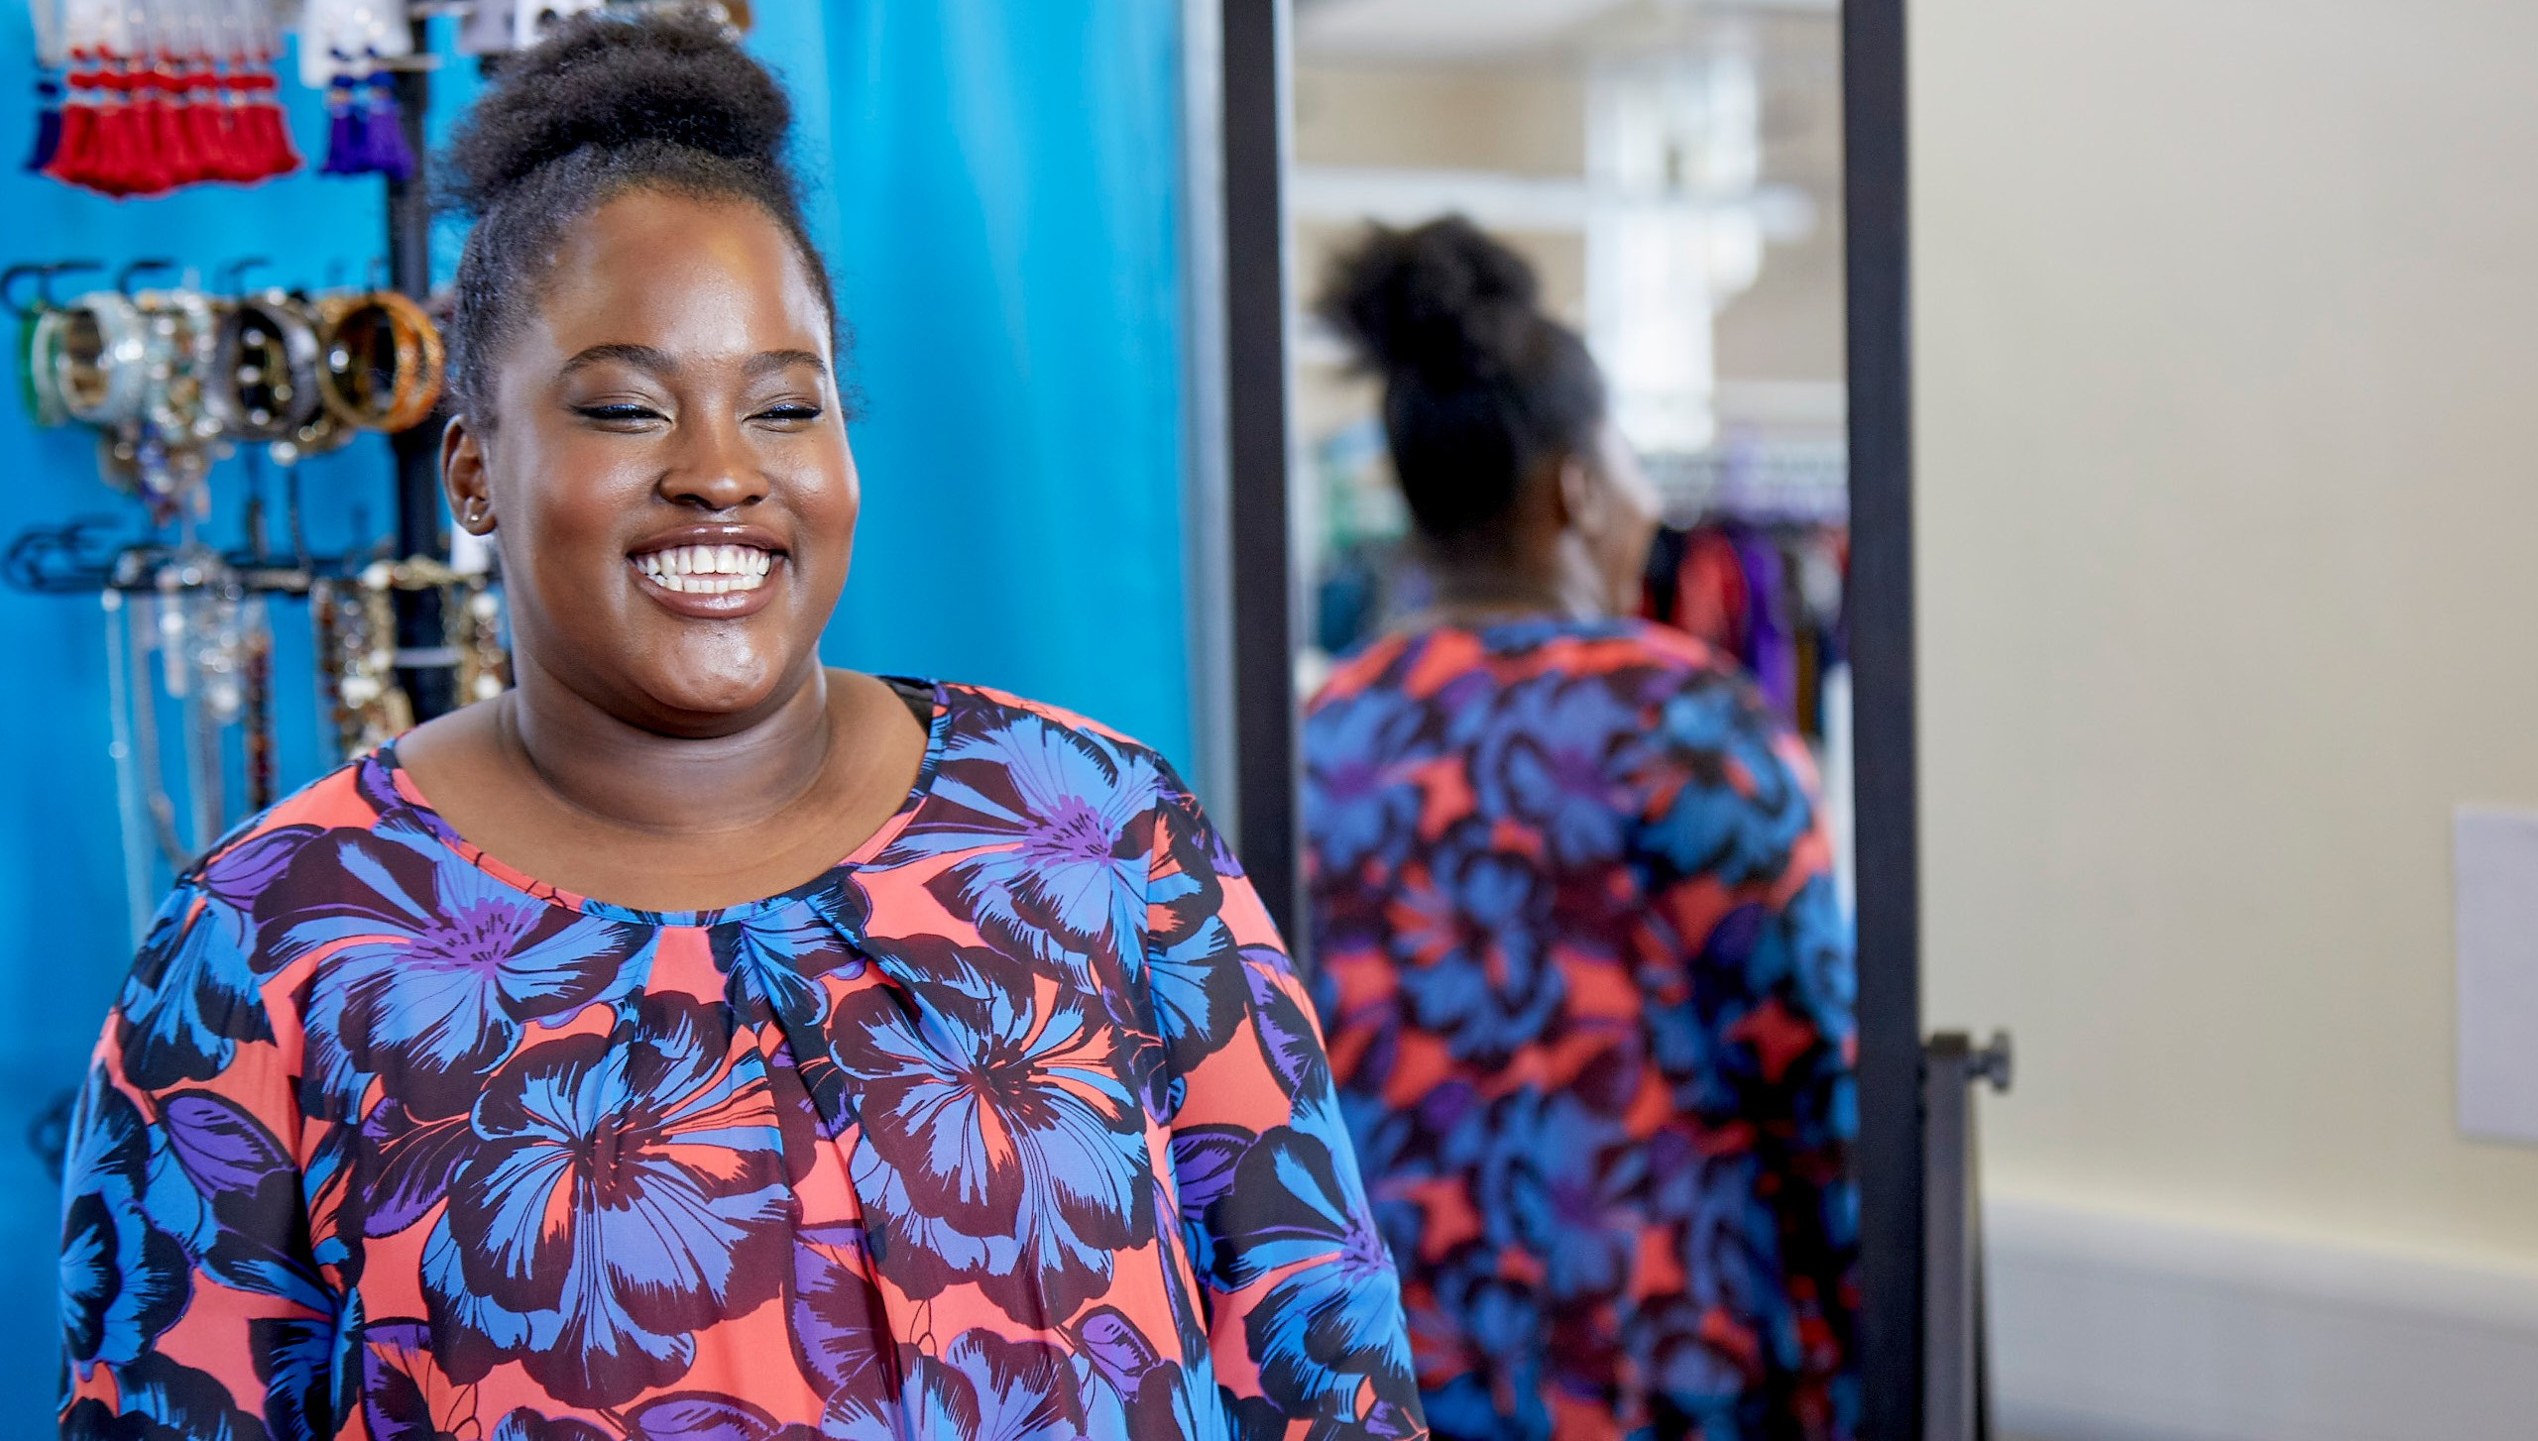
SMART WORKS

Slide 2
Who we are
Smart Works is a dynamic, high profile and fast growing UK women’s charity with our HQ based in London.
What we do
We are a female employment charity that dresses and coaches women for interview and job success.
Our mission
We listen to our clients and use the power of high quality clothing and one-to-one coaching to help them see their true potential and succeed at interview.

Slide 3
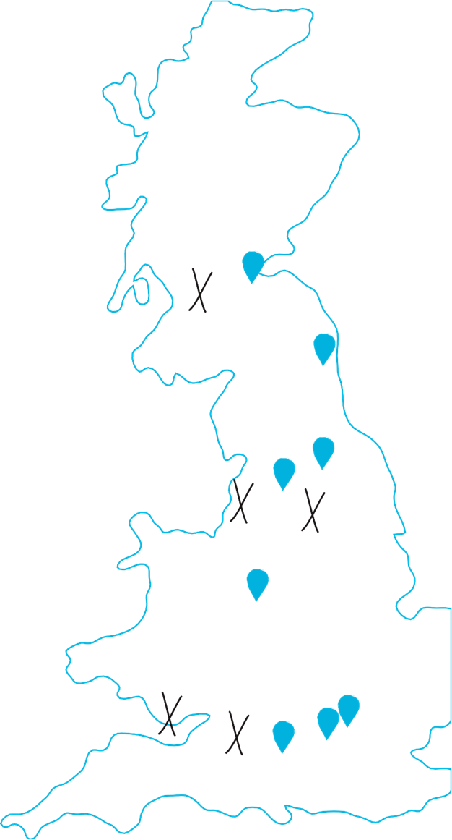
London and HQ
We started in our Islington HQ and since then we have expanded to West London and South London.
NORTH LONDON
WEST LONDON
SOUTH LONDON
VIRTUAL SERVICE

Slide 4
Our Regions
We also have regional centres in 7 other cities across the UK.

Slide 5
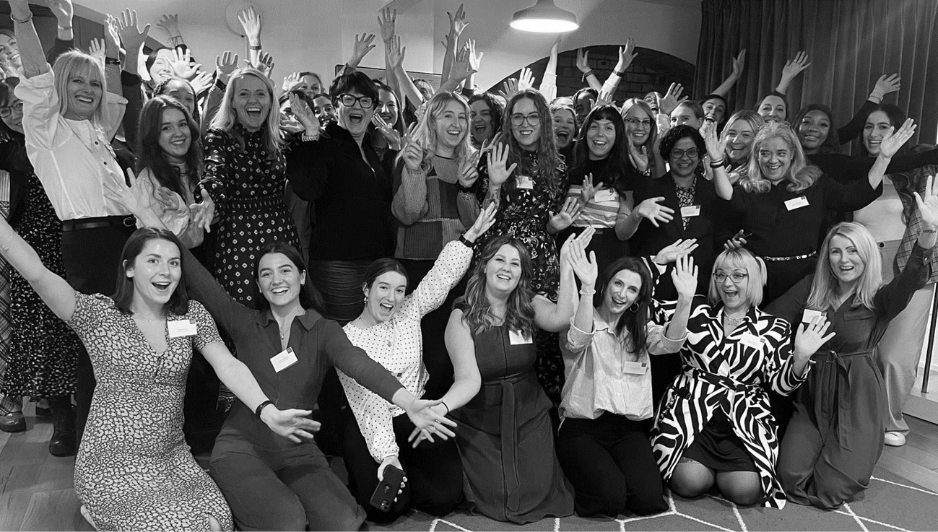
10 years 25,000 women
January 2019
The Duchess of Sussex became our Royal Patron. This raised awareness of our service, and our client numbers increased.
September 2019
The launch of the Smart Set - a collaboration with four British Retailers to provide high quality clothing for our wardrobe.
March 2020
We transitioned to a Virtual Service as a response to the pandemic, this service is still available for women who aren’t able to travel to our centres.
April 2020
We expanded our offer to include Career Coaching - for the first time we were able to support women with their job search.
September 2022
Saw us celebrate our 9th Birthday and reaching 25,000 women supported.
February 2023
We will be opening our 10th centre at the start of our 10th year. Our new centre in Croydon will be bringing our transformative service to the women of South London.
All the women we have supported were referred by referral partners like you - over 800 different organisations across London alone.

Slide 6
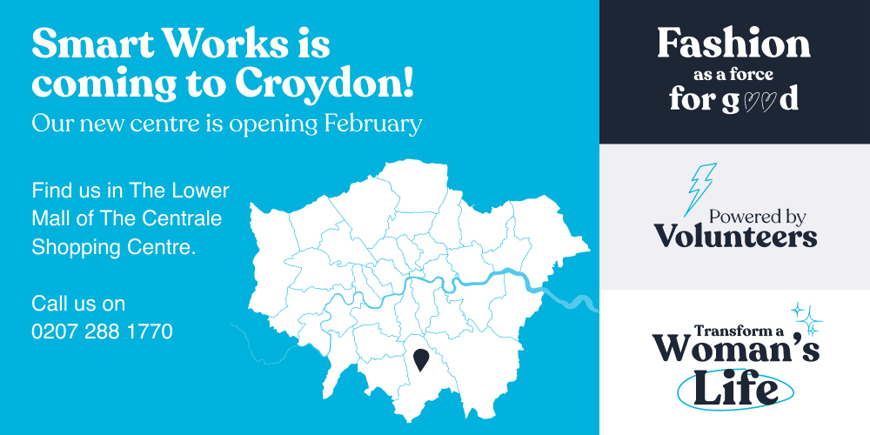

Slide 7
The Smart Works Client Journey
01. Career Coaching
One-to-one coaching with a trained volunteer to help with the next steps to securing an interview.
02 . Interview Coaching and Clothing
Personalised styling session, high-quality outfit of clothes and accessories and interview training.
03. Get the Job
Women are welcomed back to receive a working wardrobe to last until their first pay cheque.

Slide 8
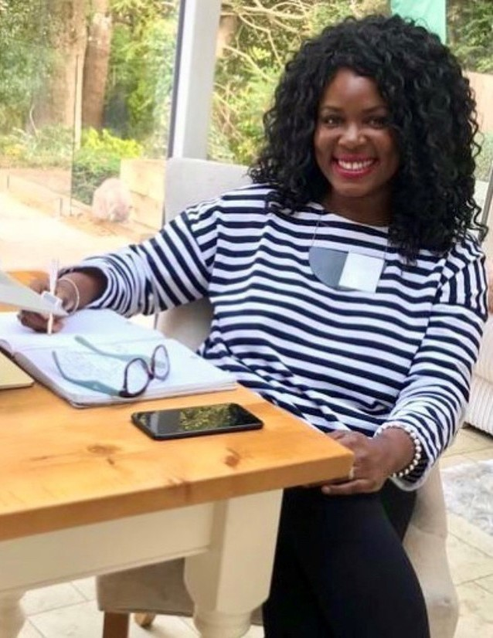
Career
Coaching
Career coaching is a one-to-one coaching session that offers clients advice on how to stand out from the crowd when applying for a job, giving them some clear next steps for their employment journey.
This one-to-one hour-long session will be delivered by one of our trained coaches. These appointments take place in person in our centres or via phone or video call.
The content of the session could include advice on job searching, CV, cover letter and application support, or suggestions on how clients can develop their workplace skills.
We have now supported 3000 women with this new service, and many of them have gone on to secure interviews and get a job.

Slide 9
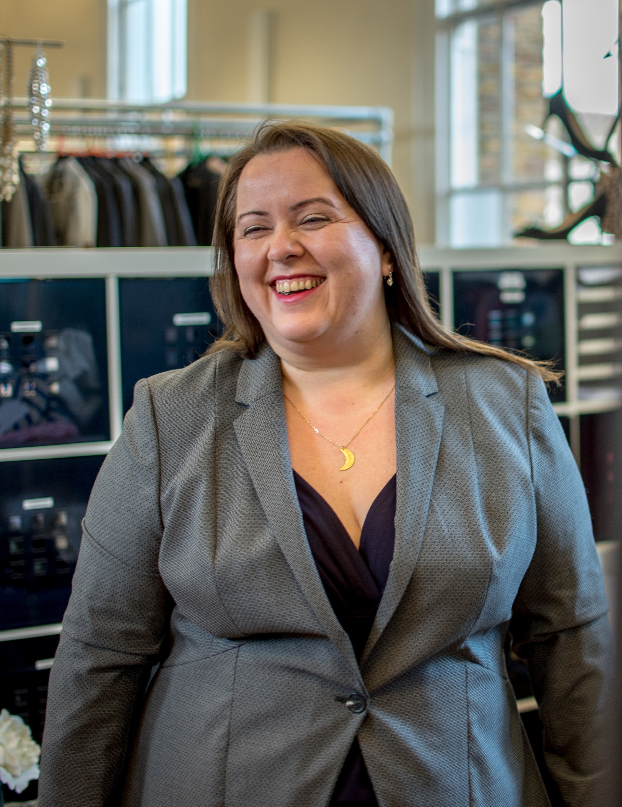
Interview
Preparation
We provide our Interview Preparation service for women who have a confirmed job interview. This is a two hour long session of high quality clothing and one-to-one coaching to give them the confidence they need to succeed at job interviews.
The first part is a full interview outfit of high-quality clothing, chosen especially for them. Given to them in an in-person styling appointment or sent in the post, following a styling consultation via phone or video call. All clothing and accessories are free of charge and hers to keep.
The second part is a one-to-one interview preparation session delivered by one of our trained coaches in person or via phone or video call. The content of the session is designed to make them more aware of their strengths and skills ahead of their interview.

Slide 10
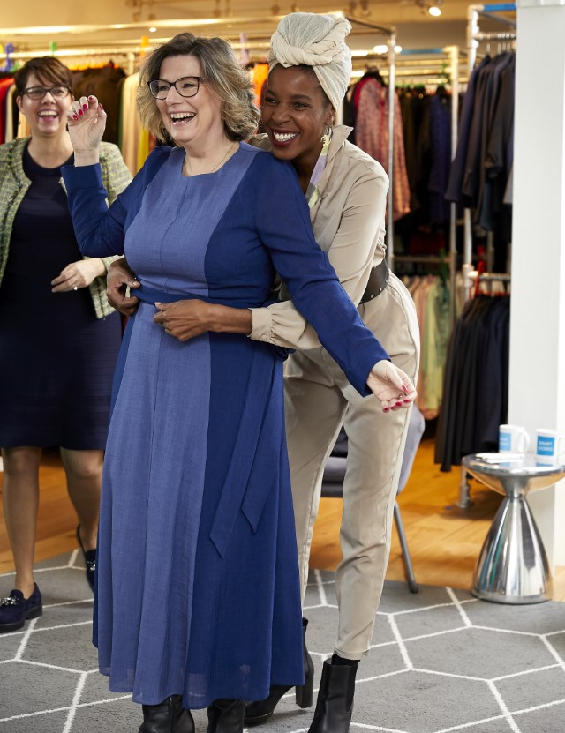
Second
Dressing
Women are welcomed back for a Second Dressing appointment once they have a confirmed job offer.
Every woman who sees us for an Interview Preparation session is then able to access our Second Dressing service once they have a job offer. This is another session with our stylists where we provide 5 additional items of clothing for their working wardrobe.
Women who have not previously been referred to us before this point can not access this service. Women are able to contact us directly to arrange this stage and we are always delighted to hear success stories from our clients.

Slide 11
Smart Works Points Of Referral
01. Career Coaching
One-to-one coaching with a trained volunteer to help with the next steps to securing an interview.
02 . Interview Coaching and Clothing
Personalised styling session, high-quality outfit of clothes and accessories and interview training.
+
We work on a referral basis for our appointments,
we take referrals from other charities or statutory organisations
just give us a call on 0207 288 1770.
We take all the details over the phone - it only takes a couple of minutes.

Slide 12
72%
got the job

Slide 13
This Is Jivan’s Story
After losing her job in a school, Jivan felt alone and sought support from a local charity who helped her get her life back on track.
After securing an interview at a pharmacy in a front of house role, the team helping Jivan referred her to Smart Works. She had been living in tracksuits for the last few years this was an opportunity for Jivan to have someone help her find the perfect outfit and prepare her for her first interview in over 20 years.
“I needed to do something with my life, I wanted to go back to work and socialise, I didn’t want to stay at home anymore. I wanted to be stimulated, I didn’t want to fall back into old habits.”
She was nervous about her appointment and didn’t know what to expect but from the moment she walked through the door Jivan said she felt welcome and important.
The first part of her appointment involved spending an hour with one of the Smart Works dressing volunteers. The dresser found her the perfect outfit and Jivan started to feel more confident about what she could achieve.
After her session with the interview coach, Jivan said she felt completely confident about her interview and we were thrilled to find out she got the job.
“It changed my attitude, I felt positive and I felt proud of myself. The clothes I wear now compared to a few years ago are so different, they give me confidence. The experience has made me feel fantastic.”

Slide 14
Where do we get our clothing from?

Slide 15
Our Wardrobe Partners

Slide 16
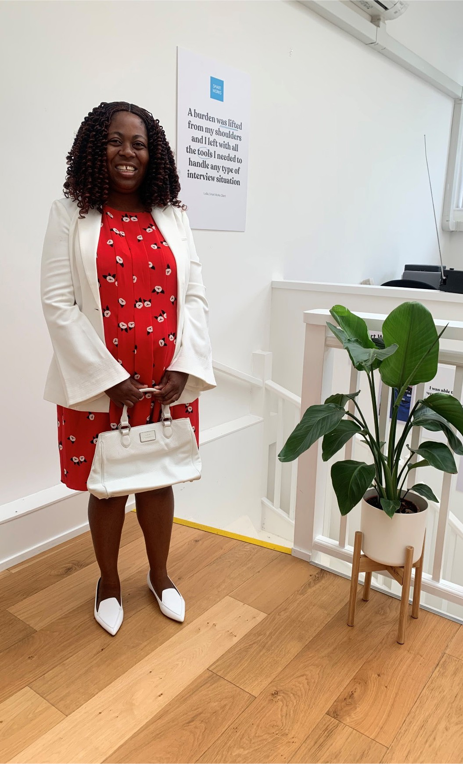
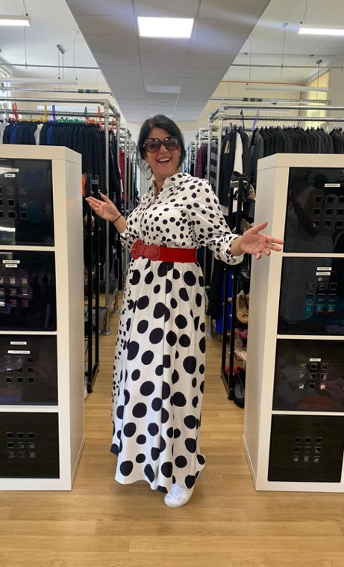
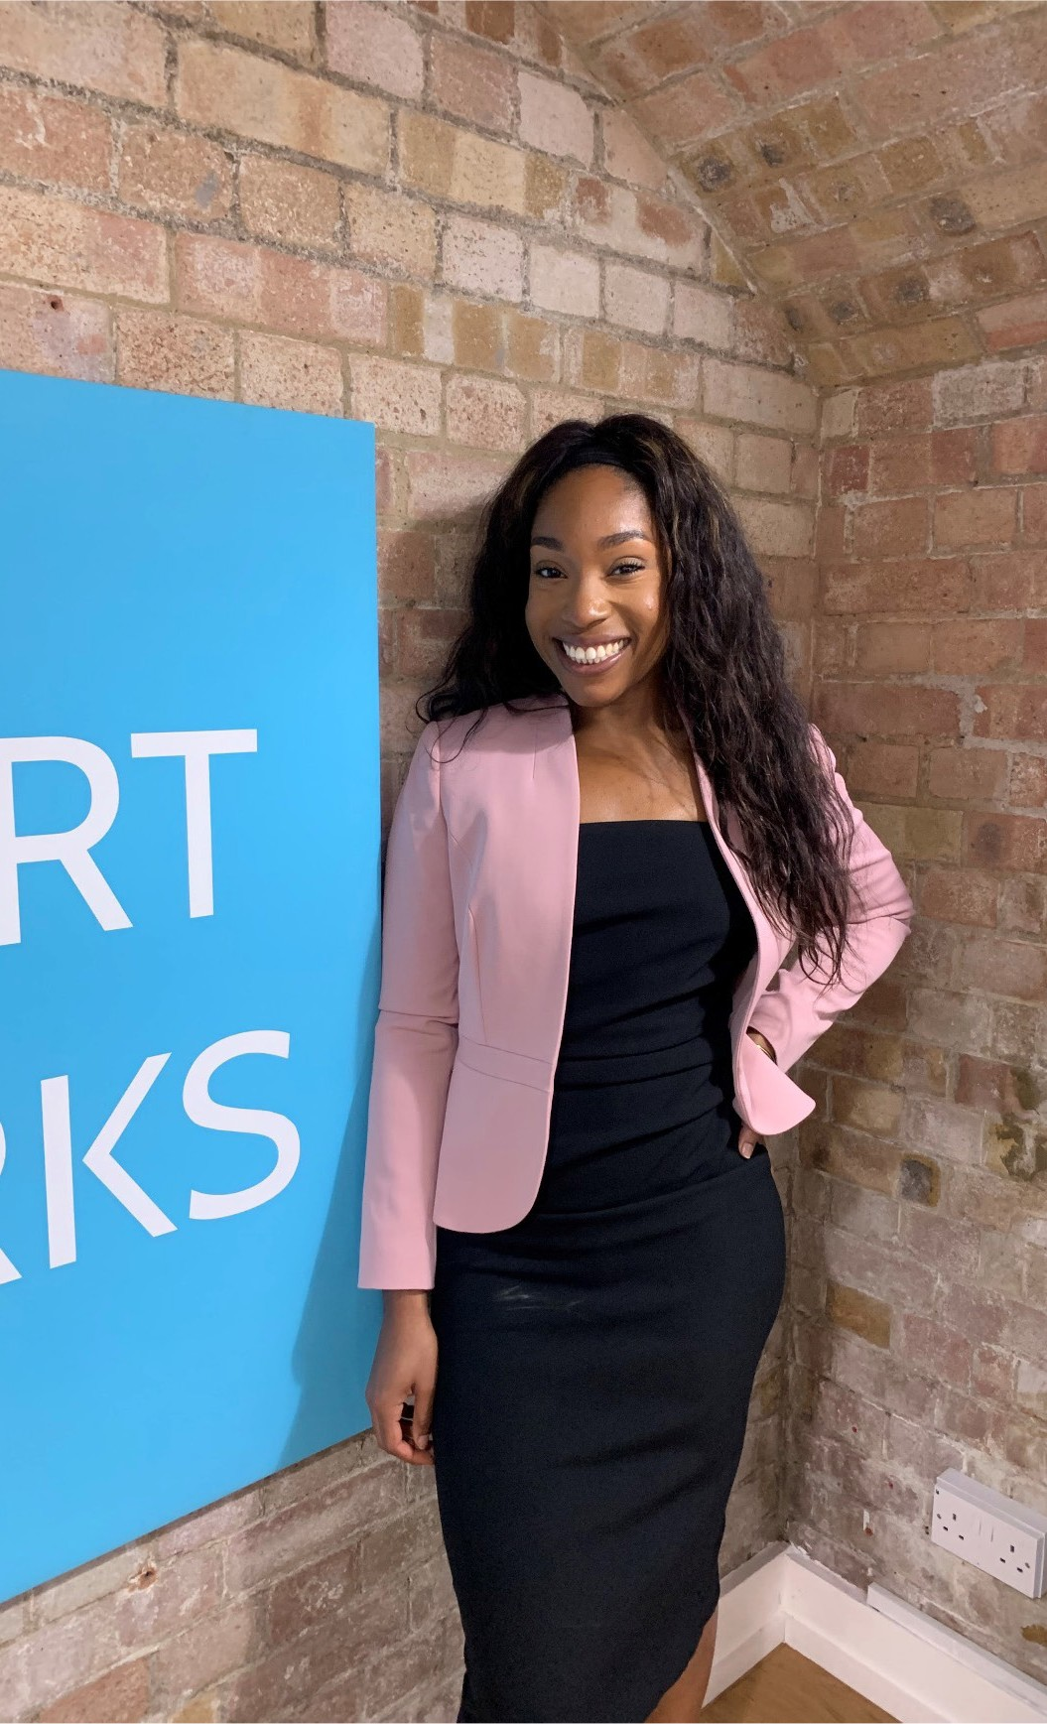

Slide 17
Care Leaver’s Programme
We launched our Care Leaver’s Programme in October 2022.
This programme offers tailored, in-depth and ongoing support for unemployed women aged 16 and over, who are care experienced.
This will involve support at all stages of a client’s job search, from finding employment all the way through to progressing in their career.
We wish to mitigate many of the challenges that care leavers may face during their job search, so we have developed this comprehensive programme in collaboration with care leavers and support organisations.
If you are working with Care experience women ad would like more information, please do get in touch.

Slide 18
THANK YOU

