Slide 1
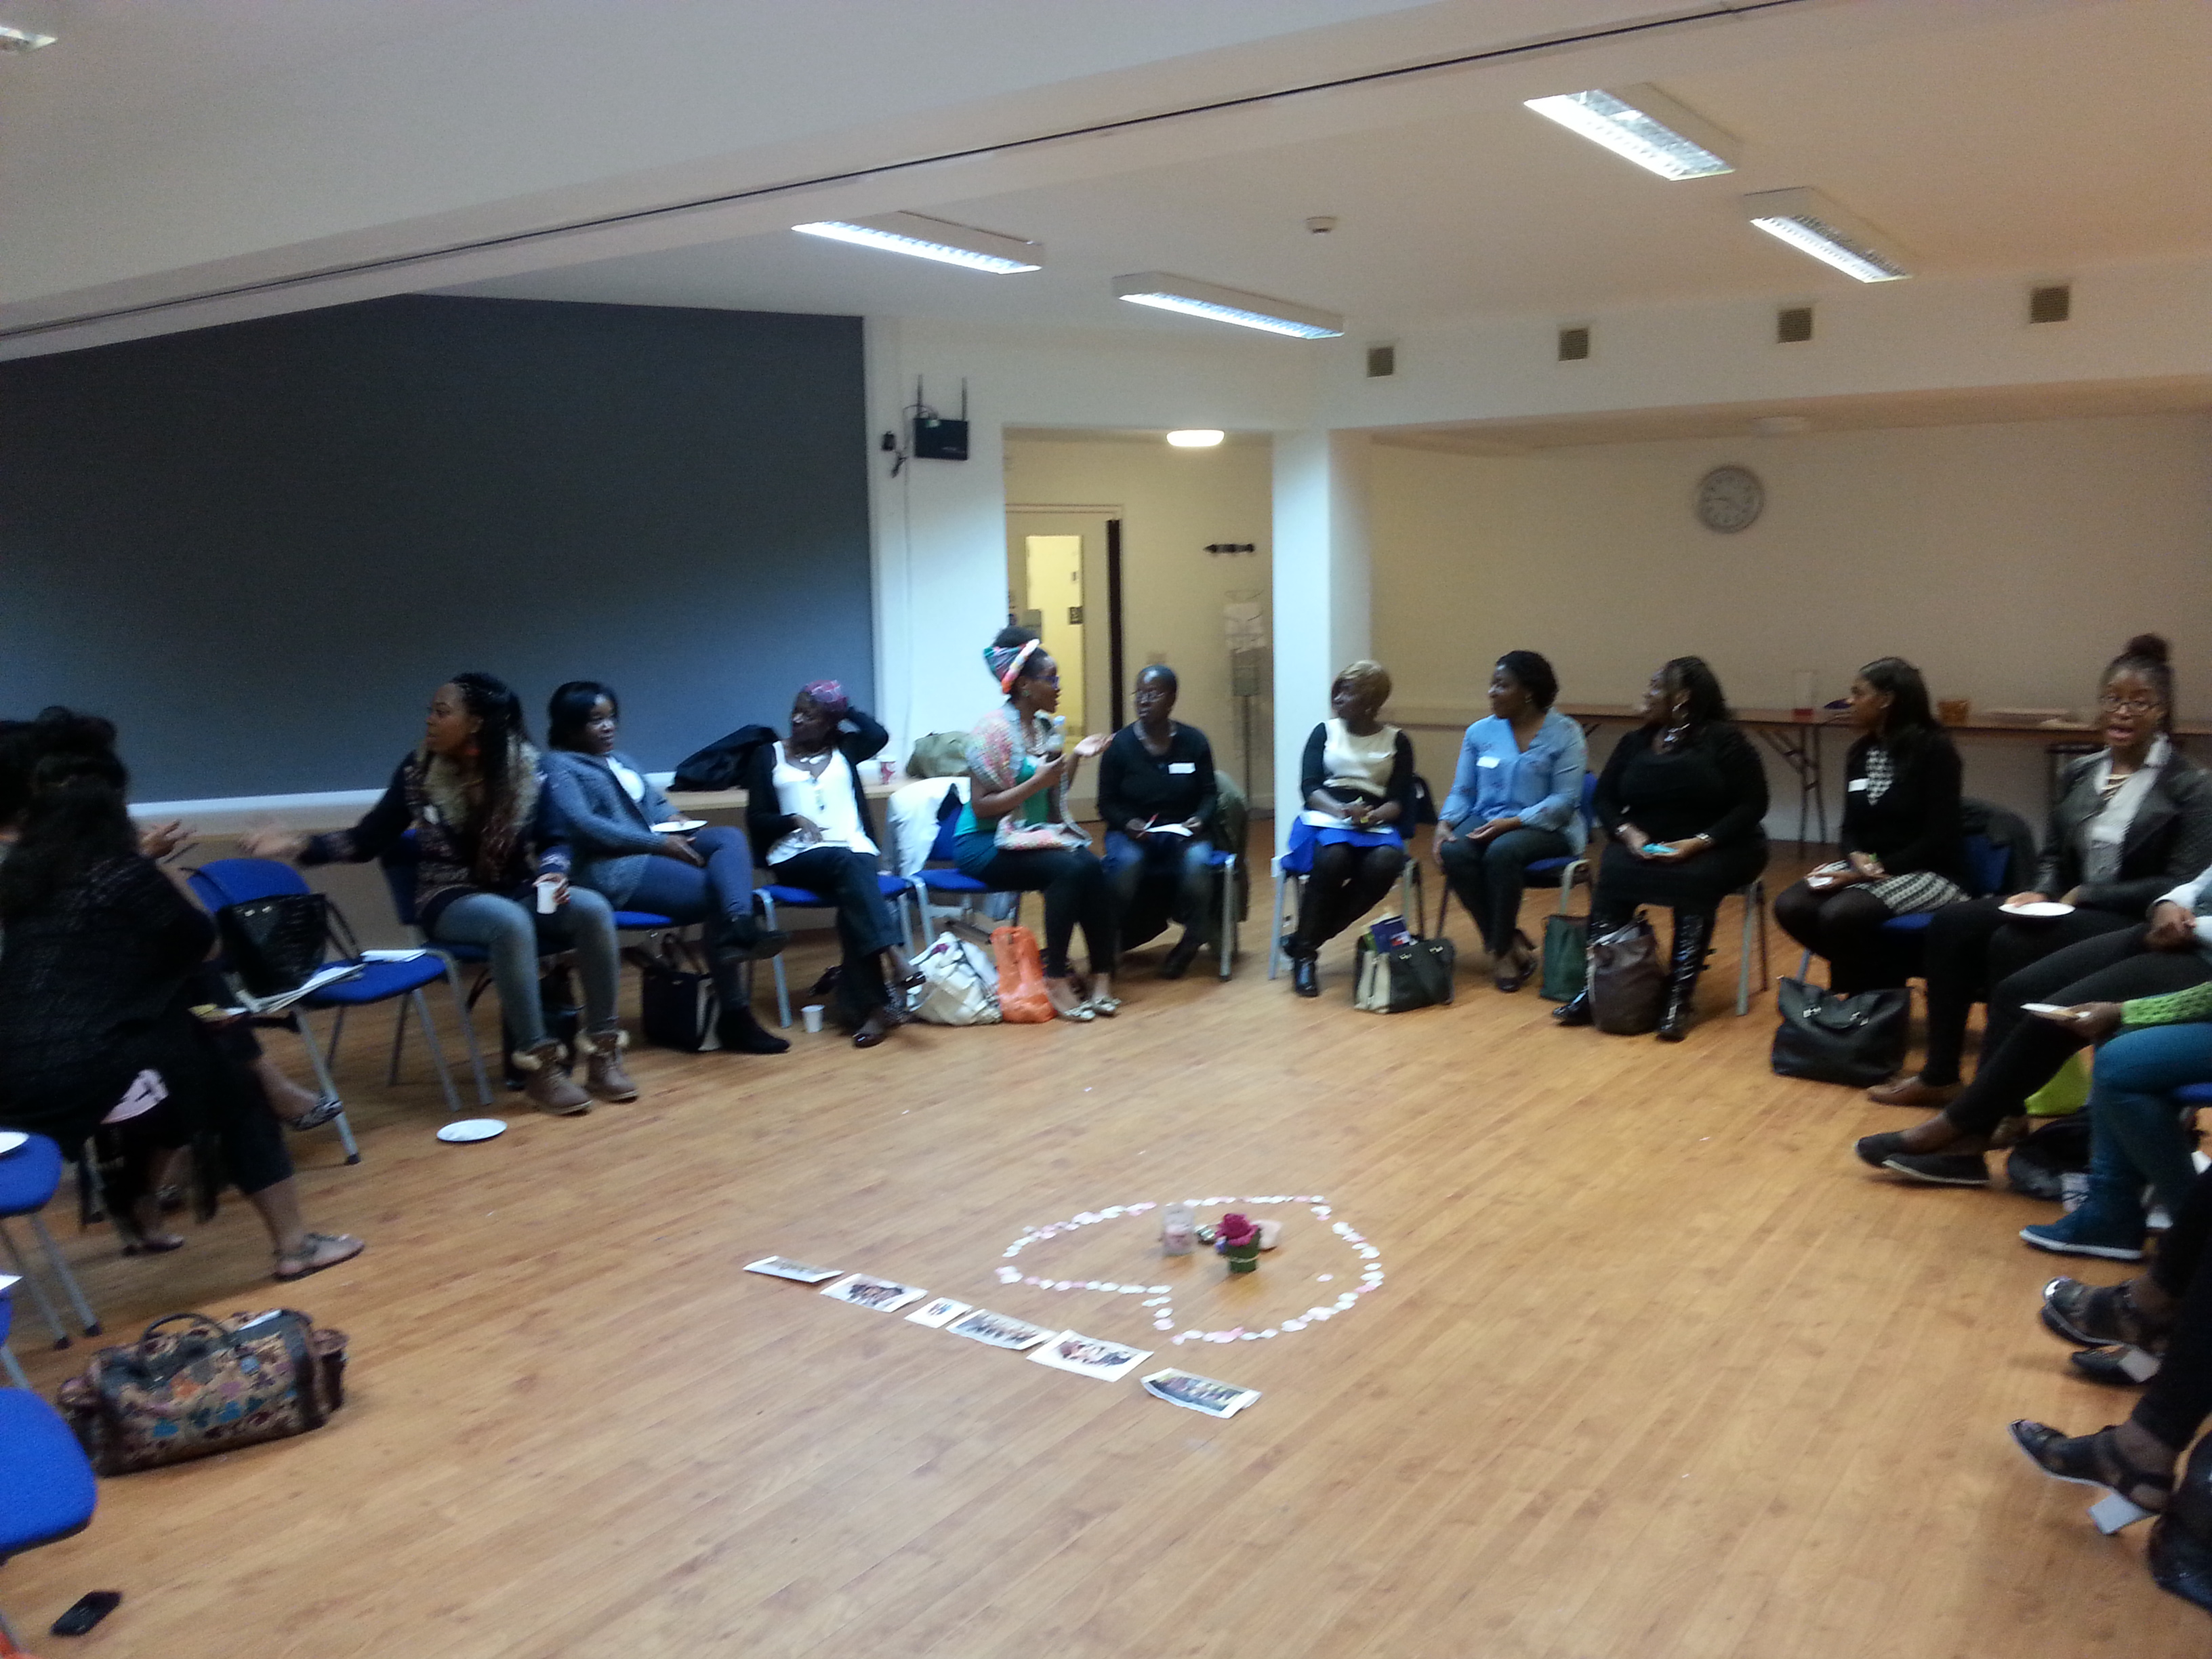
Croydon Health Champions Project: "WOMEN'S GROUP"

Slide 2
Why focus on Afro-Caribbean Women?
High obesity & lifestyle related illness rates eg. Heart disease and high blood pressure
Historically overlooked and under represented
Face unique challenges and multiple discrimination
Typically bear huge responsibility and family
Lack of culturally relevant & user led initiatives

Slide 3
What's the solution?
PEER TO PEER SUPPORT
SIGNPOSTING & ADVOCACY
PRACTICAL CLASSES IN A SAFE SPACE ENVIRONMENT

Slide 4
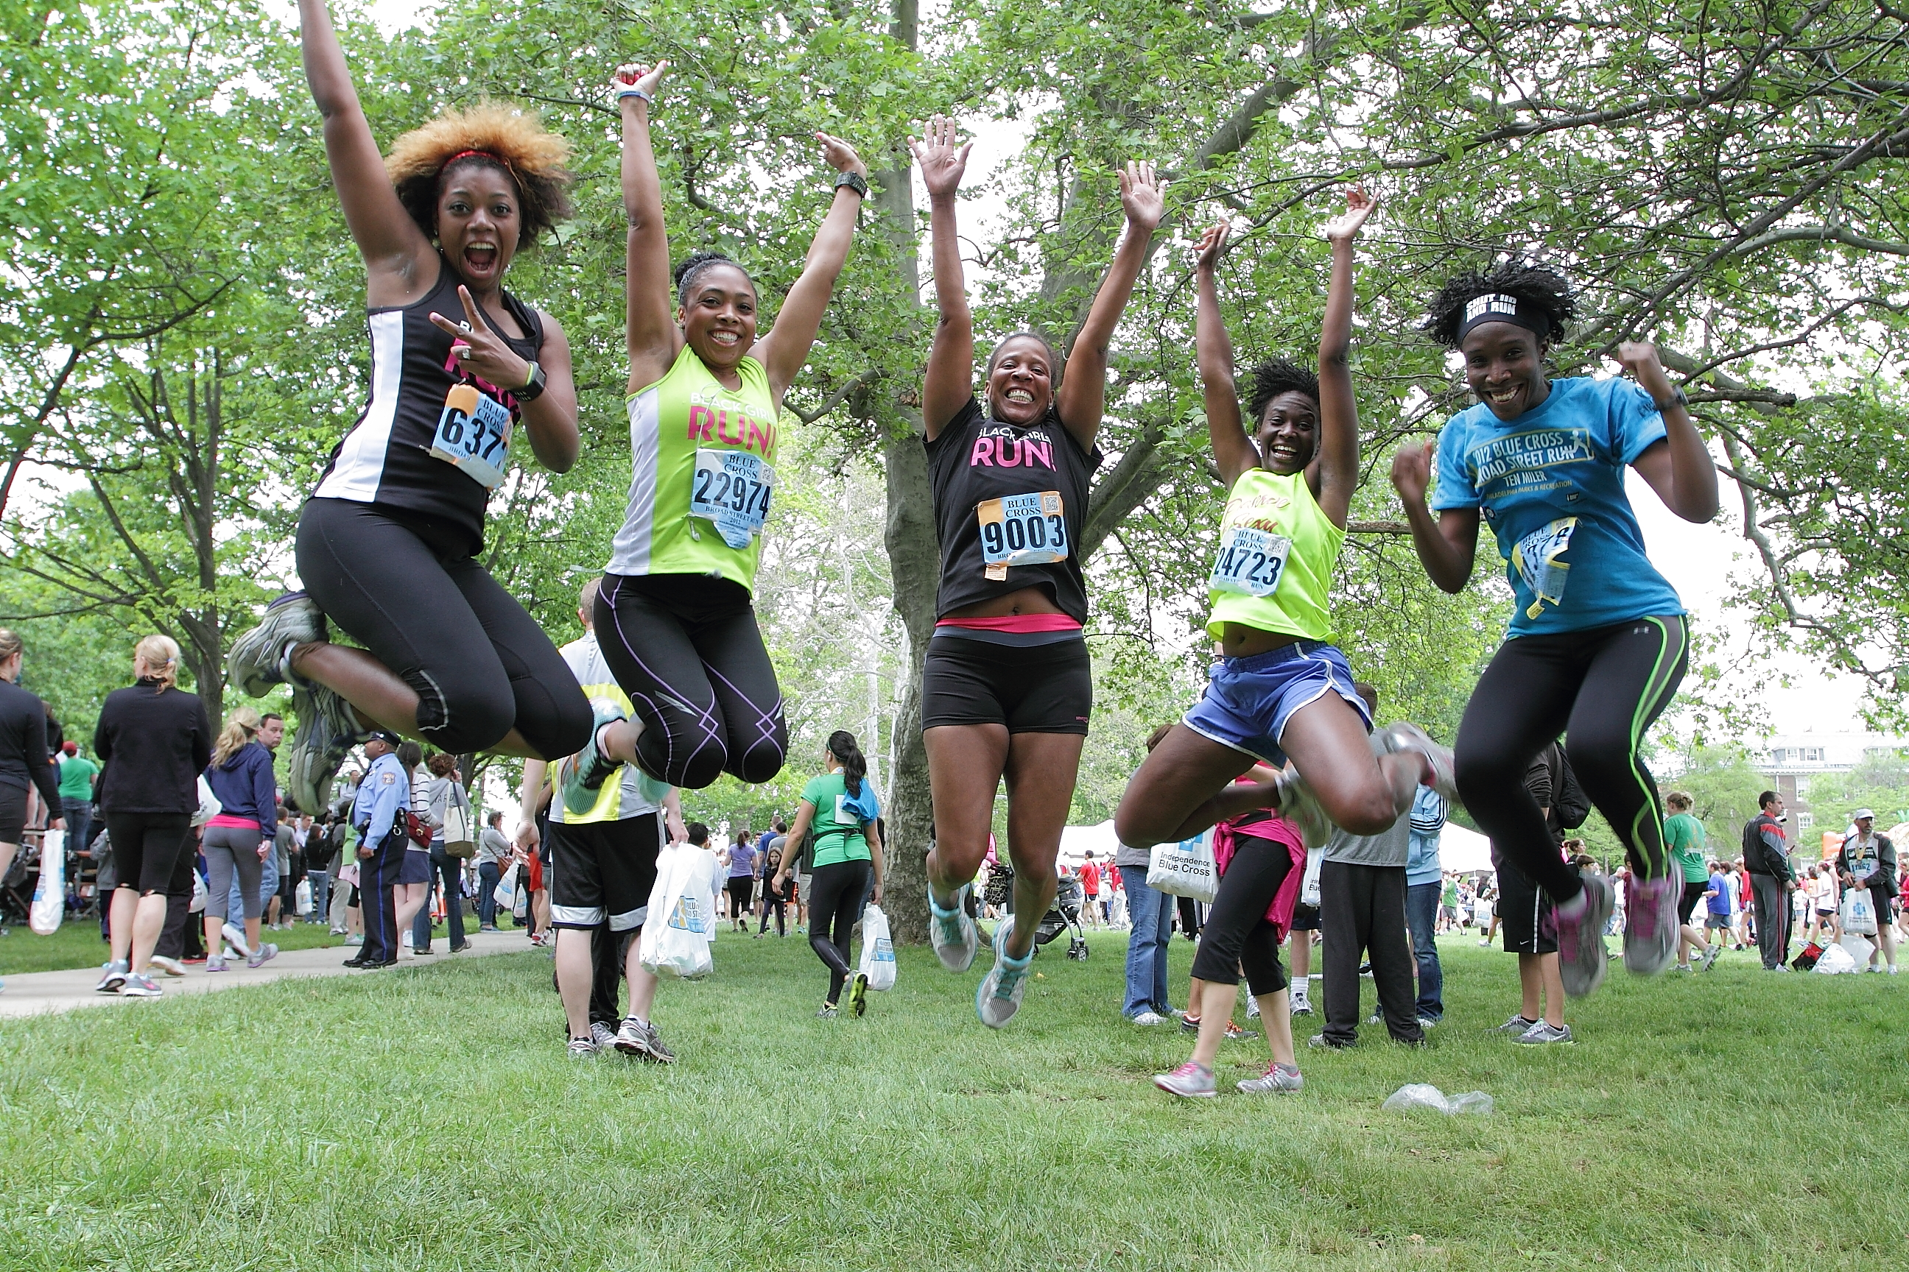
OUTCOMES
Better health outcomes for Afro-Caribbean Women
Reduction of obesity in Croydon
Reduction of social isolation and depression
Increased social equality within Croydon's health services

